Slide 1


PBS API Software Vendor Webinar
Pull quote
Thank you for joining, this webinar will begin at 9am
Wed 13 May 2026 or once traffic slows coming into the meeting.

Slide 2
Acknowledgement of Country
We acknowledge the Traditional Custodians of country throughout Australia and their connections to land, sea and community. We pay our respect to their Elders past and present and extend that respect to all Aboriginal and Torres Strait Islander peoples today.
Pull quote

Slide 3

Pull quote

Slide 4
Agenda
Overview and updates​
Recent and upcoming changes to API
PBS Policy updates​
Wholesale markups
Registered Nurse Prescribing
New Medication Charts
General - Discussion and questions
Time dependent
If there is no time for questions, they can be sent by email to HPP.Support@health.gov.au
This section will not be recorded
Pull quote

Slide 5
GENERAL RECAP
Pull quote

Slide 6
PBS API General Recap
1 May 2026 data was the final release of the legacy formats, including PBS API v2-beta. The PBS API v3 (API) is now the supported format
While improvements will still be made to the API, these will be in addition to existing information. Currently available data will remain as is for Version 3
New Health policies which require new data will be included in the API data as an update
A new API version release expected 20 – 22 May 2026
Pull quote

Slide 7
PBS API - Releases since last webinar
PBS data API Version 3.6.5 release notes (10 December 2025)
Enhancement:
Improved performance of the item overview endpoint when filtering response content.
Added INNOVATOR_INDICATOR column to the Items endpoint
Fix: [Data Modifications]
ORIGINATOR_INDICATOR within the Items endpoint data has been fixed to reflect the correct information
Fix: [API]
Parameter filtering using csv now uses correct standard format handling. e.g. a,b will be treated as two fields a and b to filter against. "a,b" will be treated as a single parameter field without splitting the string and the comma will be included in the search.
In addition quotations can be included by passing in double quotes. e.g. "a,b and ""some string""" will be treated as 'a,b and "some string"' being passed in to the filter search with quotes included.
For more information on releases - https://data.pbs.gov.au/api/pbs-api.html
https://ause-hpsp-tst-apim01.developer.azure-api.net/api-changelog#api=pbs-api-public-v3
Pull quote

Slide 8
Policy updates
- Wholesale Markups
Pull quote

Slide 9
Wholesale Markups
General Overview of Changes
The First Pharmaceutical Wholesaler Agreement (1PWA) is an agreement between the Australian Government and the National Pharmaceutical Services Association (NPSA)
Sets out the wholesale mark-up (WMU) and Community Service Obligation (CSO) funding arrangements that apply to pharmaceutical wholesalers
Reforms come into force from 1 July 2026
Standard 1 July 2026 changes for Dispensing Fee, AHI Tier One Fee and Safety Net Recording Fee will also apply
Pull quote

Slide 10
Wholesale Markups
Changes from 1 July 2026
Wholesale mark-up (WMU) structure changes: new tiered rates based on Ex-Manufacturer Price (per dispense).
WMU calculation method changes: calculated using the Ex-Manufacturer Price for the pack quantity dispensed (moving away from the current Relevant Quantity method).
The changes apply to
- Eligible section 100 medicines supplied by community pharmacies except the s100 medicines under the Efficient Funding of Chemotherapy (EFC) Program and the Botulinum Toxin Program
- Section 85 PBS medicines supplied by approved community pharmacies, public and private hospitals, and
Pull quote

Slide 11
Wholesale Markups
What is not changing?
Out of scope: section 100 medicines supplied through section 94 approved hospitals or section 92 approved medical practitioners continue under existing arrangements.
No change to: PBS patient co-payments, prescribing arrangements, or the PBS listings because of the WMU changes.
CSO: Community Service Obligation arrangements continue to support timely and reliable access to PBS medicines through community pharmacies (including rural/remote areas).
Indexation: revised WMU amounts/rates under the 1PWA are not indexed during the term of the 1PWA (to 31 December 2029).
Pull quote

Slide 12
Wholesale Markups
WMU Structure
Until 1 July 2026
Payment type | Value of WMU Payment
Wholesale Mark-up for Pharmaceutical Benefits delivered to Approved Pharmacists* | When the Ex-Manufacturer Price is up to and including $5.50 | $0.41 per dispense
 | When the Ex-Manufacturer Price is over $5.50 and up to and including $720 | 7.52% of the Ex-Manufacturer Price per dispense
 | When the Ex-Manufacturer Price is over $720 | $54.14 per dispense
From 1 July 2026
Payment type | Value of WMU Payment
Wholesale Mark-up for Pharmaceutical Benefits delivered to Approved Pharmacists* | TIER 1 When the Ex-Manufacturer Price is up to and including $5.50 | $0.24 per dispense
 | TIER 2 When the Ex-Manufacturer Price is over $5.50 and up to and including $1,000 | 4.3% of the Ex-Manufacturer Price per dispense
 | TIER 3 When the Ex-Manufacturer Price is over $1,000 and up to and including $10,000 | $43 + 2% of the amount of the Ex-Manufacturer Price over $1,000 per dispense
 | TIER 4 When the Ex-Manufacturer Price is over $10,000 | $223 per dispense
Pull quote
*WMU per dispense calculated using Relevant Quantity
*WMU per dispense calculated using Ex-Manufacturer Price for Pack Quantity of the listed brand

Slide 13
Wholesale Markups
Changes to API data (additional data only)
/item-dispensing-rules-relationship endpoint
Shows connections between ‘li_item_id’ and available Dispensing rules
Items in Programs HS/HB now have an additional row of data for Dispensing rule s90-cp-s100 (Community Access), in line with Programs PL, GH, IF programs
/markup-bands endpoint
Indications the Markups and bands available for Dispensing rules (‘dispensing_rule_mnem’)
New 4 tier bands updated against affected Programs (‘program_code’). – See ‘markup_band_code’ = ‘W’
/dispensing-rules (no changes)
No changes, use for aligning ‘dispensing_rule_mnem’ with relevant Dispensing Rule Name
Pull quote

Slide 14
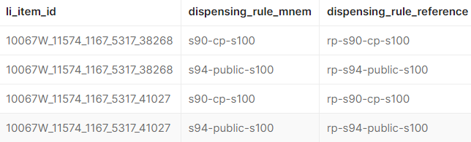
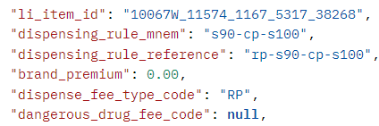
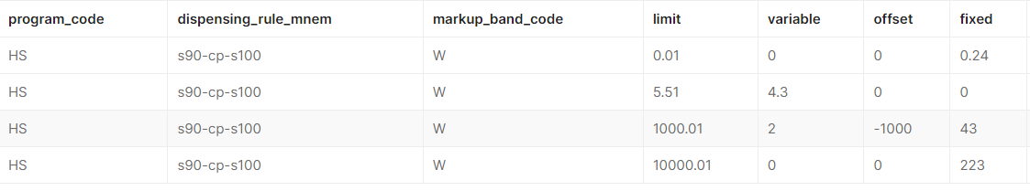
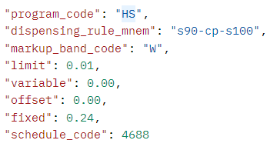
Wholesale Markups
Changes to API data Example – additional data
/item-dispensing-rule-relationships
Pull quote
/markup-bands

Slide 15
Policy updates
- Registered Nurses
Pull quote

Slide 16
Registered Nurse Prescribers
General Overview of Changes
In December 2024, Health Ministers approved a new registration standard and endorsement for registered nurses (RN) - designated RN prescriber. The Nursing and Midwifery Board of Australia’s
(NMBA) registration standard came into effect on 30 September 2025 and will allow endorsed RNs
to administer, obtain, possess, prescribe, supply and/or use Schedule 2, 3, 4 and 8 medicines in partnership with an authorised health practitioner. It is expected that endorsed registered nurses will be eligible to prescribe later in 2026.
Amendments to the National Health Act 1953 are currently being made which will authorise
RNs endorsed under the registration standard to prescribe certain medicines under the Pharmaceutical Benefits Scheme, attracting Commonwealth subsidies.The department of Health, Disability and Ageing is working with the independent expert Pharmaceutical Benefits Advisory Committee to consider each medicine listing for suitability for designated RN prescribing.
Pull quote

Slide 17
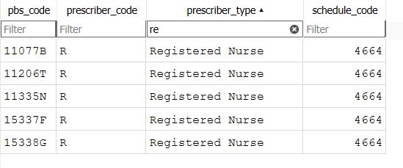
Registered Nurse Prescribers
API Data for Changes
‘/prescribers’ endpoint will show new Prescriber code ‘R’ for Registered Nurses available for each pbs_code when available
Other details for the item will be recorded as standard
/prescribers
Pull quote

Slide 18
Policy updates
Medication Charts
Pull quote

Slide 19
Medication Chart updates
General Overview of Changes
The National Health (Pharmaceutical Benefits) Regulations 2017 are in the process of being updated in line with the National Electronic Medication Chart Framework (NEMCF)
New Medication chart types and requirements are in the processes of being determined, with implementation expected implementation later in 2026
The new Charts will be added to the PBS data to show which items are eligible for these new charts for the month they come into effect
Additional data has been included in the API to facilitate these changes
Pull quote

Slide 20
Medication Chart updates
Changes to API data
Currently available chart eligibilities are visible in the /items endpoint, as separate data fields. This will not be removed
New endpoints will be added to the API data to provide any new Medication charts as data rather than adding new fields to existing endpoints:
/medication-charts
Shows list of all available chart types, a description, and durations
Includes currently available Medication Chart information
/item-chart-eligibilities
Shows relationships between all ‘pbs_codes’ and available ‘chart_name’
New data will also be available in the /item-overview endpoint
Pull quote

Slide 21
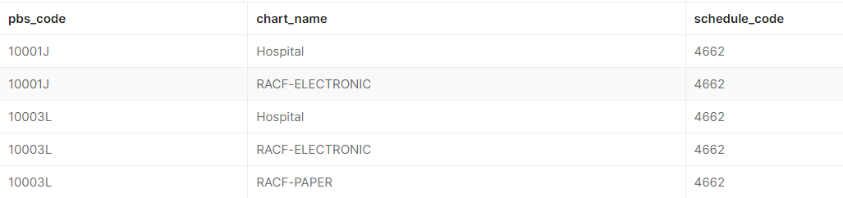

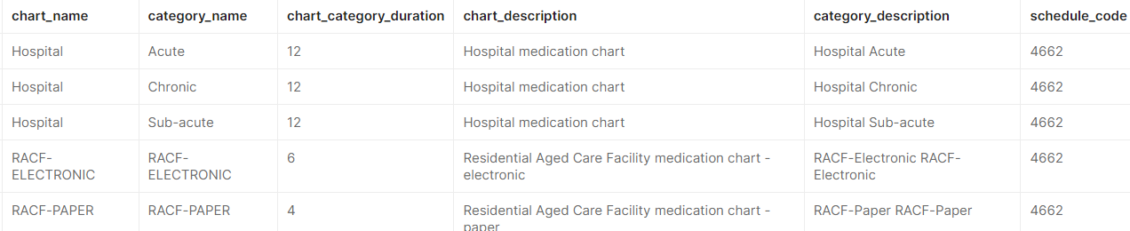
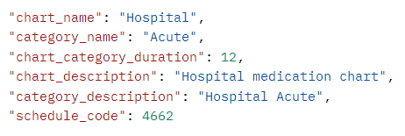
Medication Chart updates
Changes to API data Example – New endpoint data
/item-chart-relationships
Pull quote
/medication-charts

Slide 22
PBS API – General - Discussion and questions
This part will not be released as part of the recording.
If you have any questions from this webinar, email HPPSupport@health.gov.au.
We are always happy to help.
Pull quote

Slide 23
END OF WEBINAR
Pull quote

