Slide 1


PBS API Software Vendor Webinar
Pull quote
Thank you for joining, this webinar will begin at 11am
Tue 23 September 2025 or once traffic slows coming into the meeting.

Slide 2
Acknowledgement of Country
We acknowledge the Traditional Custodians of country throughout Australia and their connections to land, sea and community. We pay our respect to their Elders past and present and extend that respect to all Aboriginal and Torres Strait Islander peoples today.
Pull quote

Slide 3
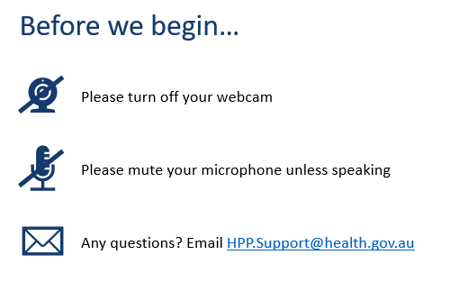
Pull quote

Slide 4
Thanks
Thank you for those who were able to reply to the Questionnaire. Your valuable input and support is appreciated and being taken on board. This will remain open after the meeting for additional/updated responses.
We appreciate your patience and understanding with late changes and data releases. We are working to minimise these disruptions but there will be times this is out of our control.
Thank you for collaborating with us to implement the first mid-month publication – February Continued Dispensing Emergency.
Pull quote

Slide 5
Agenda
Overview and updates​
Ceasing of legacy products
API v3 changes​
PBS API - General Update
PBS API - Releases since last webinar
PBS updates​
Future releases
Potential updates/changes
Discuss survey findings
General - Discussion and questions - Not published
Pull quote

Slide 6
GENERAL RECAP
Pull quote

Slide 7
PBS API General Recap
V3 (3.5.7) is the current version and is the anticipated approved baseline version.
Any change from this point will be classed as additional functionality or enhancements.
API catalogue
https://data-api-portal.health.gov.au
Pull quote

Slide 8
PBS API General Recap
When will the old forms of PBS Schedule data cease?
Following the meeting, the survey will remain open for feedback for 1 WEEK.
If there are no critical gaps or errors noted in the survey feedback, we will consider 3.5.7 as “Baseline”.
Once the Baseline is set, users will be notified of the commencement of the Transition period.
The Transition will be at least 3 month but will not end over the end of year festive period (ie not till after Feb 2026).
What will continue to be available at https://www.pbs.gov.au/browse/publications or under embargo?
Release notes
PDF Schedules and Summary of changes
PBS API CSV ZIP files
Average Rates
Services Australia Complex Authority Administration S100 items (CSV)
Pull quote

Slide 9
PBS API - Releases since last webinar
Improvements
AMT and non-AMT
TPUU
MOA
Parameter filtering and Sorting functionality as per Government API standards
Summary of Change - Source/Target revision number
Therapeutic Group Title/ID content in /items endpoint
For more information on releases - https://data.pbs.gov.au/api/pbs-api.html
https://ause-hpsp-tst-apim01.developer.azure-api.net/api-changelog#api=pbs-api-public-v3
Pull quote

Slide 10
api/v3/item-overview endpoint
This endpoint contains joined content of the full details from other related tables in a complex json structure. See https://data-api-portal.health.gov.au/ for more details.
Benefits
Improved rendering and presentation of restrictions including ordering of components withing an item code.
“One stop shop” for information related to an item, rather than multiple calls to different endpoints.
Note:
Max response 1000 due to size.
Schedule code is a mandatory parameter.
Pull quote

Slide 11
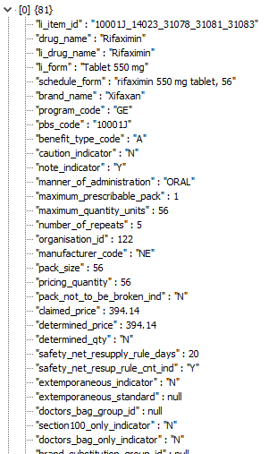
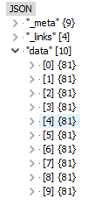
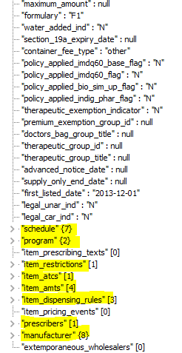
The Item-Overview is a (New endpoint) an aggregated JSON response that includes comprehensive details about items, programs, restrictions, prescriptions, dispensing rules, manufacturers, and more. This structured format ensures that all relevant information is easily accessible and understandable.
Pull quote

Slide 12
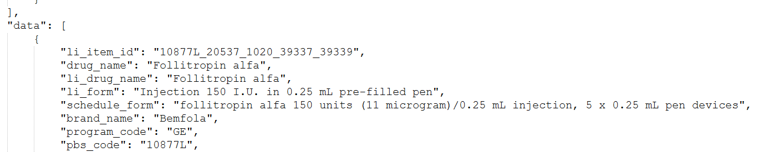
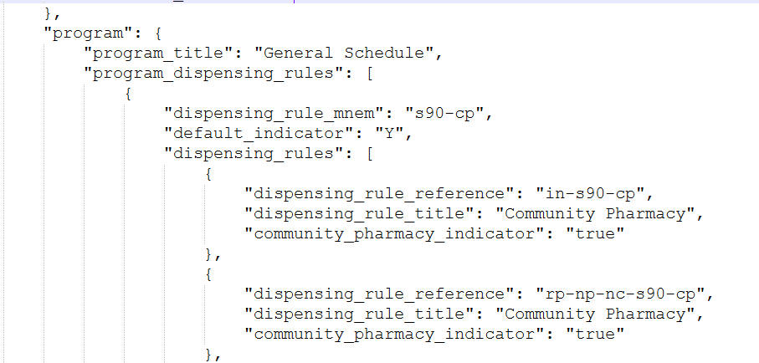
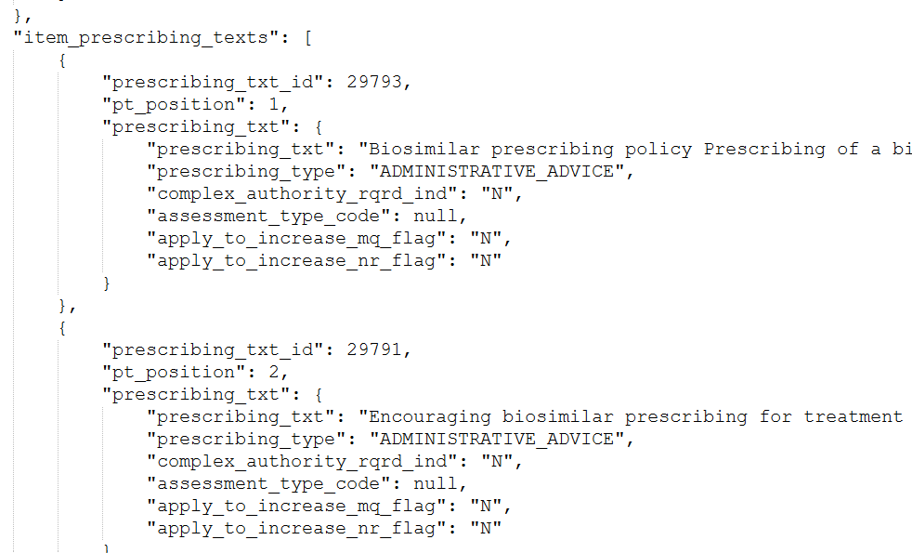
Example – Item-overview endpoint.
See also link on Meeting page for full example - https://data.pbs.gov.au/meetings/index.html
Pull quote

Slide 13
Pricing changes
Items endpoint
proportional_price (PREMP)
Item-dispensing-rules-relationship endpoint
All requested pricing information and fields have been included in API
Eliminates need for calculation of specific pricing values
Refer to SWAGGER and/or Data Dictionary for descriptions of all new fields
Any questions please send to HPP.Support@health.gov.au
Item-overview endpoint
All new fields included.
Pull quote

Slide 14
Restrictions
Working with Restrictions
Restrictions can be constructed by using the elements on the /restrictions endpoint and applying the ordering on the element by the /restriction-prescribing-text-relationships endpoint. The /item-restriction-relationships shows the linkage of Restrictions to the relevant Item codes.
Can also use the /Item-Overview endpoint to view a restriction in total. The “Fields” parameter functionality can be used to refine results.
Restrictions allowing increased Maximum Quantity/Repeats
Field variation_rule_applied indicates if authorisation of increased quantities and/or repeats is allowed.
Recently added fields
written_authority_required
Pull quote

Slide 15
Additional Community Supply Support (ACSS) payments
Eighth Community Pharmacy Agreement (8CPA) - new legislated payment to community pharmacies for dispensing PBS medicines.
API changes – production release end of March 2025
Api/v3/fees Endpoint
Added 'acss_imdq60_payment'. Field used to identify the fee amount associated with Component 1. $4.79
Added ' acss_payment '. Field used to identify the fee amount associated with Component 2. $0.78
Eligible items for the payments will need to be derived via the eligible program types.
Pull quote

Slide 16
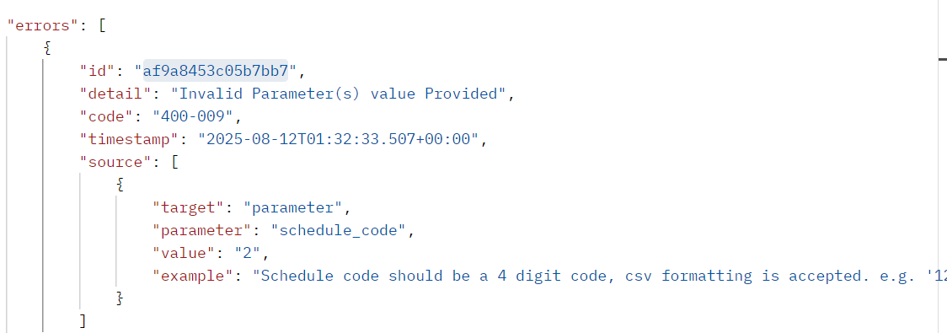
PBS API – New ID and Error response messages
For errors that occur within the API, a unique code "id" will be returned. This "id" can be sent to HPP.support@health.gov.au to assist in the issue resolution.
Pull quote

Slide 17
FUTURE UPDATES
Where to from here?
Pull quote

Slide 18
Upcoming Releases (Date: TBC)
Potential updates to PBS policy affecting data
Various updates to PBS policies are in planning that may impact the PBS data.
There are a range of potential changes. Some may be new data in existing fields, some may require additional fields or endpoints to be added to the API data.
Test data will be provided where possible for each of these updates
These will be provided in JSON and CSV formats
XML may not be released for these test files
Pull quote

Slide 19
Potential Future Releases (Date: TBC)
Software Vendor test environment
Until available, all test files will be released as CSV and JSON downloads.
API v3 or v4.
Improve Renewal function notifications.
Known issue - restrictions API endpoint, the SCHEDULE_HTML_TEXT contains incorrect formatting. Currently this field combines both Schedule and LI text information.
Improve speed of data sync to allow faster releases or other data delivery methods.
Requests for specific types please put into Questionnaire.
Enforced Pagination – CSV downloads will be provided with pagination.
Improve AMT linkages to listings for better coverage and Many to Many mappings.
Improve Extemporaneous listings information.
More history in the API.
EFC improvements – ie TPUU, Vial sizes
Pull quote

Slide 20
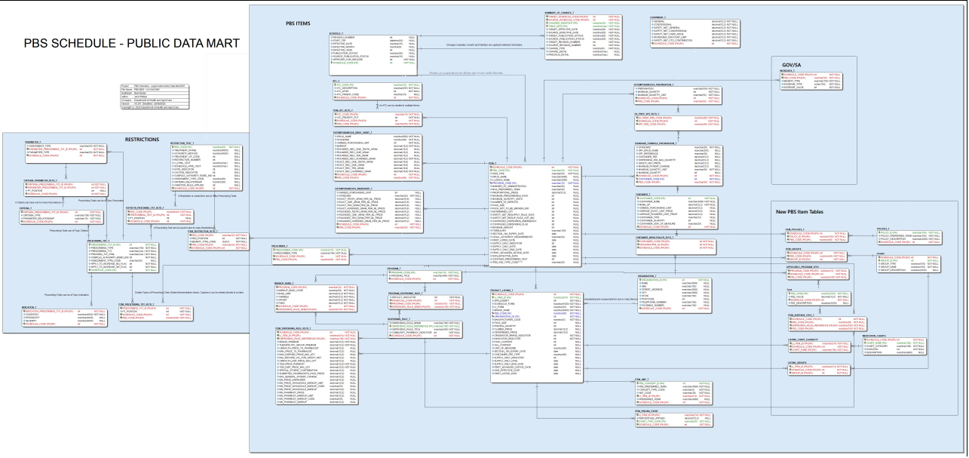
Unplanned future release (Date: TBC)
API v4 Major version intends to:
Improve functionality and structure. ​
Required breaking changes.​
Improved ease of access.
Remove duplication of data by splitting/merging specific tables as required
Eg Item_details into Item level information and brand level information separately.
Any changes that are non-breaking we will try to incorporate into API v3 – eg additional endpoints.
Pull quote

Slide 21
QUESTIONAIRE RESPONSES
Pull quote

Slide 22
Questionnaire and Email Queries
Release timelines/Late releases
Working to get a more consistent and predicable release of data.
Working to remove as many late releases as possible.
We try to avoid late amendments to the data. Some reasons it may be required:
Change cannot be implemented any other way.
Decisions from Government in response to emergencies.
Critical errors to data.
Data for late changes is released as soon as possible. We are working on ways to improve speed of release.
Pull quote

Slide 23
Questionnaire and Email Queries
Medication Charts
Q: Should all Extemporaneous items have a value of “No” for field elect_med_chart_eligible_ind?
A: Currently this is correct (i.e. the value is “No”). The policy area is reviewing the Med Chart data and all updates will be amended in a future schedule.
De-registered ARTG items still on PBS
Q: Why are some items no longer on the ARTG still in PBS data
A: Discontinued ARTG product may still be listed on the PBS for several reasons:
Sponsor's Request: The product cannot be delisted from the PBS without a formal request from the relevant pharmaceutical company.
Implementation and Processing Steps: Steps and timelines required to remove from PBS.
Supply Only Arrangements: This allows any remaining stock in the supply chain to be used and claimed until the product is officially removed from the PBS.
Pull quote

Slide 24
Questionnaire and Email Queries
Summary of Changes endpoint
Known bugs with SQL statements in Summary of Changes.
SQL statements are still available in endpoint as removing would require a breaking change. It is not recommended to use these SQL statements, as they may not be able to cater to all user implementation consistently and may not properly report all changes.
Change_detail and Previous_detail fields provide better information for the changes and were included in the API due to the known issues with SQL statements.
API Data types
Users have noted lack of detailed “data type” information in API.
Recent update has improved this information.
More detailed data types requires API v4 implementation.
Pull quote

Slide 25

PBS API – General - Discussion and questions
This part will not be released as part of the recording.
If you have any questions from this webinar, email HPPSupport@health.gov.au.
We are always happy to help.
Pull quote

Slide 26
END OF WEBINAR
Pull quote

