Slide 1
PBS API Software Vendor Webinar
Pull quote
Thank you for joining, this webinar will begin at 11am, 5 March 2025
or once traffic slows coming into the meeting.
www.health.gov.au

Slide 2
Acknowledgement of Country
We acknowledge the Traditional Custodians of country throughout Australia and their connections to land, sea and community. We pay our respect to their Elders past and present and extend that respect to all Aboriginal and Torres Strait Islander peoples today.

Slide 3
Before we begin…
Please turn off your webcam
Please mute your microphone unless speaking
Any questions? Email HPP.Support@health.gov.au

Slide 4
Thanks
QLD floods – emergency.
- CD emergency will come to an end expected 1 April schedule
- Thanks for doing mid-month publication
- Sorry about the AMT changes and Manufacturer Code issues
Safety Net – clarification.
All the support from the Software Vendor groups when we have API or legal questions.

Slide 5
Agenda
Overview and updates​
API v3 changes​
General recap​
PBS API – Embargo API Access Renewal​
Update on recent releases ​
Upcoming releases​
Future releases​
PBS updates​
Manner of administration​
Authority In Writing
AMT V4 implementation
Additional Community Supply Support (ACSS) payments ​
Safety Net Threshold changes – 18 January 2025 ​
General - Discussion and questions

Slide 6
PBS API General recap
All current forms of PBS Schedule data will continue to be available as long as there are key fixes being implemented. There will be at least three months' notice of discontinuation once the API is stable.
PDF Schedule and SOC - Will continue to be available in PDF form ongoing https://www.pbs.gov.au/browse/publications or under embargo.
V3 is the current version. API catalogue https://data-api-portal.health.gov.au

Slide 7
PBS API – Embargo API Access Renewal
Auto renewal is now fully in effect. Companies no longer need to re-apply for access to get updated secrets and keys each year.
Companies will receive a HPP correspondence requesting confirmation of API user list associated with that company.
This is sent 45 days before access expires.
These have a “Response by” date. After that date passes, you will not be able to reply to the correspondence.
All communications are managed via HPP correspondence. This includes the confirmation correspondence, and the updated secret values correspondence.
Please ensure you check HPP when you receive notification of a new correspondence to ensure continued access.
Access to the HPP is revoked without use for more than 13 months

Slide 8
PBS API – Released since the last webinar
PBS data API Version 3.0.24 release notes (11 December 2024)
NEW
New Column 'CHANGED_ENDPOINT' added to Summary of Changes, which shows the endpoint the change is related.

Slide 9
PBS data API Version 3.0.24 release notes (11 December 2024)
NEW
New column first_listing_date added to the restrictions table. This shows the first listing date for the restriction against the item reported.

Slide 10
PBS data API Version 3.0.24 release notes (11 December 2024)
Filter added to all endpoints to show the latest schedule information in descending order. Filter labelled “get_latest_schedule_only” with a value of True (or Yes) to return the most recent schedule code.
PBS data API Version 3.1.12 release notes (21 February 2025)
Added a sorting to each endpoint. It first sorts the data by 'SCHEDULE_CODE' in descending order, and then applies a secondary sort based on the specific endpoint.
Bug noted with the Schedules endpoint – From this update it sorts on Schedule code number. A fix is in to sort latest to the top, as per 3.0.24. This is expected to go in with next release.

Slide 11
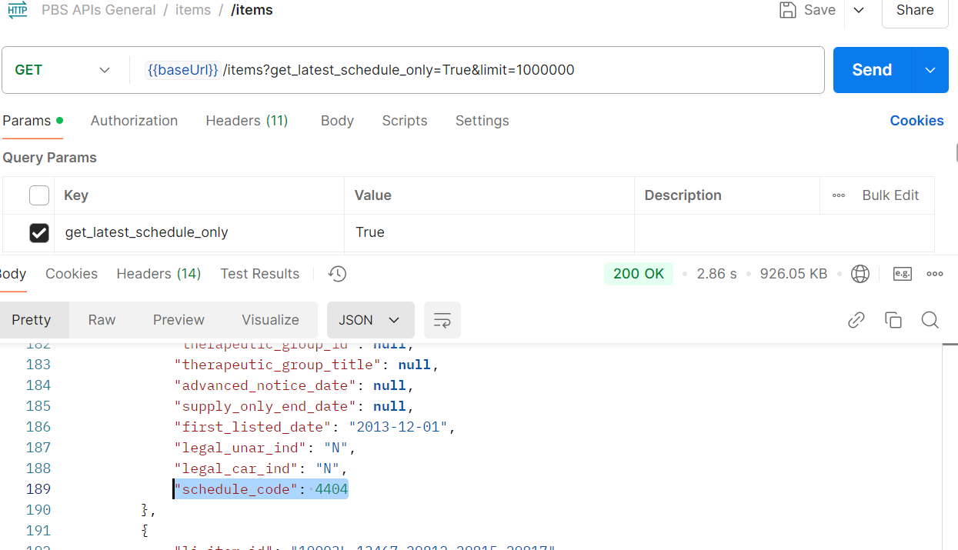
Example get_latest_schedule_only = true

Slide 12
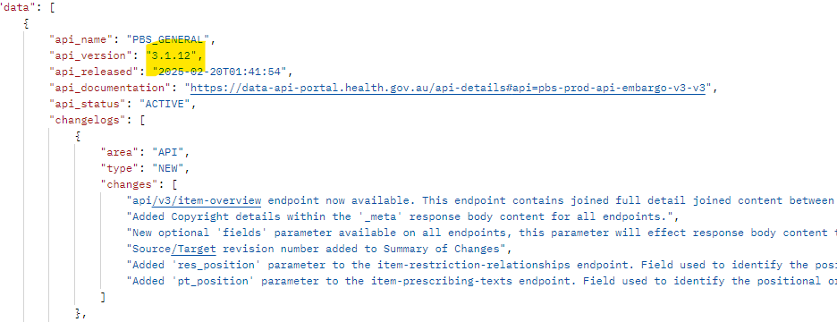
PBS data API Version 3.0.24 release notes (11 December 2024)
NEW
API Changelog Tracking Implemented for Major/Minor/Patch releases. This release with Changelog tracking labelled as Version 3.0.24. Previous release notes prior to changelog tracking have had names updated slightly to make it easier to see the sequence of updates.

Slide 13
PBS data API Version 3.0.24 release notes (11 December 2024)
DATA MODIFICATIONS
In api/v3/amt-items endpoint, remove all Null values from flags/indicators. exempt_ind
In api/v3/items endpoint, remove all Null values from flags/indicators.
pack_not_to_be_broken_ind, determined_qty, safety_net_resup_rule_cnt_ind, continued_dispensing_flag, continued_dispensing_emergency, originator_brand_indicator, water_added_ind, policy_applied_bio_sim_up_flag, policy_applied_imdq60_flag, policy_applied_imdq60_base_flag, policy_applied_indig_phar_flag, legal_unar_ind, legal_car_ind
In api/v3/items endpoint, the values in weighted_avg_disclosed_price column has been changed to NULL.
Any reference to RES_CODE 9999_9999_R and PRESCRIBING_TXT_ID 119998*, 119997 has been removed from all tables.

Slide 14
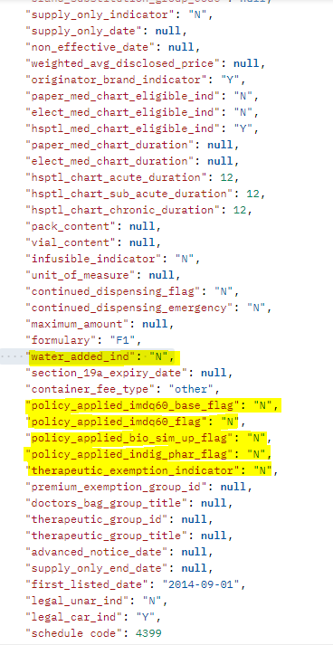
Examples – Null replaced by Y/N

Slide 15
PBS data API Version 3.0.24 release notes (11 December 2024)
DATA MODIFICATIONS
If a given item has a 'therapeutic_exemption_indicator' value of 'Y'/true in the api/v3/items endpoint, then within the 'Item-Dispensing-Rule-Relationships' endpoint, the special_patient_contribution, brand_premium and therapeutic_group_premium columns is set to '0.00’.
/Item endpoint (filtered to relevant fields) ​
/item-dispensing-rule-relationships (filtered to relevant fields)

Slide 16
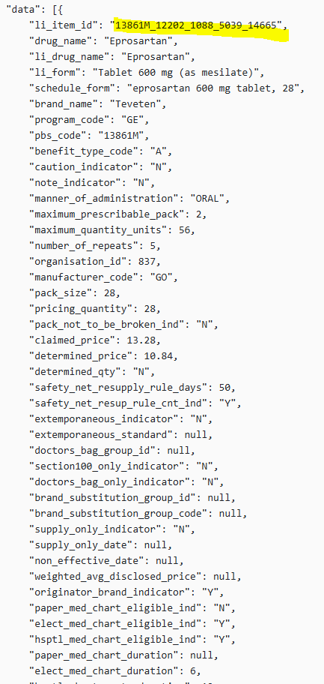
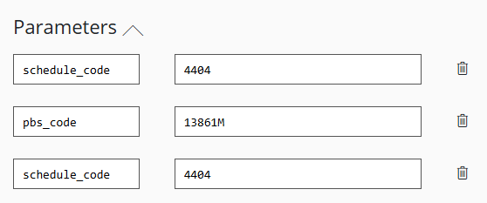
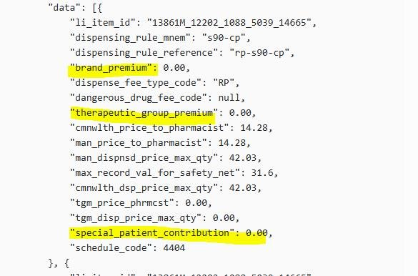
Example: Therapeutic Exemption indicator
Query Item:
Items end point
Query Item Dispensing Rule Relationship against li_item_id

Slide 17
PBS data API Version 3.1.12 release notes (21 February 2025)
NEW
api/v3/item-overview endpoint.
This endpoint contains full detail joined content between other related tables in a complex json structure. See https://data-api-portal.health.gov.au/ for more details.
Benefits
Improved rendering and presentation of restrictions including ordering of components withing an item code.
“One stop shop” for information related to an item, rather than multiple calls to different endpoints.
Note:
Max response 1000 due to size.
Schedule code is a mandatory parameter.

Slide 18
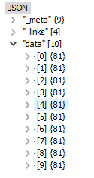
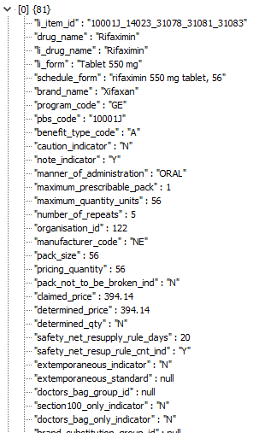
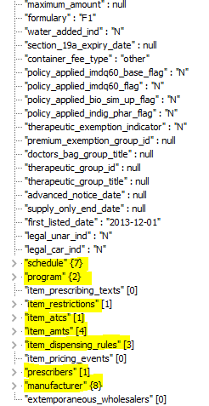
The Item-Overview is a (New endpoint) an aggregated JSON response that includes comprehensive details about items, programs, restrictions, prescriptions, dispensing rules, manufacturers, and more. This structured format ensures that all relevant information is easily accessible and understandable.

Slide 19
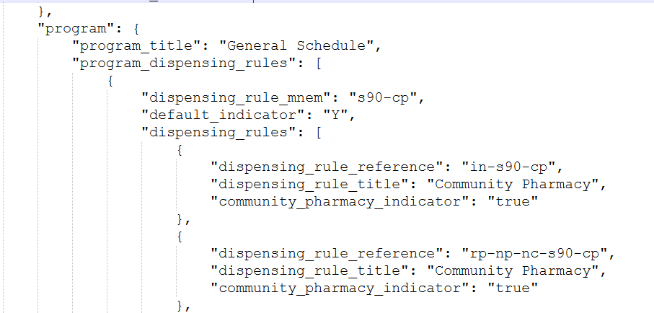
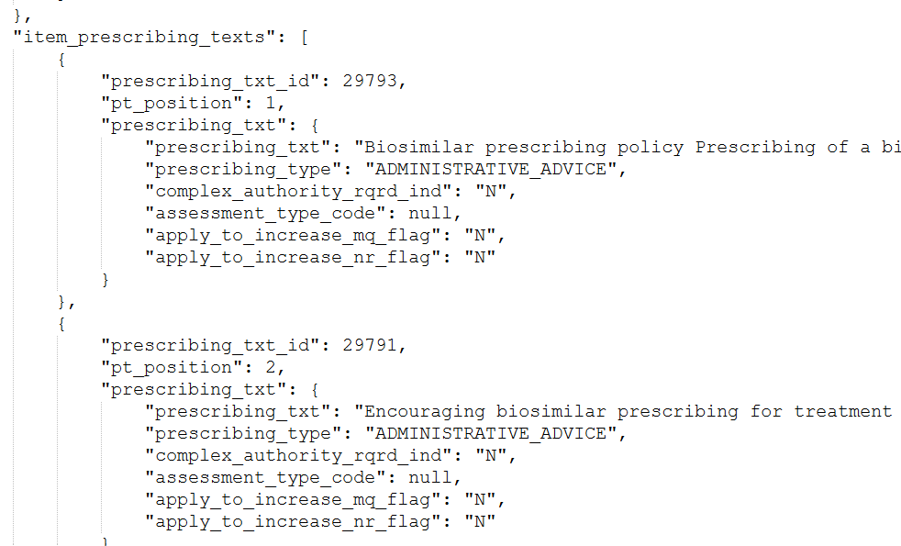
Example – Item-overview endpoint.
See also link on Meeting page for full example - https://data.pbs.gov.au/meetings/index.html

Slide 20
PBS data API Version 3.1.12 release notes (21 February 2025)
NEW
Added Copyright details within the '_meta' response body content for all endpoints.

Slide 21
PBS data API Version 3.1.12 release notes (21 February 2025)
NEW
All API endpoints now allows users to specify the fields they wish to return in the response payload by specifying the fields in the query parameters.
Query Parameters | Description
fields | This parameter specifies specify the fields to return in the response payload by specifying the fields in the query parameters.
Sample Enhanced Request:
{{baseUrl}}/api/v3/atc-codes?fields=atc_code,atc_level (This query parameter specifies which fields should be included in the response. In this case, only the atc_code and atc_level fields will be returned.)
Sample Response:
[
{
"atc_code": "A01",
"atc_level": 1
},
{
"atc_code": "A",
"atc_level": 1
}
]

Slide 22
PBS data API Version 3.1.12 release notes (21 February 2025)
NEW
Api/v3/summary-of-changes endpoint.
Added Source/Target revision number.

Slide 23
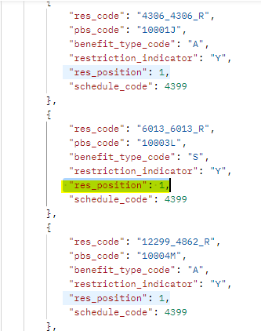
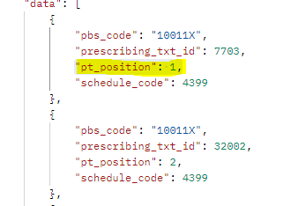
PBS data API Version 3.1.12 release notes (21 February 2025)
NEW
Api/v3/item-restriction-relationships endpoint - Added 'res_position' parameter (new column). Field used to identify the positional ordering of a restriction associated to a given item.
Api/v3/item-prescribing-texts endpoint -Added 'pt_position' parameter (new column). Field used to identify the positional ordering of prescribing texts associated to a given item.

Slide 24
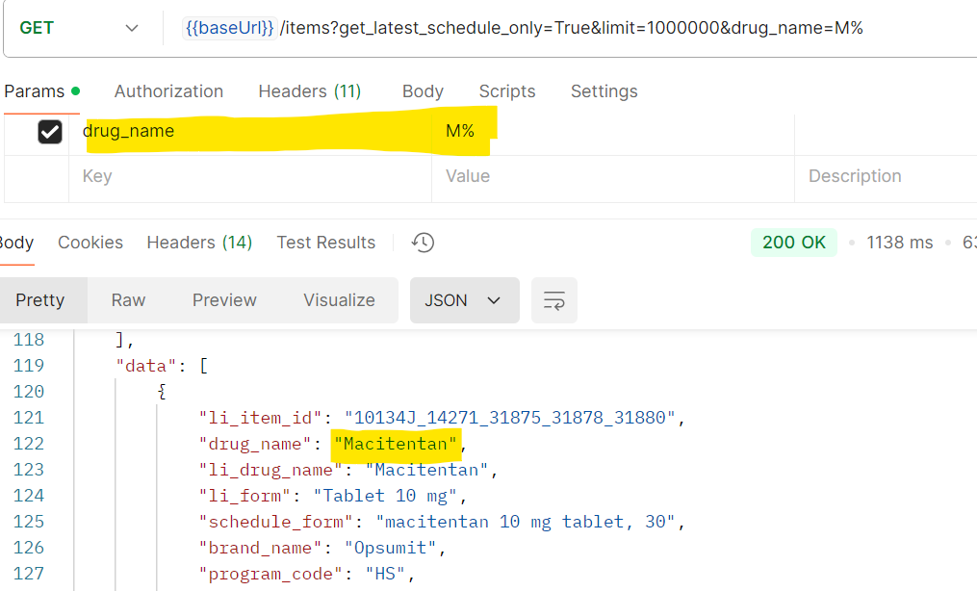
PBS data API Version 3.1.12 release notes (21 February 2025)
ENHANCEMENT
Parameter filtering for each field on all endpoints. Users can filter using any/multiple field(s) across all endpoints. See https://data-api-portal.health.gov.au/ for more details.
Parameter will affect response body content to return the specified data fields provided.
Wildcard responses ad more advanced responses available – For full list Refer to https://learn.microsoft.com/en-us/sql/t-sql/language-elements/like-transact-sql?view=sql-server-ver16
Example
– All drug names starting with “M”

Slide 25
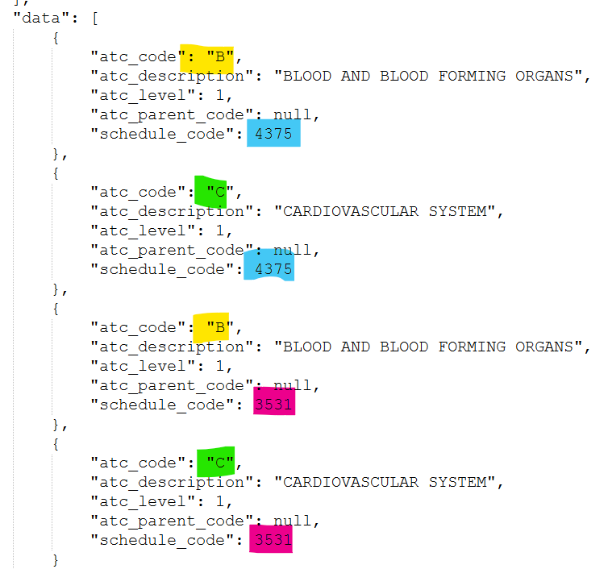
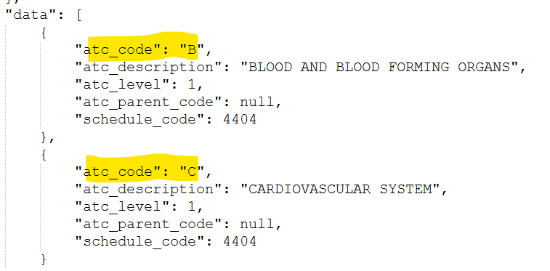
Example – Filtering with Multiple values, and multiple fields
{{baseUrl}}/api/v3/atc-codes?atc_code=B,C (users can filter by providing a comma-separated list)
{{baseUrl}}/api/v3/atc-codes?atc_code=B,C&schedule_code=4031,4078 (multi-parameter filtering)

Slide 26
PBS data API Version 3.1.12 release notes (21 February 2025)
DATA MODIFICATIONS
Api/v3/items endpoint.
Removed 'brand_substitution_group_id' and 'brand_substitution_group_code' data values for EFC items.
Api/v3/markup-bands, /program-dispensing-rules, /dispensing-rules, /item-dispensing-rule-relationships endpoints.
Removed 'ds-manu' dispensing_rule_mnem from data as it is not a valid dispensing rule used.
Api/v3/item-dispensing-rule-relationships endpoint.
Modified the 'dispense_fee_type_code' data for extemporanious concepts to have a value of 'EP' instead of 'NF'.

Slide 27
PBS data API Version 3.1.12 release notes (21 February 2025)
DATA MODIFICATIONS
Further definition updates made to various swagger definitions. See https://data-api-portal.health.gov.au/ for more details.
An update to the ‘accessTokenUrl’ – you can now use the following (with health.gov.au) as an alternative to using the Tennant ID https://login.microsoftonline.com/health.gov.au/oauth2/v2.0/token

Slide 28
PBS data API Version 3.1.12 release notes (21 February 2025)
API v1 beta has been removed.
API v2 beta – An API-Retire-Time for the date this version is planned to decommission is visible in API Headers information.
The date will update to be remain available until 3 months after API v3 is confirmed to be fully stable and functional as the main source of PBS data. Currently this is set in Production for June 2025, and will be updated to 1 October 2025 soon.

Slide 29
PBS API - Future Releases
Future release (Date: TBC but aiming for this fanatical year)
API v3.
AMT TPUU content & Non-AMT concepts/codes. Possibly adding Vial size for chemotherapy separately.
Improve pricing information.
Known issue - /items API endpoint, The Originator_brand_indicator values may be incorrect.
Allow manual sort on API endpoints. Example on next slide
If there is something you think we have missed that is required in v3, please email HPPSupport@gov.au.

Slide 30
Enhanced API Endpoints: Sorting Example
All API endpoints will allow users to custom sort.
Use case - Client applications may require data in a specific order. Therefore, custom sorting will offer flexibility for clients to retrieve data in the order they need.
Query Parameters | Description
sort | This parameter specifies that the sorting should be in ascending or descending order. Values are asc or desc
sort_fields | This parameter lists the fields by which the data should be sorted.
Sample Enhanced Request:
{{baseUrl}}/api/v3/atc-codes?sort=asc&sort_fields=atc_code,atc_level (the request will return the atc-codes data sorted in ascending order, first by atc_code and then by atc_level.)
{{baseUrl}}/api/v3/atc-codes?sort=desc&sort_fields=atc_code,atc_level (the request will return the atc-codes data sorted in descending order, first by atc_code and then by atc_level.)

Slide 31
Future release (Date: TBC)
Software Vendor test environment
Until available, all test files will be released as CSV and JSON downloads.
API v3 or V4.
Known issue - restrictions API endpoint, the SCHEDULE_HTML_TEXT contains incorrect formatting. Currently this field combine both Schedule and LI text information.
Embargo files disappearing.
More history in the API.
API v4.
Improve functionality, structure, and clarity.
Evolve with Government API standards.
V4 requires breakable changes.

Slide 32
PBS Updates
Manner of administration
For 1 March 2025 data, a new Manner of Administration was added to the list for “Oral/transdermal”.
This showed that the API “manner_of_administration” is populated with data field name without the formatting – ie “ORAL_TRANSDERMAL”
A future update will include a new field for the plain text description of the Manner of administration.
This is the same as the text that appears in the PBS Legal Instrument.
The existing field will remain as is.

Slide 33
Authority In Writing
API changes – in upcoming release
Api/v3/restrictions endpoint​
Adding 'written_authority_required'.
Field to be used to determines if the Authority needs to Comply with written Authority requirements for the LI. ​
'Assessment_type'. Full/Immediate.
Written Authority was previously synonymous with Full Assessment, but this is no longer the case – many written authority applications can now be assessed in real time through HPOS.
Services Australia independently maintain their own system flags to indicate whether a restriction is subject to Full (Delayed) Assessment or Immediate Assessment – Health data on assessment types should therefore not be relied upon at this time. We will advise software vendors if/when there is any further change to the handling of the Assessment Type field.

Slide 34
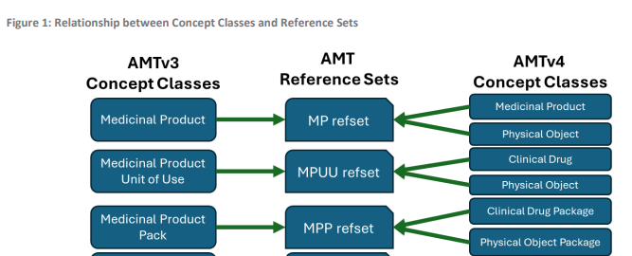
PBS API – AMT v4
PBS incorporation
The first AMT v4 (1 September 2024) file was incorporated into the PBS data update for 1 March 2025. While most terms have not updated, there may be many background data updates to accommodate these changes. Some items may become non-AMT for a period while reconciliation to AMT v4 terms is progressed over the coming months.
Reference from CSIRO document.
AMT v3 to AMT v4 &
SNOMED CT-AU Package
Changes
Comparison
and Migration
Guidance
March 2024

Slide 35
PBS API – AMT v4
API data schedule name issue
Some Medicinal Product (MP) preferred terms were updated with AMT v4 names that do not match what the PBS intends to display. Examples below.
Update to the API in progress to display names according to the PBS name, while still be reconciled to AMT lineages for these affected MPs.
A list of affected items will be sent to Vendors.

Slide 36
Additional Community Supply Support (ACSS) payments
API and PBSOnline system solutions to be in place by 1 July 2025.
Eighth Community Pharmacy Agreement (8CPA) - new legislated payment to community pharmacies for dispensing PBS medicines.*
The payment will only be made in respect of Commonwealth subsidised PBS items and has two components:
Component 2 - $0.78 per dispense for each supply of a PBS/RPBS prescription of a section 85 medicine dispensed by Approved Pharmacists.
Affects Programs:
GE – for general PBS supplies (ready prepared items)
PL – for supplies of items on the palliative care list
EP – for supplies of extemporaneously prepared items
R1 – for RPBS supplies
RPBS unlisted – Not part of the PBS schedule, managed by Services Australia.
Component 1 - $4.79 per dispense for each supply of a PBS/RPBS prescription of a section 85, 60day prescription (iMDQ) medicine when dispensed at the full maximum dispensing quantity by Approved Pharmacists.
Fee will be indexed 1 July each year of the 8CPA.
*8CPA – Table 4

Slide 37
Additional Community Supply Support (ACSS) payments
API changes – production release end of March 2025
Api/v3/fees Endpoint
Added 'acss_imdq60_payment'. Field used to identify the fee amount associated with Component 1.
Added ' acss_payment '. Field used to identify the fee amount associated with Component 2.
Eligible items for the payments will need to be derived via the eligibility on the previous slide.
API download will be release soon on the embargo page for Software Vendor PBSOnline NOI testing.

Slide 38
Safety Net Threshold changes – 18 January 2025​
The Australian Government is reviewing legislative requirements regarding PBS co-payments and the Safety Net. The Government has made changes to its systems and guidance from 18 January 2025 in relation to PBS co-payment charges for ‘threshold prescriptions’ that exactly meet the PBS Safety Net threshold. A threshold prescription is a prescription that either exactly meets or exceeds the PBS Safety Net threshold amount.
Section 49 (s49) prescriptions are treated as a single supply, therefore if the value of the s49 supply meets or exceeds the relevant safety net threshold, a patient should only pay the relevant reduced co-payment (no co-payment for a concessional patient, $7.70 co-payment for a general patient).
For s49 prescriptions priced above the co-payment, patients pay the relevant number of co-payments, irrespective of whether the Commonwealth price calculations would make repeat supplies within the same dispense fall below the co-payment.
PRF to show all scripts including the script that either exactly meets or exceeds the PBS Safety Net threshold amount.

Slide 39
Example of s49 Prescription Priced Near Co-payment
Scenario – further policy investigations ongoing
s49 repeat supply (being original and one repeat) for Kinson 100mg tablets – PBS Item code 1242J. (AEMP = $17.65)
Price for Reimbursement if PBS subsidised – Under-copayment
Patient Co-payment
2 x $31.60 = $63.20 where standard discounting and under-co pricing can be applied.
Amount to be recorded on the PRF
Amount charged to the patient, less such items as additional patient charge.
Component | Calculation | Price
Wholesale price | AEMP 2 x $17.65 + $2.65 wholesale markup | $37.96
Dispensing fee | $8.67 per dispense | $8.67
AHI (Markup) | 2 x $4.79 | $9.58
Total |  | $56.21
May also charge
SN recording fee $1.45
Additional fee $3.45
= total $61.11

Slide 40
PBS API – General - Discussion and questions
This part will not be released as part of the recording.
If you have any questions from this webinar, email HPPSupport@health.gov.au.
We are always happy to help.

Slide 41
END

