Slide 1
PBS Developers’ Forum
14th November 2018

Slide 2
Agenda
Welcome/Introduction
Electronic Medication Management
Supply/Dispense Only
Dispensing Rules
Restriction Numbers
Supply Chain Reform
Radiopharmaceuticals
AMT Mapping Update
PIR: v3.0 PBS XML
Data Future Direction
Action Items
Other Business
Meeting close

Slide 3
Agenda
Welcome/Introduction
Electronic Medication Management
Supply/Dispense Only
Dispensing Rules
Restriction Numbers
Supply Chain Reform
Radiopharmaceuticals
AMT Mapping Update
PIR: v3.0 PBS XML
Data Future Direction
Action Items
Other Business
Meeting close

Slide 4
Electronic Medication Mgmt
Active ingredient prescribing
ePrescribing

Slide 5
Agenda
Welcome/Introduction
Electronic Medication Management
Supply/Dispense Only
Dispensing Rules
Restriction Numbers
Supply Chain Reform
Radiopharmaceuticals
AMT Mapping Update
PIR: v3.0 PBS XML
Data Future Direction
Action Items
Other Business
Meeting close

Slide 6
Supply/Dispense Only
Supply Only
Can no longer be prescribed

Slide 7
Supply/Dispense Only
Legislation
What are the changes?
What is the intent?
Changed February 2018
Listing can continue for supply but not for prescribing

Slide 8
Supply/Dispense Only
Legislation
Listing information controls period of supply-only status
Otherwise, a listing remains the same

Slide 9
Supply/Dispense Only
Data
Listing stays ‘alive’
No need for translation
Updates to pricing and substitution as normal

Slide 10
Agenda
Welcome/Introduction
Electronic Medication Management
Supply/Dispense Only
Dispensing Rules
Restriction Numbers
Supply Chain Reform
Radiopharmaceuticals
AMT Mapping Update
PIR: v3.0 PBS XML
Data Future Direction
Action Items
Other Business
Meeting close

Slide 11
Dispensing Rules
Request from vendor
Missing dispensing rules for PL, R1
Public, private hospital
Same as GE

Slide 12
Dispensing Rules
Test XML published 6 November
Implementation ASAP
Avoid pricing changes

Slide 13
Agenda
Welcome/Introduction
Electronic Medication Management
Supply/Dispense Only
Dispensing Rules
Restriction Numbers
Supply Chain Reform
Radiopharmaceuticals
AMT Mapping Update
PIR: v3.0 PBS XML
Data Future Direction
Action Items
Other Business
Meeting close

Slide 14
Restriction Numbers
Restriction code: Unique to whole restriction.
Treatment-of code: Unique to legal text of restriction
Currently 4 digits
Maximum value: Theoretically none, practically – not the case.
Rate of consumption: around 50 restrictions, 110 codes a month
Soon will be 5 digits
Test file to be provided
Forecast date: Early 2020

Slide 15
Agenda
Welcome/Introduction
Electronic Medication Management
Supply/Dispense Only
Dispensing Rules
Restriction Numbers
Supply Chain Reform
Radiopharmaceuticals
AMT Mapping Update
PIR: v3.0 PBS XML
Data Future Direction
Action Items
Other Business
Meeting close

Slide 16
Supply Chain Reform
Improved PBS Payment Administration
Changes to PBS XML
Pricing methodology
Crediting arrangements
Administrator-Pharmacy interface
Identification of suppliers

Slide 17
Overview - the Budget measure
2018-19 Budget measure - Improving Access to Medicines – additional funding for new medicines and improved payment administration
Government to pay a ‘net’ price for some medicines, rather than paying the higher published price and receiving rebates from manufacturers.
Will reduce PBS revenue.
Initial 12 month phase will include a smaller sub-set of medicines with Special Pricing Arrangements.
8 November, 2018

Slide 18
Purpose
The measure seeks to address issues raised by the Independent Review of Pharmacy Remuneration and Regulation by:
Increasing consumer access to high cost medicines
Addressing cash flow concerns from pharmacists and wholesalers
Addressing the financial risks associated with the payment of large rebates to the Australian Government for some high cost medicines
2 July 2018

Slide 19
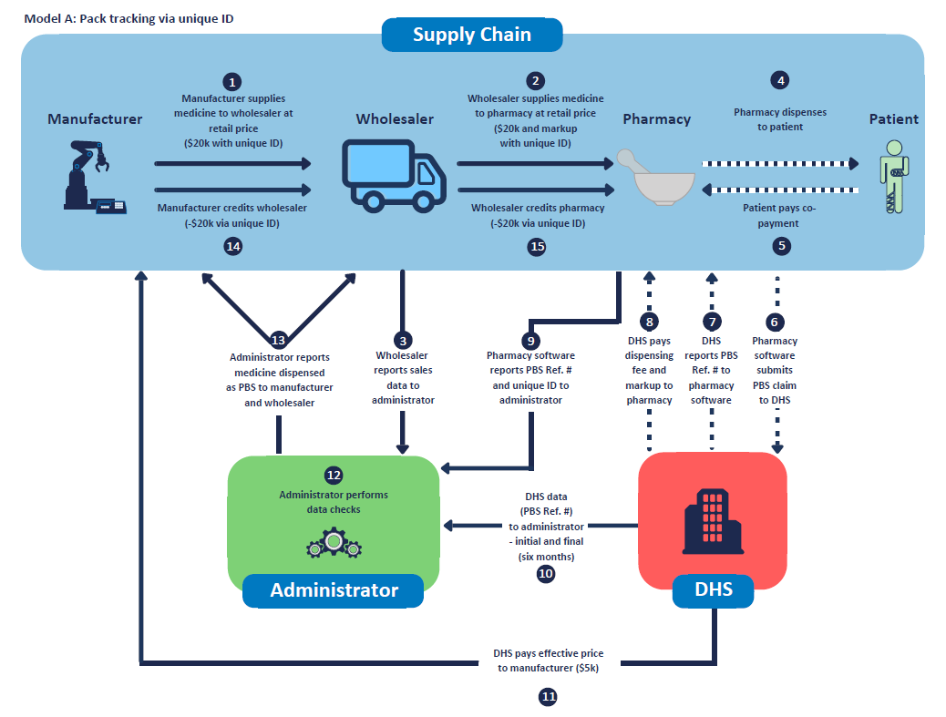
Dispensing and point of sale systems
2 July 2018

Slide 20
Dispensing and point of sale systems
Role of administrator (centralise data, but will not take over business functions such as credit requests)
Systems reporting to administrator – data elements set out in VRD.
Language/connectivity: JSON (REST API)
Administrator reporting back: aiming for real-time, and giving a net view of credits by party (real time) plus variety of data views via login
Credit or payment request to be sent (if applicable)
System (dispense/PoS/financial systems for hospitals)
Connectivity between dispense and PoS
‘Business rules’ for decision making on sending requests (e.g. who)
2 July 2018

Slide 21
Dispensing and point of sale systems continued
Possible endpoints for request
5-6 wholesalers
Manufacturer (direct supply arrangements)
Third party hub (escrow agent, credit manager)
Other (e.g. QLD Central Pharmacy)
Customers may wish to:
Self-select party that receives request
Send a request separately (e.g. manual process, which may occur if extra info is required)
Use business rules to automate process (as per last slide)
Update administrator on credits paid (remove from active data views)
2 July 2018

Slide 22
Supply Chain Reform
Changes to PBS XML Schema ⇒ v3.1
Melbourne presentation (updated)

Slide 23
Supply Chain Reform
Current status
PBS XML V3.1 alpha3
PBS XML V2.13 alpha3
text extracts alpha3
Feedback period expired
beta1 releases

Slide 24
Supply Chain Reform
Current status
PBS XML V3.1
alpha3
PBS XML V2.13
alpha3
text extracts
alpha3
Sample
Sample

Slide 25
Supply Chain Reform
Pricing methodology
John Green

Slide 26
Supply Chain Reform
Administrator-Pharmacy interface
Greg Pryde

Slide 27
Supply Chain Reform
POST /v0.1/SCR/ {ApprovalNo} /Query
{
"event": “string” [Options:A,U,C,R,TO,TI,D],
"pbsSupplyStatus": “string” [Options: P,N],
"approvalNum": “string”,
"dateOfDispensing": "0001-01-01T00:00:00",
"pbsItemCode": “string”,
"manufacturerCode": “string”,
"pbsReferenceNum": “string”,
"pharmxSupplierID": “string”,
"categoryOfPayment": “string”,
"claimPeriodNum": “string”,
"serialNum": “string”,
"packPercSupl": 0.0,
"tpp": “string”,
“Ctpp": “string”,
"uniqueID": “string”,
"uppn": “string”
}
Unknown supplier

Slide 28
Supply Chain Reform
400 , Bad Request
{
"error": "bool",
"errorDetails": "string"
“approved”:”bool”
“resultCode”:”string”
AvaliableCredits": [{
"PharmxSupplierCode": “string”,
"CreditsAvaliableInPacks": 0.0
}]
}
Return result
Notes:
NB speling error: AvaliableCredits

Slide 29
Supply Chain Reform
POST /v0.1/SCR/ {ApprovalNo}
{
"event": “string” [Options:A,U,C,R,TO,TI,D],
"pbsSupplyStatus": “string” [Options: P,N],
"approvalNum": “string”,
"dateOfDispensing": "0001-01-01T00:00:00",
"pbsItemCode": “string”,
"manufacturerCode": “string”,
"pbsReferenceNum": “string”,
"pharmxSupplierID": “string”,
"categoryOfPayment": “string”,
"claimPeriodNum": “string”,
"serialNum": “string”,
"packPercSupl": 0.0,
"tpp": “string”,
“Ctpp": “string”,
"uniqueID": “string”,
"uppn": “string”
}
Known supplier
Post with supplier code
Returns transaction ID

Slide 30
Supply Chain Reform
400 , Bad Request
{
"error": "bool",
"errorDetails": “string"
“transactionID”: “string”,
“approved”:”bool”
“resultCode”:”string”
}
Return result
Notes:
NB speling error: AvaliableCredits

Slide 31
Supply Chain Reform
Delete a UPPN
Returns transaction ID
DELETE /v0.1/SCR/ {ApprovalNo}/{UPPN} , Cancel a UPPN

Slide 32
Supply Chain Reform
404, UPN not found
400 , Bad Request
{
"error": "bool",
"errorDetails": “string"
“transactionID”: “string”,
“approved”:”bool”
“resultCode”:”string”
}
Return result
Notes:
NB speling error: AvaliableCredits

Slide 33
Supply Chain Reform
Get status of UPPN
GET /v0.1/SCR/ {ApprovalNo}/{UPPN}

Slide 34
404, UPN not found
400 , Bad Request
{
"currentUPPNStatus": {
"event": “string” [Options:A,U,C,R,TO,TI,D],
"pbsSupplyStatus": “string” [Options: P,N],
"approvalNum": “string”,
"dateOfDispensing": "0001-01-01T00:00:00",
"pbsItemCode": “string”,
"manufacturerCode": “string”,
"pbsReferenceNum": “string”,
"pharmxSupplierID": “string”,
"categoryOfPayment": “string”,
"claimPeriodNum": “string”,
"serialNum": “string”,
"packPercSupl": 0.0,
"tpp": “string”, "Ctpp": “string”,
"uniqueID": “string”, “uppn": “string”
}
,
"error": false,
"errorDetails": “string”
}
Return result
Notes:
NB speling error: AvaliableCredits

Slide 35
Supply Chain Reform
Get statement for a period for close of claim
GET /v0.1/SCR/ {ApprovalNo}/{ClaimPeriod}

Slide 36
400 , Bad Request
{
{
"currentUPPNStatus": [{
"uppn": “string”,
"tpp": “string”,
"Ctpp": “string”,
"pbsItemCode": “string”,
"manufacturerCode": “string”,
"matchedToDHS": false,
"matchedToWholesaler": false
}],
Return result
Notes:
NB speling error: AvaliableCredits

Slide 37
"currentInvoiceStatus": [{
"tpp": “string”,
"pbsItemCode": “string”,
"manufacturerCode": “string”,
"pharmxSupplierID": “string”,
"noOfPacksSupplied": 0.0,
"matchedToUPPN": false
}],
Return result
Notes:
NB speling error: AvaliableCredits

Slide 38
"paymentStatus": {
"amountToPayPharmacy": 0.0
},
"error": false,
"errorDetails": “string”
}}
Return result
Notes:
NB speling error: AvaliableCredits

Slide 39
Supply Chain Reform
C# classes
Base response class
public class SCRBaseResponse
{
public bool error { get; set; }
public string errorDetails { get; set; }
}

Slide 40
Supply Chain Reform
C# classes
Common request class
public class SCRRecord
{
public string Event { get; set; }
public string PBSSupplyStatus { get; set; }
public string ApprovalNum { get; set; }
public DateTime DateOfDispensing { get; set; }
public string PbsItemCode { get; set; }
public string ManufacturerCode { get; set; }
public string PBSReferenceNum { get; set; }
public string PharmxSupplierID { get; set; }
public string CategoryOfPayment { get; set; }
public string ClaimPeriodNum { get; set; }
public string SerialNum { get; set; }
public double PackPercSupl { get; set; }
public string TPP { get; set; }
public string CTPP { get; set; }
public string UniqueID { get; set; }
public string UPPN { get; set; }
}

Slide 41
Supply Chain Reform
C# classes
Response to add new script
public class SCRPostUPPNStatusResponse:SCRBaseResponse
{
public string TransactionID { get; set; }
public bool Approved { get; set; }
public string ResultCode{ get; set; }
}

Slide 42
Supply Chain Reform
C# classes
Response to query for available credits
public class SCRQueryUPPNStatusResponse:SCRBaseResponse
{
public string TransactionID { get; set; }
public bool Approved { get; set; }
public string ResultCode{ get; set; }
public SCRUPPNAvaliableCredits [] AvaliableCredits { get; set; }
}
public class SCRUPPNAvaliableCredits
{
public string PharmxSupplierCode { get; set; }
public double CreditsAvaliableInPacks { get; set; }
}

Slide 43
Supply Chain Reform
C# classes
Response to status for a UPPN
public class SCRGetUPPNStatusResponse:SCRBaseResponse
{
public SCRRecord CurrentUPPNStatus { get; set; }
}

Slide 44
Supply Chain Reform
C# classes
Response to query for payments in a claim period
public class SCRGetClaimPeriodStatusResponse : SCRBaseResponse
{
public SCRUPPNStatus[] CurrentUPPNStatus { get; set; }
public SCRInvoiceStatus[] CurrentInvoiceStatus { get; set; }
public SCRPaymentStatus PaymentStatus { get; set; }
}

Slide 45
Supply Chain Reform
C# classes
Response to query for payments in a claim period
public class SCRUPPNStatus
{
public string UPPN { get; set; }
public string TPP { get; set; }
public string CTPP { get; set; }
public string PbsItemCode { get; set; }
public string ManufacturerCode { get; set; }
public bool MatchedToDHS { get; set; }
public bool MatchedToWholesaler { get; set; }
}

Slide 46
Supply Chain Reform
C# classes
Response to query for payments in a claim period
public class SCRInvoiceStatus
{
public string TPP { get; set; }
public string PbsItemCode { get; set; }
public string ManufacturerCode { get; set; }
public string PharmxSupplierID { get; set; }
public double NoOfPacksSupplied { get; set; }
public bool MatchedToUPPN { get; set; }
}
public class SCRPaymentStatus
{
public double AmountToPayPharmacy { get; set; }
//can be positive or negative
}

Slide 47
Agenda
Welcome/Introduction
Electronic Medication Management
Supply/Dispense Only
Dispensing Rules
Restriction Numbers
Supply Chain Reform
Radiopharmaceuticals
AMT Mapping Update
PIR: v3.0 PBS XML
Data Future Direction
Action Items
Other Business
Meeting close

Slide 48
Radiopharmaceuticals
Nuclear medicine
Radium-223
First radiopharmaceutical
Prescribed only by nuclear medicine specialists

Slide 49
Radiopharmaceuticals
PBAC listing ASAP
Interim approach:
List in Botox program
Same conditions
Long-term approach?
Please provide feedback

Slide 50
Agenda
Welcome/Introduction
Electronic Medication Management
Supply/Dispense Only
Dispensing Rules
Restriction Numbers
Supply Chain Reform
Radiopharmaceuticals
AMT Mapping Update
PIR: v3.0 PBS XML
Data Future Direction
Action Items
Other Business
Meeting close

Slide 51
AMT v3
PharmCIS uses AMT v3
Load monthly releases
Backlog of un-reconciled concepts

Slide 52
AMT v3

Slide 53
Agenda
Welcome/Introduction
Electronic Medication Management
Supply/Dispense Only
Dispensing Rules
Restriction Numbers
Supply Chain Reform
Radiopharmaceuticals
AMT Mapping Update
PIR: v3.0 PBS XML
Data Future Direction
Action Items
Other Business
Meeting close

Slide 54
PIR: v3.0 PBS XML
Major version 3
Production release: 28/7/2017
v3.0 data: 1 August 2017

Slide 55
PBS XML v3.0
May 2017
Sept 2017
June 2017
Aug 2017
Oct 2017
July 2017
V2 Prod
V3 Prod
V3 Test
V2 Down

Slide 56
Agenda
Welcome/Introduction
Electronic Medication Management
Supply/Dispense Only
Dispensing Rules
Restriction Numbers
Supply Chain Reform
Radiopharmaceuticals
AMT Mapping Update
PIR: v3.0 PBS XML
Data Future Direction
Action Items
Other Business
Meeting close

Slide 57
PBS Data Future Direction
Notes:
requirements vs solutions

Slide 58
PBS Data Future Direction
Health
Policy implementation
Administer Payments
Schedule data
Schedule data
DHS
Professionals (Software)
Submit claims
Claim processing

Slide 59
PBS Data Future Direction
 | Text extracts | PBS XML v2 | PBS XML v3 | MBS XML | PLAC XML
Supports LIs | ✘ | ✔︎ | ✔︎ | ? | ?
Supports publications (website, PDFs) | ✘ | ✔︎ | ✔︎ | ? | ?
Supports DHS | ✘ | ✔︎ | ✔︎ | ? | ?

Slide 60
PBS Data Future Direction
 | Text extracts | PBS XML v2 | PBS XML v3 | MBS XML | PLAC XML
Supports automation of prescribing | ✘ | ✔︎ | ✔︎ | n/a | n/a
Supports automation of dispensing (CP) | Partial | ✔︎ | ✔︎ | n/a | n/a
Supports automation of dispensing (Hosp) | ✘ | ✔︎ | ✔︎ | n/a | n/a

Slide 61
PBS Data Future Direction
 | Text extracts | PBS XML v2 | PBS XML v3 | MBS XML | PLAC XML
Forward compatibility | ✘ | ✔︎ | ✔︎ | ✘ | ✘
I18N | ✘ | ✔︎ | ✔︎ | ✔︎ | ✔︎
Partial download | ✘ | ✘ | ✘ | ✘ | ✘
Textual content | ✘ | ✔︎ | ✔︎ | ✘ | ✘

Slide 62
PBS Data Future Direction
 | Text extracts | PBS XML v2 | PBS XML v3 | MBS XML | PLAC XML
History | ✘ | ✔︎ | ✔︎ | ✘ | ✘
Delta processing | ✘ | ✔︎ | ✔︎ | ✘ | ✘
Metadata | ✘ | ✔︎ | ✔︎ | ✘ | ✘
Simple/basic consumption | ✔︎ | ✘ | ✘ | ✘ | ✘

Slide 63
PBS Data Future Direction
 | Text extracts | PBS XML v2 | PBS XML v3 | MBS XML | PLAC XML
Normalised | ✘ | ✔︎ | ✔︎ | ✘ | ✘
Customised | ✘ | ✘ | ✘ | ✘ | ✘
Responsive to change | ✘ | ✘ | ✘ | ✘ | ✘
Scope of content | Basic | Partial | Comprehensive | ? | ?

Slide 64
PBS Data Future Direction
 | Text extracts | PBS XML v2 | PBS XML v3 | MBS XML | PLAC XML
Integrated data | ✘ | ✘ | ✘ | ✘ | ✘
Support terminologies | ✘ | ✔︎ | ✔︎ | ✘ | ✘
Access to internal terminologies | ✘ | ✔︎ | ✔︎ | ✘ | limited
Supports digital transformation | ✘ | ✔︎ | ✔︎ | ✔︎ | ✔︎

Slide 65
PBS Data Future Direction
 | Text extracts | PBS XML v2 | PBS XML v3 | MBS XML | PLAC XML
Business feature: x-item subs | ✘ | ✔︎ | ✔︎ | n/a | n/a
Business feature: restrictions | ✘ | ✔︎ | ✔︎ | n/a | n/a
Business feature: dispensing rules | ✘ | ✔︎ | ✔︎ | n/a | n/a
Business feature: history granularity | ✘ | ✔︎ | ✔︎ | n/a | n/a

Slide 66
PBS Data Future Direction
 | Text extracts | PBS XML v2 | PBS XML v3 | MBS XML | PLAC XML
Responsive to NPP changes | ✘ | ✘ | Partial | ✘ | ✘

Slide 67
PBS Data Future Direction
Vendor requirements?

Slide 68
Agenda
Welcome/Introduction
Electronic Medication Management
Supply/Dispense Only
Dispensing Rules
Restriction Numbers
Supply Chain Reform
Radiopharmaceuticals
AMT Mapping Update
PIR: v3.0 PBS XML
Data Future Direction
Action Items
Other Business
Meeting close

Slide 69
Action Items
The PBS Online system will identify if a patient has been to another Pharmacy for the same script. Department of Health will advise further on this issue.
Action for EMMS

Slide 70
Action Items
S/O: Manufacturer code changes/removals
DHS system does not handle changes to brands
See agenda item

Slide 71
Action Items
Pro’s and Con’s of adding PBS code to script.
Policy discussion

Slide 72
Action Items
Add Rendering Specification to PBS XML Schema package
Accepted
Will be provided ASAP

Slide 73
Action Items
Provide feedback of impact on having Safety Net values independent of day and counted values

Slide 74
Action Items
Email PBAC to raise issue of Blinatumomab vials only yielding 35mcg
George @ Fred

Slide 75
Action Items
XML Subsets high level detailed design to be published
Do comparison of tools used by industry to process XML

Slide 76
Agenda
Welcome/Introduction
Electronic Medication Management
Supply/Dispense Only
Dispensing Rules
Restriction Numbers
Supply Chain Reform
Radiopharmaceuticals
AMT Mapping Update
PIR: v3.0 PBS XML
Data Future Direction
Action Items
Other Business
Meeting close

Slide 77
Agenda
Welcome/Introduction
Electronic Medication Management
Supply/Dispense Only
Dispensing Rules
Restriction Numbers
Supply Chain Reform
Radiopharmaceuticals
AMT Mapping Update
PIR: v3.0 PBS XML
Data Future Direction
Action Items
Other Business
Meeting close

Slide 78
Meeting Close
Next meeting

