Slide 1

Health Products Portal
Webinar
Updated API version and transition Q&A
Pull quote
Thank you for joining, this webinar will begin at 3.00pm,
26 February 2024
www.health.gov.au

Slide 2
Acknowledgement of Country
We acknowledge the Traditional Custodians of country throughout Australia and their connections to land, sea and community. We pay our respect to their Elders past and present and extend that respect to all Aboriginal and Torres Strait Islander peoples today.

Slide 3



Before we begin…
Please turn off your webcam
Please mute your microphone unless speaking
Any questions? Email HPP.Support@health.gov.au

Slide 4
Agenda
Introduction
  PBS Data Distribution Project background and timeline
v3 API updates
  PBS Public data API
  Bugfixes and minor enhancements
Timeline
  Transition Q & A

Slide 5
PBS Data Distribution Project
Background
The Department of Health is modernising the consumption and data distribution model for the monthly PBS Schedule data, in order to:
  Improve accessibility to PBS Schedule data;
  Make the data easier to understand and use in software; and
  Improve data latency and data provision through best practice architecture.
Timing
  The project started in 2019, and conducted a series of working group meetings in 2020-21
  A Private Beta with a small group of vendors was held in late 2022
  A Public Beta was held between June and October 2023

Slide 6
PBS Data Distribution Project
The Department is working to the following timeline
  From November 2023, the API is a production system. Vendors are encouraged to commence their transition.
  May 2024 will be the last PBS schedule for which data in existing formats will be released under embargo.
  From the June 2024 PBS schedule onwards, data released under embargo will be made available only via the API.
  The API for the general public, released earlier in February, will follow the same timeline as the embargo API.

Slide 7
PBS Data Distribution Project – v3 updates
The PBS public API is now available
  There is now a version of the API, that is open for access without registration via the HPP. Guidance on this can be found in our article on Accessing PBS public and embargo data via the API.
  The differences are outlined below:
    Only the current effective schedule and those published in the past 12 months are available. Future (embargo) schedules are not accessible.
    The API is rate-limited to one request per 20 seconds.
    Note: this limit is shared amongst all concurrent users of the PBS public data API.

Slide 8
PBS Data Distribution Project – v3 updates
Updates to documentation and pagination
  The developer portal documentation can now be accessed without myGovID and RAM authentication via https://data-api-portal.health.gov.au/. This has been updated to reflect the v3 changes.
  Updated versions of the following documentation is available in our article on Accessing PBS public and embargo data via the API:
    PBS DDS - Data Dictionary
    API Data Model
    PBS DDS – PBS Text File generation process
  The API can now support pagination so that large requests can be downloaded in pages/chunks. This requires additional “page” and “limit” parameters to be included in API requests, as detailed in the developer portal

Slide 9
PBS Data Distribution Project – v3 updates
Bugfixes and minor enhancements
  There have been several bugfixes and enhancements across the following tables, details on the specifics can be found in our news item regarding the v3 update and in the release notes available on the HPP website:
    item-increases
    Items
    Restrictions
    prescribing-text
    summary-of-changes

Slide 10
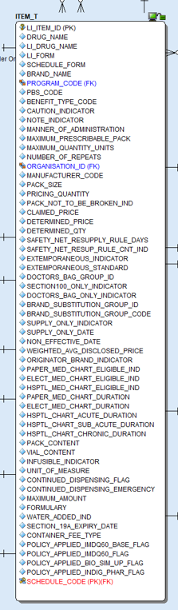
PBS Data Distribution Project – v3 updates
Enhancements to Items endpoint
    saftey_net_resup_rule_cnt_ind - misspelling corrected
    Policy Applied flags
    Continued Dispensing flag and emergency

Slide 11
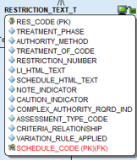
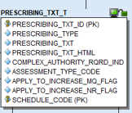
PBS Data Distribution Project – v3 updates
Restrictions and Prescribing Text
    Variation_rule_applied field
    Apply_to_increase_xx_flag, for Max Quantity and No. Of Repeats

Slide 12
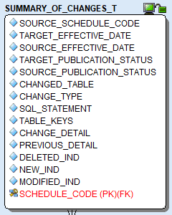
PBS Data Distribution Project – v3 updates
Summary of Changes fixes
    SQL Statement syntax changes, column lists on Insert statements
    Inclusion of Previous and Change detail columns

Slide 13
PBS Data Distribution Project
Supporting resources that are available
  A guide to accessing the API endpoints in Postman
  A guide (33 pages) that explains the process for converting API data to PBS text files
  A guide (24 pages) that explains how PBS restrictions work, in the API
  A data dictionary and data model for the API
https://data.pbs.gov.au/data-distribution/data-distribution.html

Slide 14

Discussion

