Slide 1
PBS API Software Vendor Webinar
Prescribing overview and updates
Pull quote
This meeting will be recorded. If you do not wish to take part in the MS Teams recording, please do not join the meeting. By joining the meeting, you are consenting to being included in the recording.
Thank you for joining, this webinar will begin at 11am, 6 November 2024
or once traffic slows coming into the meeting.
www.health.gov.au

Slide 2
Acknowledgement of Country
We acknowledge the Traditional Custodians of country throughout Australia and their connections to land, sea and community. We pay our respect to their Elders past and present and extend that respect to all Aboriginal and Torres Strait Islander peoples today.

Slide 3
Before we begin…
Please turn off your webcam
Please mute your microphone unless speaking
Any questions? Email HPP.Support@health.gov.au

Slide 4
Agenda
Prescribing overview and updates
Introduction
General recap
Future releases
Update on AMT v4
v3 API changes
Restrictions
PBS Public data API
Discussions
Q & A

Slide 5
PBS API General recap
All current forms of PBS Schedule data will continue to be available as long as there are key fixes being implemented. There will be at least three months' notice of discontinuation once the API is stable.
PDF Schedule and SOC - Will continue to be available in PDF form ongoing https://www.pbs.gov.au/browse/publications or under embargo.
Supporting resources that have been updated
V3 is the current version. API catalogue - https://data-api-portal.health.gov.au

Slide 6
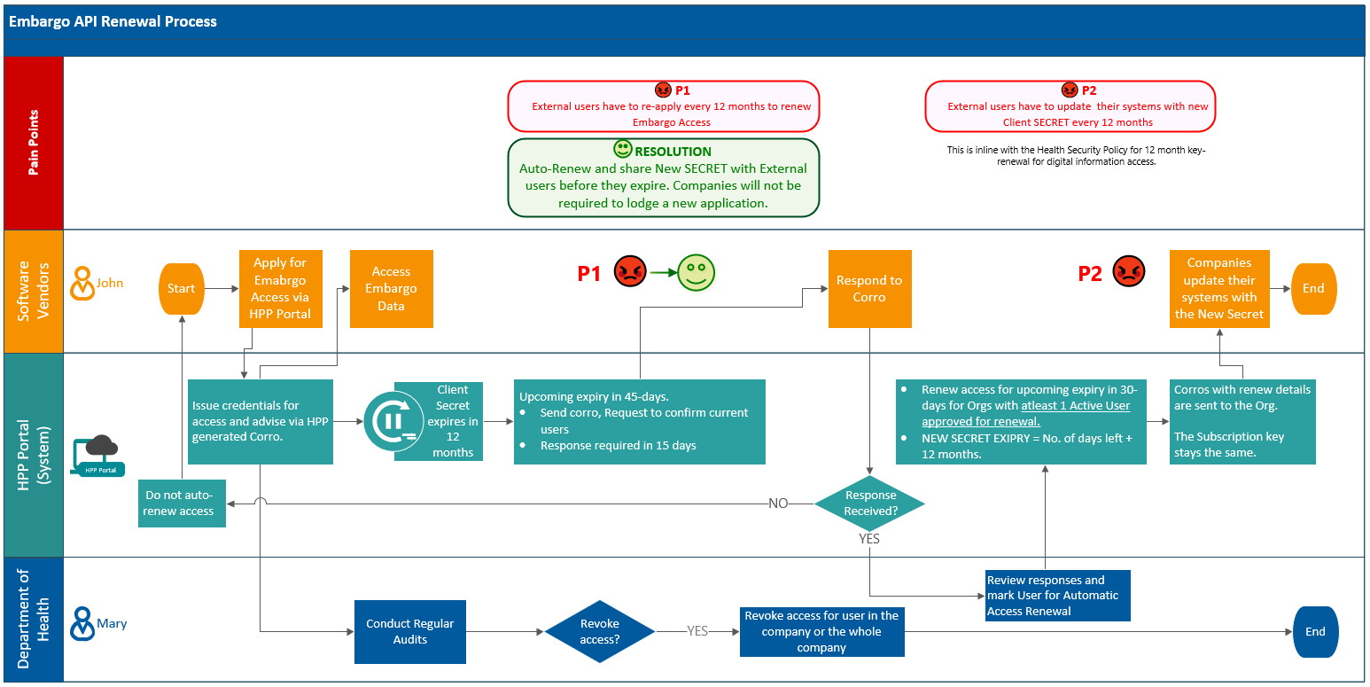
PBS API – Future Releases
Future release (November 2024)
Embargo API Access Renewal
Companies will no longer need to re-apply for access renewal, if they confirm which users need to retain access beforehand
Updated Process below; the communication will be managed via correspondence. Expect this solution to be in-place before the end of the year.

Slide 7
PBS API – Future Releases
Future release (Date: TBC, around December trying not to interfere with production data releases)
New (For V3 only)
New Column changed_endpoint added to Summary of Changes
New column first_listing_date added to the restrictions table
Schedule endpoint : Get latest schedule in newest to oldest format
New filter added to all endpoints to show the latest schedule information only
API Changelog Tracking Implemented for Major/Minor/Patch releases

Slide 8
PBS API – Future Releases
Future release (Date: TBC, around December trying not to interfere with production data releases)
Data Modifications (Data Enhancement)
In api/v3/items endpoint, the values in weighted_avg_disclosed_price column has been changed to NULL.
Data Modifications (Flags/indicators)
In api/v3/amt-items endpoint, remove all Null values from flags/indicators. exempt_ind
In api/v3/items endpoint, remove all Null values from flags/indicators. pack_not_to_be_broken_ind, determined_qty, safety_net_resup_rule_cnt_ind, continued_dispensing_flag, continued_dispensing_emergency, originator_brand_indicator, water_added_ind, policy_applied_bio_sim_up_flag, policy_applied_imdq60_flag, policy_applied_imdq60_base_flag, policy_applied_indig_phar_flag, legal_unar_ind, legal_car_ind

Slide 9
PBS API - Future Releases
Future release (Date: TBC, around December trying not to interfere with production data releases)
Data Modifications (Data Enhancement)
Any reference to res_code 9999_9999_R and prescribing_txt_id 119998, 119997 has been removed from item-restriction-relationships, restrictions, restriction-prescribing-text-relationships and prescribing-texts tables
If a given item has a 'therapeutic_exemption_indicator' value of 'Y'/true in the api/v3/items endpoint, then within the 'Item-Dispensing-Rule-Relationships' endpoint, the special_patient_contribution, brand_premium and therapeutic_group_premium columns is set to '0.00’
Documentation updates
API definition Updates – Swagger and data dictionary

Slide 10
PBS API - Future Releases
Future release (Date: TBC)
AMT V4 Updates, AMT TPUU Content & Non-AMT Codes
Incorporate the copyright statement into the API
Embargo files disappearing
More history in the API
Known issue - restrictions API endpoint, the SCHEDULE_HTML_TEXT contains incorrect formatting. These fields combine both Schedule and LI text information.
Improved rendering and presentation of restrictions including ordering of components withing an item code
Possible new /item-overview API endpoint
Remove API v1 beta
Remove API v2 beta
Known issue - /item-dispensing-rule-relationships API endpoint, the DISPENSE_FEE_TYPE_CODE values are incorrect for all extemporaneous medicines. These are currently appearing with a value of ‘NF’. The correct value for these items should be ‘EP’, as per the data dictionary. The values are correct for ready-prepared and EFC medicines )
Known issue - /items API endpoint, The Originator_brand_indicator values may be incorrect.

Slide 11
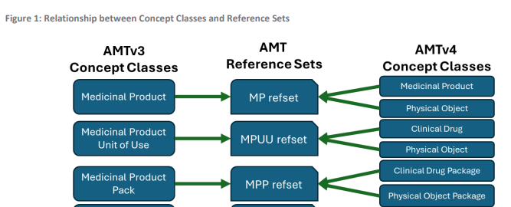
PBS API – AMT v4
PBS incorporation
Early next year.
No change to the reference set name of the 7 box set Health uses.
Semantic tags will be added to the data dictionary for reference.
Reference from CSIRO document.
AMT v3 to AMT v4 &
SNOMED CT-AU Package
Changes
Comparison
and Migration
Guidance
March 2024

Slide 12
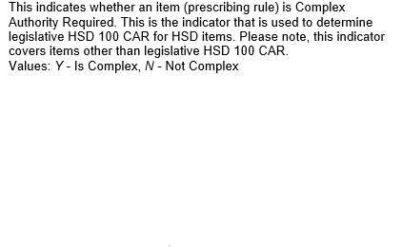
PBS API - Authority
Legal HSD CAR and UNAR
Services Australia Complex Authority Administration S100 items (CSV).
The API does not include the Section 100 Efficient Funding of Chemotherapy (EFC) items where the processing of the application for an authority to prescribe the item has a high degree of complexity.
/items
/restrictions end point

Slide 13
PBS API - Authority
Flag Compliance with Written Authority Required procedures
API does flag where ‘Compliance with Written Authority Required procedures’ is needed.
assessment_type_code = Full flag

Slide 14
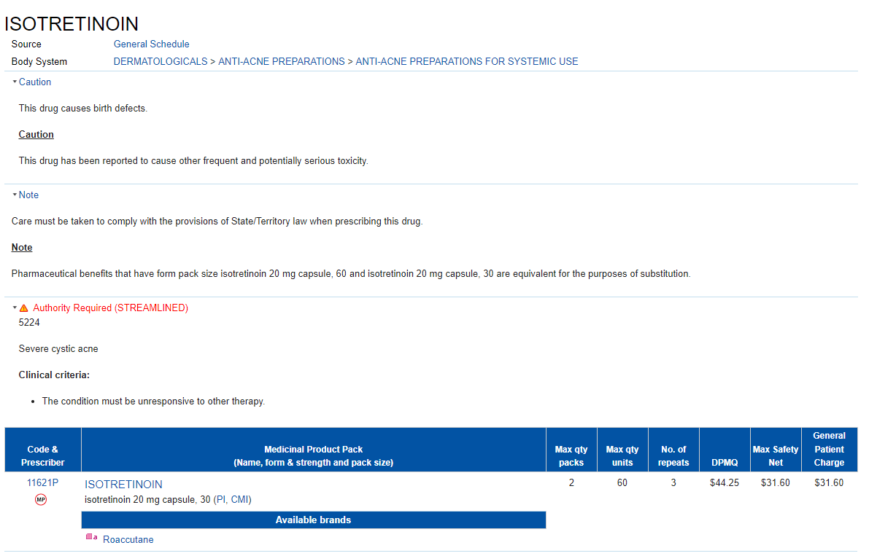
PBS API – restrictions
Known V3 model issues
eg 11621P_7851_391_46688_46709
/Items, caution_indicator = Y and note_indicator = Y
/item-restriction-relationships
5224_5224_R Benefit type S, restriction_indicator Y
23291_N Benefit type S, restriction_indicator N
Where is the Caution - Part of the 5224_5224_R
/restrictions
5224_5224_R caution_indicator = N and note_indicator = N
23291_N authority_method = Null, caution_indicator = N and note_indicator = Y
/prescribing-texts
5224_5224_R 14511 Caution, 14512 Caution, 14507 INDICATION, 14509 Criteria , 13099 ADMINISTRATIVE_ADVICE
23291_N – 23291 Admin advice

Slide 15
PBS API - Authority
/Restrictions endpoint, the schedule_html_text contains incorrect formatting and data.
Contains basic HTML text.
Know issue. Within the /restrictions API endpoint, the SCHEDULE_HTML_TEXT contains incomplete information . These fields combine both Schedule and LI text information.
For information on how to combine restriction elements refer to PBS DDS - Piecing together restriction fragments V1.1.docx on the Knowledge Articles page.
Some of the confusion may be fixed by upcoming proposed changes in a new '/item-overview' or '/item-restrictions-overview' endpoint.
What would be most useful?

Slide 16
PBS API – restrictions
Any other general questions?

Slide 17
API data to PBS text files
Please be aware that the Department does not endorse the current text files
The current text files are no longer fit for purpose, they have become an over-simplification of the PBS.
The API has been developed with a view that different end users can seek to obtain only the data they specifically need (e.g. prescribers might not need pricing information but need to access other information for the purpose of prescribing).
New documentation with better SQL matching outputs to the current text files will be published soon. Please note that these SQL queries are for reference purposes only to help identify relationships between text files and the API data. Not designed to be use as your end product solution.
Some show differences due to extra white spaces in the middle or at the end of sentences. This issue is consistent with the PBS data, where spaces or returns are displayed as spaces.

Slide 18
PBS Text File -> API Mapping Information Summary
Text File Name | Readiness Status and Key Differences
AMT | Status :- In Progress Current text file will be available until issues are resolved. We have identified an issue in the following text file columns: tpp_pt – Content does not exist in the API for Non-AMT. cemp-tpp (Proportional Published Ex-Manufacturer Price)– Content does not exist in the API. tpuu_id – Content does not exist. 2. PFDI is not in API data. From 1 July 2020, the Premium-free Dispensing Incentive (PFDI) was discontinued, with funding reallocated to other 7CPA components including the significant increases to the dispensing fee, AHI and dangerous drug fee.
ATC | Status :- Complete Testing has been completed. The extracted text files and API data show differences due to extra white spaces in the middle or at the end of sentences. This issue mirrors the PBS data, where spaces or returns are displayed as spaces.
Manufacturer data | Status :- Complete The extracted text files and API data show a formatting difference in the mnfr-telephone column. The API data includes the country code, which is consistent with the PBS data.
Continued Dispensing (CD) | Status :- Complete All columns and data are matching between the text files and the API result-set.
Medication Chart | Status :- Complete All columns and data are matching between the text files and the API result-set.
Prescriber Type | Status :- Complete The extracted text files and API data show differences in the drug name text in a few cases.

Slide 19
PBS Text File -> API Mapping Information Summary
Text File Name | Readiness Status and Key Differences
Drug data | Status :- In Progress 80% of the results are matching the query. We are reviewing the business rules to identify the correct values. In the drug text files, fields like mp-pt have an 80-character length limit, but the API is displaying the full content without truncation. sample data in text for mp-pt column :- amino acid synthetic formula supplemented with long chain polyunsaturated fatty api response it displays :- amino acid synthetic formula supplemented with long chain polyunsaturated fatty acid Truncated drug name have caused issues with prescribers and dispensers in the past. Manufacture price to Pharmacy – Investigation underway API is NULL for infusibles and Extemp. Equals the commonwealth price to pharmacy ? mp-pt differences for RPBS - Investigation underway
Fees | Status :- In Progress Current text file will be available until issues are resolved.
Safety Net | Status :- Complete All columns and data are matching between the text files and the API result-set.
Pharmacy PBS Item Table | Status :- Complete All columns and data are matching between the text files and the API result-set. We are not considering those records from Pharmacy PBS Item Table Txt file which contains end-date.
Authorities Restrictions | Status :- Complete The extracted text files and API data show differences due to extra white spaces in the middle or at the end of sentences. This issue is consistent with the PBS data, where spaces or returns are displayed as spaces.
Restriction Extract (Delimited/Fixed) | Status :- Complete There are two restriction text files, Fixed and Delimited, but only one example is provided. The main difference noted is that the misc-flag column exists in the text file but not in the API result-set.

Slide 20
PBS Text File -> API Mapping Information Summary
Text File Name | Readiness Status and Key Differences
Link Extract | Status :- Complete All columns and data are matching between the text files and the API result-set where data is available. The following fields will not be displayed in the API response: increase-code – not re-creatable. start-date – restriction start date will be added soon. end-date – when it stops being in the data is when it ends.
Note extract | Status :- Complete The extracted text files and API data show differences with spacing between or at the end of text in sentences. This issue is consistent with the PBS data, where spaces or returns are displayed as spaces.
Caution extract | Status :- Complete All columns and data are matching between the text files and the API result-set.
streamlined.txt | Status :- Complete All columns and data are matching between the text files and the API result-set.
Control Text | Status :- Rejected The control.txt file is solely for extracting text, and if a publication date is needed, it can be retrieved through the schedule endpoint. The control.txt file has now been removed.
Dispensing Incentive Items (DI) | Status :- Rejected From 1 July 2020, the Premium-free Dispensing Incentive (PFDI) was discontinued.

Slide 21
Discussion

