Slide 1
PBS API Software Vendor Webinar
General Overview and updates
Pull quote
Thank you for joining, this webinar will begin at 11 AM,
22 October 2024
www.health.gov.au

Slide 2
Acknowledgement of Country
We acknowledge the Traditional Custodians of country throughout Australia and their connections to land, sea and community. We pay our respect to their Elders past and present and extend that respect to all Aboriginal and Torres Strait Islander peoples today.

Slide 3
Before we begin…
Please turn off your webcam
Please mute your microphone unless speaking
Any questions? Email HPP.Support@health.gov.au

Slide 4
Agenda
General Overview and updates
Introduction
Update on project.
Rollcall
Can all companies please email MSIA - medications@msia.com.au
Company name (API registration)
Software name
Software type (eg dispensing, prescribing, hospital)
Representatives present here today
Best contact number

Slide 5
Agenda
General Overview and updates
API
Discuss API versions
Access renewal update
v3 API changes
PBS Public data API
Discussions
Q & A

Slide 6
PBS API
Update
Thanks for giving us time to evaluate the feedback and derive a new plan.
The Department is modernising the consumption and data distribution model for the monthly PBS Schedule data, in order to:​
Improve accessibility to PBS Schedule data; ​
Make the data easier to understand and use in software; and​
Improve data latency and data provision through best practice architecture.
All current forms of PBS Schedule data will continue to be available as long as there are key fixes being implemented. There will be at least three months' notice of discontinuation once the API is stable.
PDF Schedule and SOC - Will continue to be available in PDF form ongoing https://www.pbs.gov.au/browse/publications or under embargo.

Slide 7
PBS API
Supporting resources that have been updated
An updated guide that explains the process for converting API data to PBS text files
An updated data dictionary and data model for the API
Data dictionary content can also be found within the Developer portal containing the OpenAPI Definitions: https://data-api-portal.health.gov.au/api-details#api=pbs-prod-api-public-v3

Slide 8
PBS API
API versions/Version Control
V3 is the current version. API catalogue - https://data-api-portal.health.gov.au
Currently Only Major Version tracking is enabled within the current system, no minor/patch revisions are tracked with any changelog information.
A Major Version Increment will only be made when it will enforce a breaking change in the current latest version. This includes Data Type Modifications, Endpoint/Field Removals, Endpoint/Field Renaming, Enforcing/Restricting existing functionality, etc. This does not include Additions of endpoints/fields, positional changes in the field responses or data available within the fields.
When a Major version is released, the previous version will be available for an agreed period of time in parallel of the new major version being available.
Question for Vendors: Can we remove API V1-beta and V2-beta? If yes, when will be the good time to remove it?

Slide 9
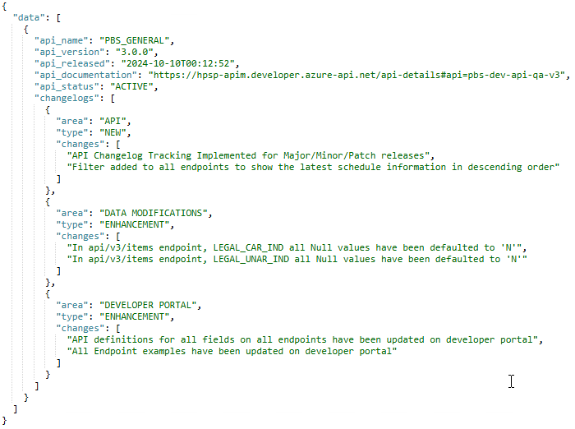
PBS API
API versions/Version Control – Change Tracking Upcoming Release.
New API Endpoint at the root url of the api Version (i.e. /pbs/api/v3)
This will contain information around:
Current Release Version
Release Date
Status
Active – Currently Active release available and recommended to use.
Deprecated – Deprecated Release, Data available but not recommended.
Historical – Change Information only, specific release not available.
Changes grouped by area/type
Type – New/Enhancement/Fix
Area – Dev Portal/API Fields/Data

Slide 10
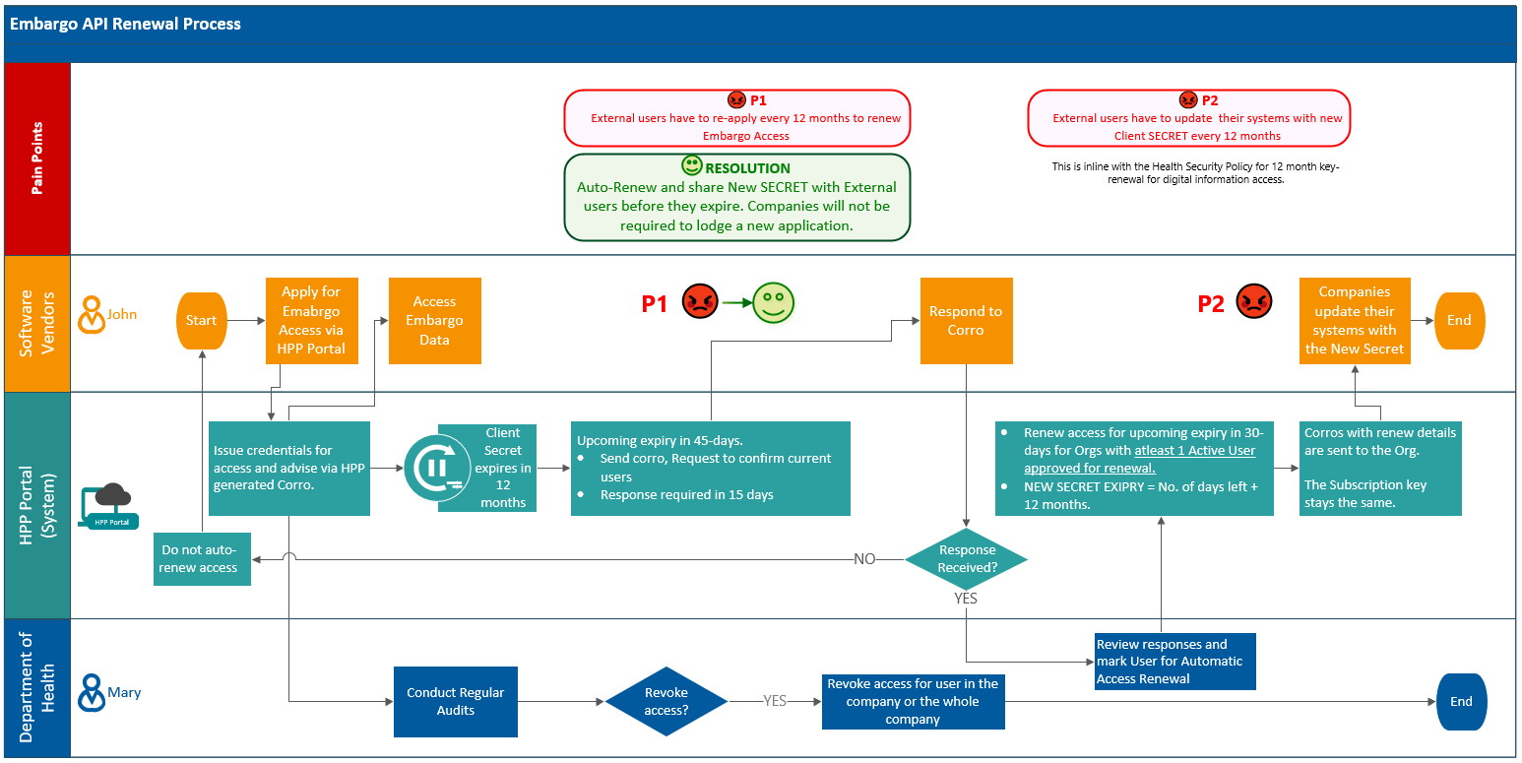
Embargo API Access Renewal
Companies will no longer need to re-apply for access renewal-if they confirm which users need to retain access beforehand
Updated Process below; the communication will be managed via Corros. Expect this solution to be in-place before the end of the year.

Slide 11
PBS API – Future Releases
Next week - “SOC INNOVATOR_INDICATOR” bug – By Wednesday COB.
Future release (Date: TBC)
New (For V3 only)
New Column changed_endpoint added to Summary of Changes
New column first_listing_date added to the restrictions table
Schedule endpoint : Get latest schedule in newest to oldest format
New filter added to all endpoints to show the latest schedule information only
API Changelog Tracking Implemented for Major/Minor/Patch releases
Data Modifications (Data Enhancement)
In api/v3/items endpoint, the values in weighted_avg_disclosed_price column has been changed to NULL.
In api/v3/amt-items endpoint, exempt_ind all Null values have been defaulted to 'N'
In api/v3/items endpoint, pack_not_to_be_broken_ind all Null values have been defaulted to 'N' for EP Program items. All other program items have been defaulted to Y
In api/v3/items endpoint, Determined_qty all Null values have been defaulted to 'N'
In api/v3/items endpoint, safety_net_resup_rule_cnt_ind all Null values have been defaulted to 'N'
In api/v3/items endpoint, continued_dispensing_flag all Null values have been defaulted to 'N'

Slide 12
PBS API - Future Releases
Data Modifications (Data Enhancement)
In api/v3/items endpoint, continued_dispensing_emergency all Null values have been defaulted to 'N'
In api/v3/items endpoint, originator_brand_indicator all Null values have been defaulted to 'N'
In api/v3/items endpoint, water_added_ind all Null values have been defaulted to 'N'
In api/v3/items endpoint, policy_applied_bio_sim_up_flag all Null values have been defaulted to 'N'
In api/v3/items endpoint, policy_applied_imdq60_flag all Null values have been defaulted to 'N'
In api/v3/items endpoint, policy_applied_imdq60_base_flag all Null values have been defaulted to 'N'
In api/v3/items endpoint, policy_applied_indig_phar_flag all Null values have been defaulted to 'N'
In api/v3/items endpoint, legal_unar_ind all Null values have been defaulted to 'N'
In api/v3/items endpoint, legal_car_ind all Null values have been defaulted to 'N'
Any reference to res_code 9999_9999_R and prescribing_txt_id 119998, 119997 has been removed from item-restriction-relationships, restrictions, restriction-prescribing-text-relationships and prescribing-texts tables
If a given item has a 'therapeutic_exemption_indicator' value of 'Y'/true in the api/v3/items endpoint, then within the 'Item-Dispensing-Rule-Relationships' endpoint, the special_patient_contribution, brand_premium and therapeutic_group_premium columns is set to '0.00'.

Slide 13
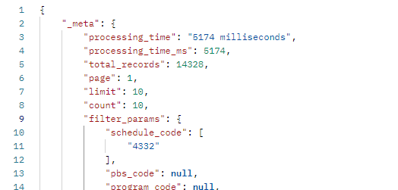
General updates and FQAs
How do I know I have all the records?
Pagination Documentation on api.gov.au :
https://api.gov.au/sections/pagination.html

Slide 14
Known Issues for Future Roadmap
AMT V4 Updates, AMT TPUU Content & Non-AMT Codes
AMT V4 + Providing TPUU Content Work in Development.
Current Process to obtain Non-AMT Codes:
Currently the DOHA Non-AMT Codes can be derived by concatenating the string, the DOHA AMT Namespace code (100014410) and the check sum digit using Verhoff's Algorithm - https://confluence.ihtsdotools.org/display/DOCRELFMT/6.4.2+Check-digit+Computation e.g. Concat(51303, 100014410, VerhoeffChecksum(Concat(51303, 100014410))) = 513031000144104
- li_item_id -
PBS_code, PIG ID, MP, MPP, TPP (PBS IDs)
- pbs_item_id
Examples Provided within the text file to API mapping document.
This will be available in a future release, Date TBC.

Slide 15
Known Issues for Future Roadmap
Incorporate the copyright statement into the API
On every endpoint within the _meta element response within the request.
Embargo files disappearing
Restriction text HTML updates
Please send through other suggestion for improvements to HPP.Support@health.gov.au

Slide 16
API data to PBS text files
Please be aware that the Department does not endorse the current text files
The current text files are no longer fit for purpose, they have become an over-simplification of the PBS.
The API has been developed with a view that different end users can seek to obtain only the data they specifically need (e.g. prescribers might not need pricing information but need to access other information for the purpose of prescribing).
New documentation with actual matching outputs to the current text files is now available.

Slide 17
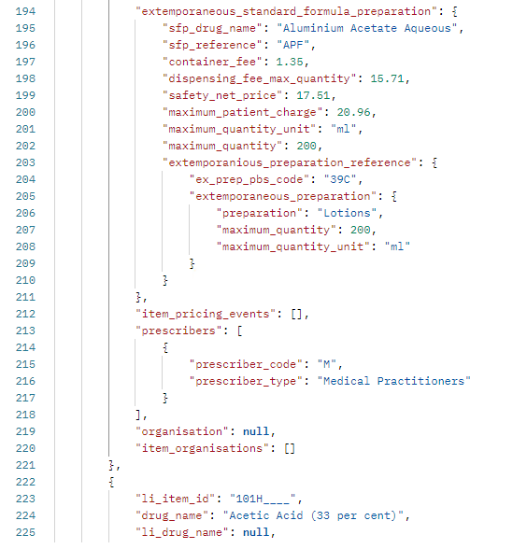
Discussion on potential improvements
Potential new endpoint
Item overview endpoint – Return consolidated Item code information. JSON only due to the structure.
Example in NotePad is available Data Distribution Project | PBS Data
Would something similar in CSV be useful?
Similar to Text files

Slide 18
Prescribing changes - summary
To be discussed in a separate session
Restriction changes and questions
Restriction enhancements - add start date, rendering of text, ordering of components
Text file difference explained
Authority Required - comply with written Authority - FULL flag
Legal CAR and UNAR
Issue is with the Restriction Text field being inserted into the SUMMARY_OF_CHANGES_T
Restrictions endpoint, the schedule_html_text contains incorrect formatting

Slide 19
Dispensing changes - summary
To be discussed in a separate session
Pricing changes and questions
Price enhancement – add markup code and amount, add Max patient contribution, fix Therapeutic goods premium and special patient contribution calculations, remove all values in weighted average disclosed price column, enhance Item dispensing rule relationships
Hospital discount co-payment amounts.
DPMQ of the brand with the brand premium
Markups
dispensing_rule_mnem
cp2p and cdpmq value - DETERMINED_PRICE gives us the value for cemp_tpp and CLAIMED_PRICE gives us the value for memp_tpp
Container_WholeSaler

Slide 20
Discussion and reminder of rollcall.
Rollcall​
​
Can all companies please email MSIA - medications@msia.com.au ​
Company name (API registration) ​
Software name ​
Software type (eg dispensing, prescribing, hospital) ​
Representatives present here today ​
Best contact number​

