Slide 1
PBS Software Vendor
Webinar
The PBS Data API data model
Pull quote
Thank you for joining, this webinar will begin at 2.00pm,
24 July 2023
www.health.gov.au

Slide 2
Acknowledgement of Country
We acknowledge the Traditional Custodians of country throughout Australia and their connections to land, sea and community.
We pay our respect to their Elders past and present and extend that respect to all Aboriginal and Torres Strait Islander people on this webinar today.

Slide 3
Before we begin…
Please turn off your webcam
Please mute your microphone unless speaking
Any questions? Email HPP.Support@health.gov.au

Slide 4
Agenda
PBS Data Distribution Project model background and derivation
Introduction to the API data model
Schedules
Items
Dispensing and Prescribing Rules
Restrictions
Summary of Changes

Slide 5
PBS Data Distribution Project
Background
The Department of Health is modernising the consumption and data distribution for the monthly PBS Schedule data.
To achieve this, it was decided to revisit the underlying XML/Text file distribution system and deliver the data in a more relational format via the use of an API.
The data was remodelled into a relational data model, and a series of endpoints designed to deliver the data for each entity/table in the model.
As per standard modelling rules; data lives in its most natural location, with associative tables resolving any many-to-many relationships, and reference tables used to reduce redundant storage.

Slide 6
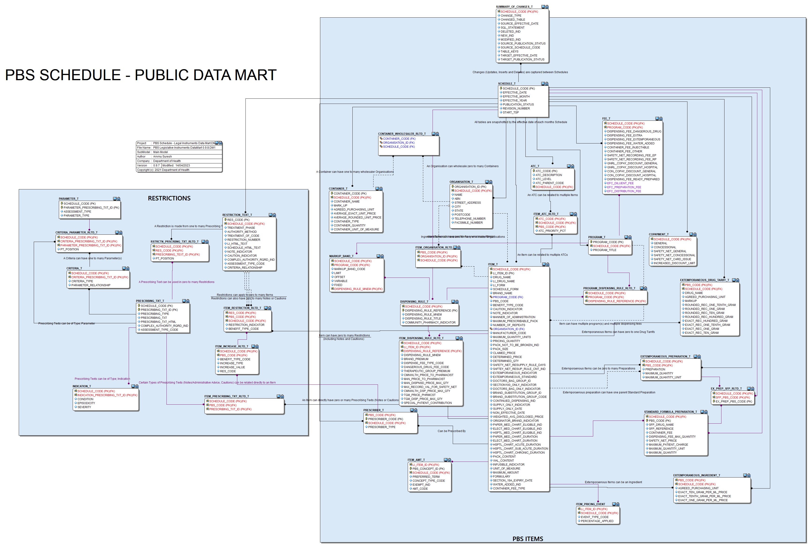
Notes:
NOTE: Share a hi-vis version of this model in the Chat

Slide 7
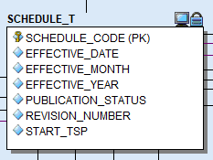
PBS Data Distribution Project
Data Model – Schedule Table
The data model has been designed to act as a repository of data, rather than a transactional or operational database. It is recommended that the endpoint responses be loaded into a local repository for interrogation and use.
The Schedule table is the main controlling entity, and every table can be segmented into data specific to the relevant schedule.
The Schedule Code is then used as part of the Primary Key of all child tables across the model.
The table stores the Schedule Code, with the effective dates and publication status.
The status itself is used to indicate whether the current Schedule is under embargo.
Notes:
Explain the Schedule Code is simply a number assigned to give uniqueness to that slab of data.

Slide 8
PBS Data Distribution Project
Data Model – Schedule Table
Notes:
Explain the Schedule Code is simply a number assigned to give uniqueness to that slab of data.

Slide 9
PBS Data Distribution Project
Data Model – Domains
Even though it still looks complex, the model has been designed to deliver data in two main domains:
Items – the data related to the PBS Items themselves
Restrictions – the data related to the rules used for the prescribing of PBS Items

Slide 10
PBS Data Distribution Project
Data Model – Item Domain
The Item table holds data at the Trade Product Pack (TPP) AMT level:
One record per Drug, Form and Brand. Both Ready Prepared and Extemporaneous items are stored in this table
An identifier (LI_ITEM_ID) has been added to the table to force a single unique identifier onto the records. LI_ITEM_ID is a concatenation of the PBS_CODE; PIG_ID (Pharmaceutical Item Group); MP_ID; MPP_ID and TPP_ID
Much of the data then relates to the Item records using established relationships, i.e. Dispensing Rules; Extemporaneous Items; Prescribers; etc.
Various reference tables are also included such as Fees; Program; Markup Band; Container; Organisation; etc.
Notes:
PIG is used as an internal ID in PharmCIS. Note: Show the Item part of the model as you walk through this bit. May also need to ask questions for both this slide and the next

Slide 11
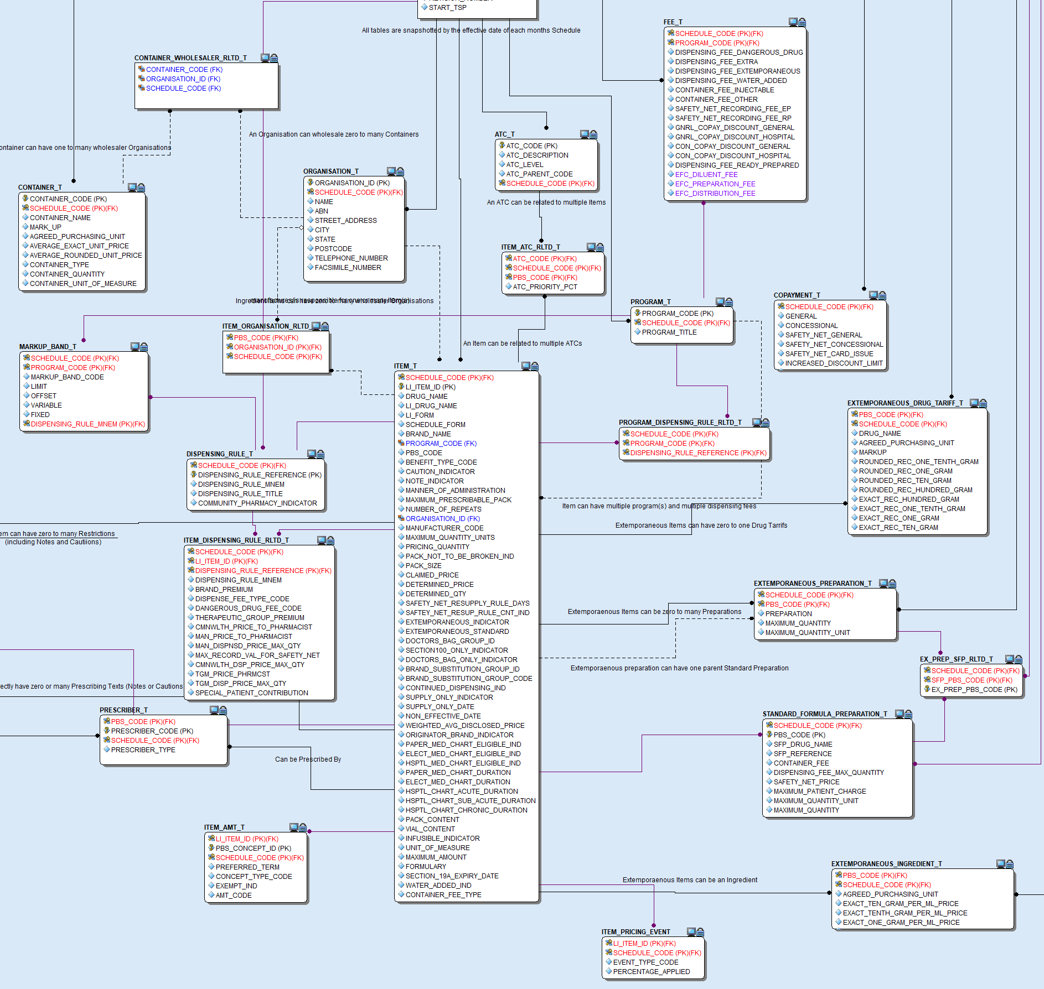
Item Domain
As an example:
Additional data relating to Extemporaneous Items can be found in the tables marked in Green;
Data relating to Dispensing Rules is marked in Blue.
Notes:
PIG is used as an internal ID in PharmCIS. Note: Show the Item part of the model as you walk through this bit. May also need to ask questions for both this slide and the next

Slide 12
PBS Data Distribution Project
Data Model – Restrictions domain
Anybody who has attempted to piece together the Restrictions using the XML would understand the complexity. With this in mind, the Restrictions domain has been designed to deliver the data in the most effective way possible. Restriction data is delivered in two ways:
The fully formed Restriction text is found in the Restriction endpoint;
With the fragmented text, as found in the XML currently, located in the Prescribing Text endpoint.
A document has been included on the HPP Website that delves deeper into the Restrictions and explains how to use the data model to piece together a complete Restriction using the fragments as delivered through the endpoints.
Notes:
Note: Show the Restriction domain part of the model. Possibly show the data from the Restriction text and from the Prescribing Text.
Show the document/KBA for the Restriction stuff.

Slide 13
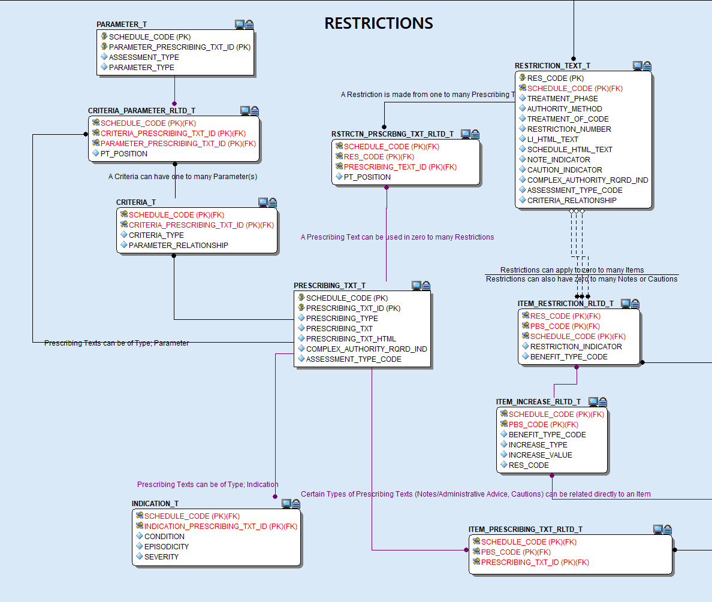
Restrictions domain
The Restriction text table holds both the full text for the Schedule version and Legal Instrument version of a restriction in marked-up format ready for display through rich text field.
Using the Restriction_Prescribing_Rltd table, the fragments can be identified. These are available in raw text and markup versions.
Further granular info is available through the Indication and Criteria tables.
Notes:
Note: Show the Restriction domain part of the model. Possibly show the data from the Restriction text and from the Prescribing Text.
This is probably a little too complex to examine now, so I’ve written a document that goes through the process.

Slide 14
PBS Data Distribution Project
Data Model – Summary of Changes
To assist Users with consuming the data available in the API, a Summary of Changes endpoint has been included which contains a catalogue of all Inserts, Deletes, and Updates to the previous schedule.
Each record includes the source Schedule Code; the affected Entity; the type of change (i.e. Insert, Update, Delete), the Keys used to form the “Where” clause; and the actual SQL Statement;
The SQL Statements themselves can be used to apply all changes against the previous Schedule data to create the new Schedule.
SOURCE SCHEDULE CODE | CHANGED TABLE | CHANGE TYPE | TABLE_KEYS | SCHEDULE CODE
3651 | ITEM_T | UPDATE | "SCHEDULE_CODE":"3675","LI_ITEM_ID":"10620Y_20518_375_39453_39459" | 3675
3651 | ITEM_T | UPDATE | "SCHEDULE_CODE":"3675","LI_ITEM_ID":"9356K_11492_1310_5739_6966" | 3675
3651 | ITEM_AMT_T | DELETE | "SCHEDULE_CODE":"3675","PBS_CONCEPT_ID":"38398","AMT_CODE":"","LI_ITEM_ID":"10693T_17636_143_38396_38398" | 3675
3651 | ITEM_AMT_T | DELETE | "SCHEDULE_CODE":"3675","PBS_CONCEPT_ID":"38400","AMT_CODE":"","LI_ITEM_ID":"10683G_17643_38400_38403_38405" | 3675

Slide 15
PBS Data Distribution Project
Data Model – Summary of Changes – Example
Below is the SQL Statement from an Item insert that occurred for Schedule 3651, and the Table_Keys entry, which in this case shows the Schedule Code, and the LI_ITEM_ID for the new record.
INSERT INTO ITEM_T VALUES (''3675' , '12979D_9505_1344_5821_56349' , 'lenalidomide' , 'Lenalidomide' , 'Capsule 25 mg' , 'lenalidomide 25 mg capsule, 21' , 'Lenalidomide Viatris' , 'HB' , '12979D' , 'A' , 'Y' , 'Y' , 'ORAL' , '1' , '21' , '2' , '142' , 'AF' , '21' , '14' , 'N' , '2397.21' , '1598.14' , 'N' , '20' , 'N' , 'N' , 'null' , 'null' , 'Y' , 'N' , 'null' , 'null' , 'N' , 'N' , 'null' , 'null' , 'null' , 'N' , 'N' , 'N' , 'Y' , 'null' , 'null' , '12' , '12' , '12' , 'null' , 'null' , 'N' , 'null' , 'null' , 'F2' , 'N' , 'null' , 'other’);
TABLE_KEYS: "SCHEDULE_CODE":"3675","LI_ITEM_ID":"12979D_9505_1344_5821_56349"
Notes:
An example SQL Statement

Slide 16
PBS Data Distribution Project
Data Model – Summary of Changes – Embargo
Prior to publishing, the Schedule data may be revised several times whilst still under Embargo. This results in new Schedule Codes being assigned to the revised Schedules, and a new Revision number being assigned to the record.
Revised Schedules may appear in the data during the Embargo period, but previous revisions will be removed once the Schedule is published.
The Summary of Changes will also reflect this via the Source Schedule Code and Schedule Code fields indicating which set of data the changes should be applied to.
Notes:
An example SQL Statement

Slide 17
PBS Data Distribution Project
Data Model – Summary of Changes – Embargo Schedules
Notes:
As an example. During July there were four revisions of the data. Whilst July was in Embargo, those revised Schedules were available to download, each superseding the previous Schedule, but once the data was Published only 3751 was available.
The takeaway is that during the Embargo period, the data can be volatile. If a new revision appears for August, then the Schedule Code will change and the revision number will be incremented.

Slide 18
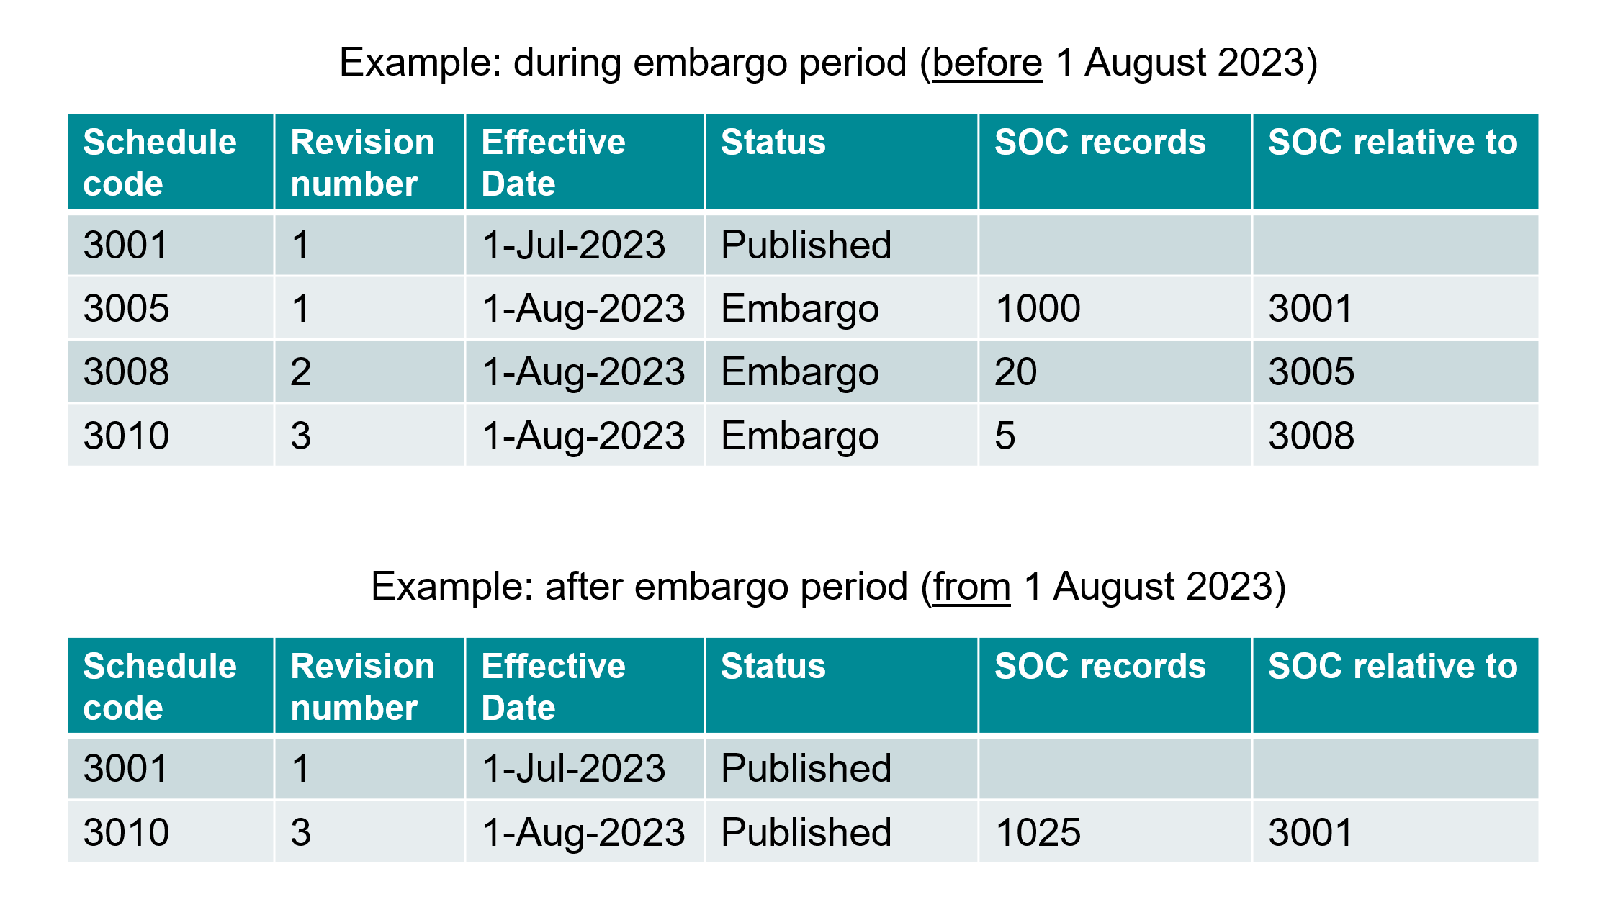
PBS Data Distribution Project
Data Model – Summary of Changes – Embargo Schedules
Notes:
As an example, this could be what is seen over the Embargo period, with final Published versions of the Schedules resolving as seen at the bottom of the slide.

Slide 19
PBS Data Distribution Project
Data Model – Documentation
To assist Users with downloading and using the API endpoint data, several documents can be accessed from the HPP website.
API (data dictionary and database diagram): HPP Article Details · API Data Dictionary
Restrictions: Piecing together Restrictions fragments

Slide 20
PBS Data Distribution Project
Comparisons to the existing download methods
The data held in the API has been aligned closely with the XML and an internal reporting system checks the veracity of the API data against the expected XML outputs to maintain this.
The text files are based on the XML and due to the number of Users still accessing the text files, a task is underway to map the API data to the text file data and provide guidance on how to recreate the text files from the API endpoint data.

Slide 21
Resources
Project page: Data Distribution Project | PBS Data
API (data dictionary and database diagram): HPP Article Details · API Data Dictionary
Restrictions: Piecing together Restrictions fragments
Any feedback during the public beta can be provided
via email to HPP.Support@health.gov.au

Slide 22
Questions?
Any feedback during the public beta can be provided
via email to HPP.Support@health.gov.au

