Slide 1
Health Products Portal
Webinar
Software Vendor API access
Pull quote
Thank you for joining, this webinar will begin at 3.00pm,
13 November 2023
www.health.gov.au

Slide 2
Acknowledgement of Country
We acknowledge the Traditional Custodians of country throughout Australia and their connections to land, sea and community. We pay our respect to their Elders past and present and extend that respect to all Aboriginal and Torres Strait Islander peoples today.

Slide 3
Before we begin…
Please turn off your webcam
Please mute your microphone unless speaking
Any questions? Email HPP.Support@health.gov.au

Slide 4
Agenda
Introduction
PBS Data Distribution Project background and timeline
Applying to access the API
Signing into the HPP
Lodging a 'Request access to PBS embargo data API' form

Slide 5
PBS Data Distribution Project
Background
The Department of Health is modernising the consumption and data distribution model for the monthly PBS Schedule data, in order to:
Improve accessibility to PBS Schedule data;
Make the data easier to understand and use in software; and
Improve data latency and data provision through best practice architecture.
Timing
The project started in 2019, and conducted a series of working group meetings in 2020-21
A Private Beta with a small group of vendors was held in late 2022
A Public Beta was held between June and October 2023

Slide 6
PBS Data Distribution Project
The Department is working to the following timeline
From November 2023, the API is a production system. Vendors are encouraged to commence their transition.
February 2024 will be the last PBS schedule for which data in existing formats will be released under embargo.
From the March 2024 PBS schedule onwards, data released under embargo will be made available only via the API.
A version of the API for use by the general public is also in development. This API will be made available in early 2024.

Slide 7
PBS Data Distribution Project
We want to work collaboratively with all stakeholders to establish a timeline that is realistic and mutually acceptable
The Department acknowledges that this timeline may be difficult for some embargo data users to meet, for a range of reasons. The Department invites individual organisations in this situation to provide the following information by to the Department:
The circumstances that prevent your organisation from achieving the published timeline
A proposed timeline that your organisation could achieve the transition by
The logic behind your proposed timeline, such as a high-level schedule of activities
Please provide feedback by email to hpp.support@health.gov.au by Thursday 23rd November.

Slide 8
PBS Data Distribution Project
Supporting resources that are available
Sample data from the API, for developers to familiarise themselves with the format
A guide (33 pages) that explains the process for converting API data to PBS text files
A guide (24 pages) that explains how PBS restrictions work, in the API
A data dictionary and data model for the API
https://data.pbs.gov.au/data-distribution/data-distribution.html

Slide 9
PBS Data Distribution Project
User Journeys
Dept. approval
Initial
Get a myGovID
Link to your company in RAM
Register your company in the HPP
Apply for access to the API
Development
(after approval) Receive API credentials
Login to dev. portal (using MyGovID/RAM)
View API documentation
Access your subscription key
Regular
Request a bearer token
Download API data

Slide 10
What can PBS embargo data users do in the HPP?
Manage
Personal profile details
Apply for Embargo data API access
Correspondence to and from the Department

Slide 11
Things to note prior to using the HPP
Before logging into the HPP
Please ensure you are using a recent version of Google chrome or Microsoft edge for optimal performance on the HPP
Your myGovID will need to be of a 'Basic' identity strength and linked to an organisation in RAM

Slide 12
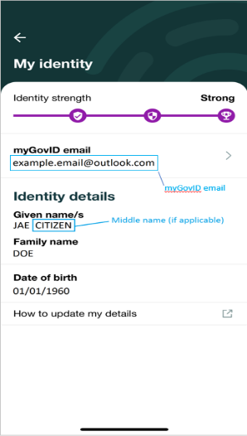
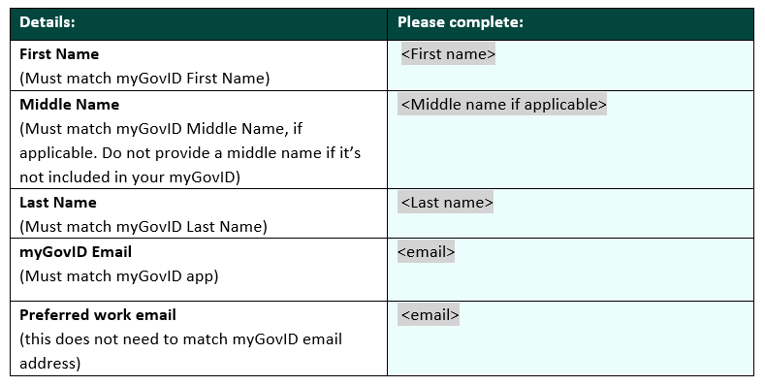
Accessing the HPP
1
Register with myGovID and verify your identity Please note: myGovID is the Australian Government’s Digital Identity app you can use to sign in to a range of participating government online services like myGov and also the HPP.
Provide your myGovID details to your Principal Authority
Click ‘My identity’ which will bring up a screen that looks like the below where you can get the information required for the above table. It is important that all the fields match. Do not provide a middle name if it’s not included in your myGovID
2

Slide 13
Accessing the HPP
Receive communications from Relationship Authorisation Manager (RAM) You will be linked to your company in RAM and will receive an email with a code which will expire in 7 days, follow the instructions in the RAM email.
Sign in to HPP, update your personal profile and register your organisation If your organisation has already been registered, you can request access via the Personalise your Session page.
3
4
These are once-off activities

Slide 14
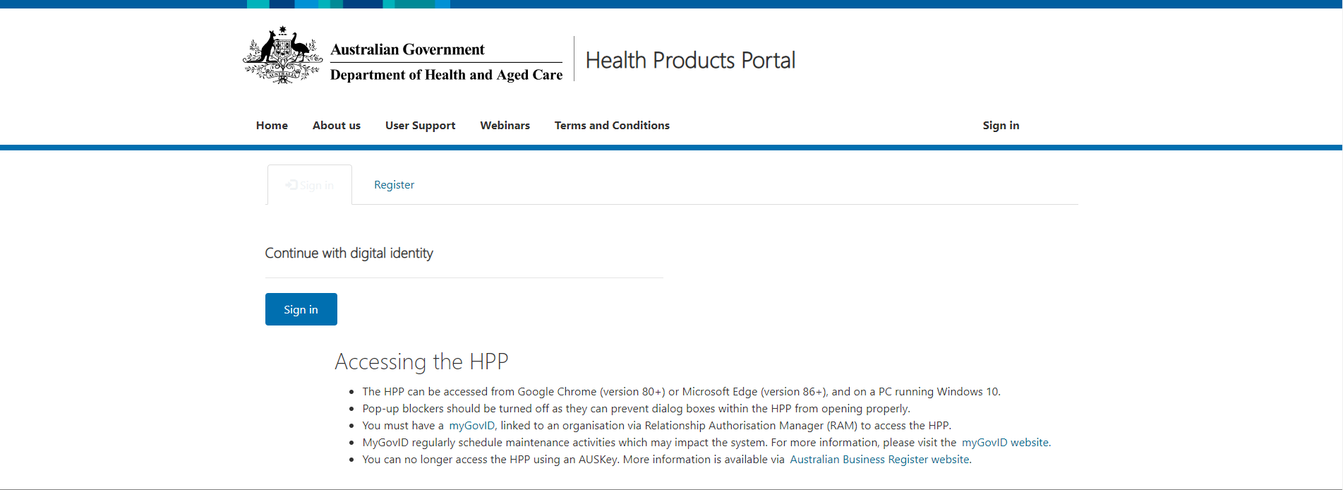
Access the Health Products Portal via https://business.health.gov.au/SignIn

Slide 15
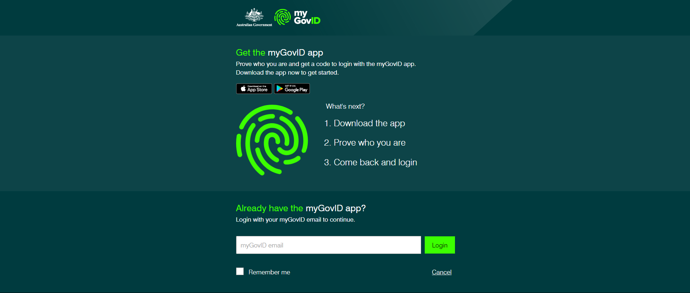
This must match your myGovID email address, not the one registered with Health Products Portal

Slide 16
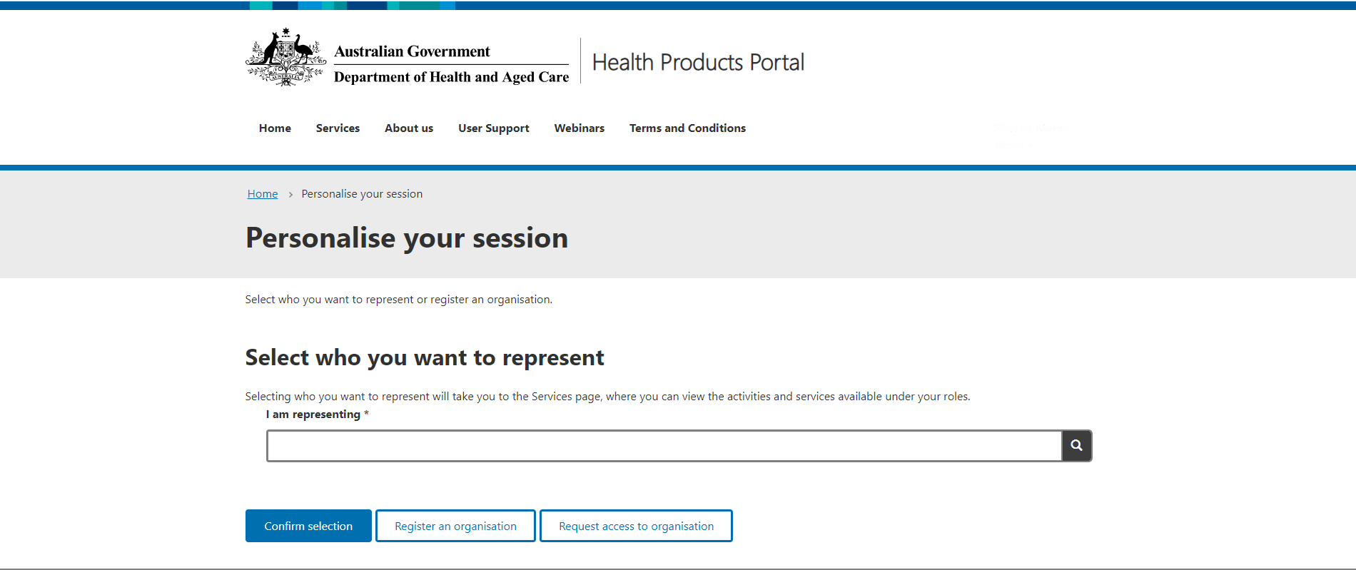

Slide 17
Demonstration

