Slide 1
Health Products Portal
Webinar
Software Vendor API access Public Beta
Pull quote
Thank you for joining, this webinar will begin at 2.00pm,
10 July 2023
www.health.gov.au

Slide 2
Acknowledgement of Country
We acknowledge the Traditional Custodians of country throughout Australia and their connections to land, sea and community. We pay our respect to their Elders past and present and extend that respect to all Aboriginal and Torres Strait Islander peoples today.

Slide 3
Before we begin…
Please turn off your webcam
Please mute your microphone unless speaking
Any questions? Email HPP.Support@health.gov.au

Slide 4
Agenda
Introduction
PBS Data Distribution Project background and timeline
Beta
Signing into the HPP
Lodging a 'Request access to PBS embargo data API' form

Slide 5
PBS Data Distribution Project
Background
The Department of Health is modernising the consumption and data distribution model for the monthly PBS Schedule data, in order to:
Improve accessibility to PBS Schedule data;
Make the data easier to understand and use in software; and
Improve data latency and data provision through best practice architecture.

Slide 6
PBS Data Distribution Project
User Journeys
Dept. approval
Initial
Get a myGovID
Link to your company in RAM
Register your company in the HPP
Apply for access to the API
Development
(after approval) Receive API credentials
Login to dev. portal (using MyGovID/RAM)
View API documentation
Access your subscription key
Regular
Request a bearer token
Download API data

Slide 7
What can PBS embargo data users do in the HPP?
Manage
Personal profile details
Apply for Embargo data API access
Correspondence to and from the Department

Slide 8
Things to note prior to using the HPP
Before logging into the HPP
Please ensure you are using a recent version of Google chrome or Microsoft edge for optimal performance on the HPP
Your myGovID will need to be of a 'Standard' identity strength and linked to an organisation in RAM

Slide 9
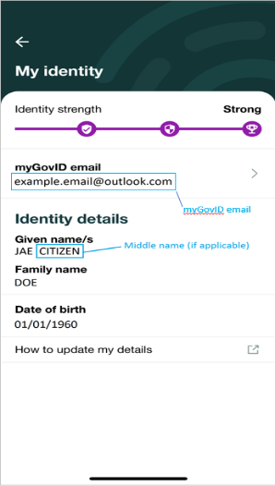
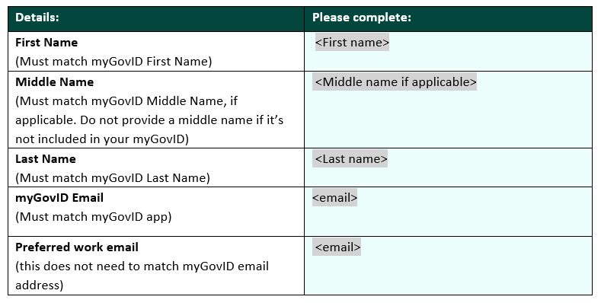
Accessing the HPP
1
Register with myGovID and verify your identity Please note: myGovID is the Australian Government’s Digital Identity app you can use to sign in to a range of participating government online services like myGov and also the HPP.
Provide your myGovID details to your Principal Authority
Click ‘My identity’ which will bring up a screen that looks like the below where you can get the information required for the above table. It is important that all the fields match. Do not provide a middle name if it’s not included in your myGovID
2

Slide 10
Accessing the HPP
Receive communications from Relationship Authorisation Manager (RAM) You will be linked to your company in RAM and will receive an email with a code which will expire in 7 days, follow the instructions in the RAM email.
Sign in to HPP, update your personal profile and register your organisation If your organisation has already been registered, you can request access via the Personalise your Session page.
3
4
These are once-off activities

Slide 11
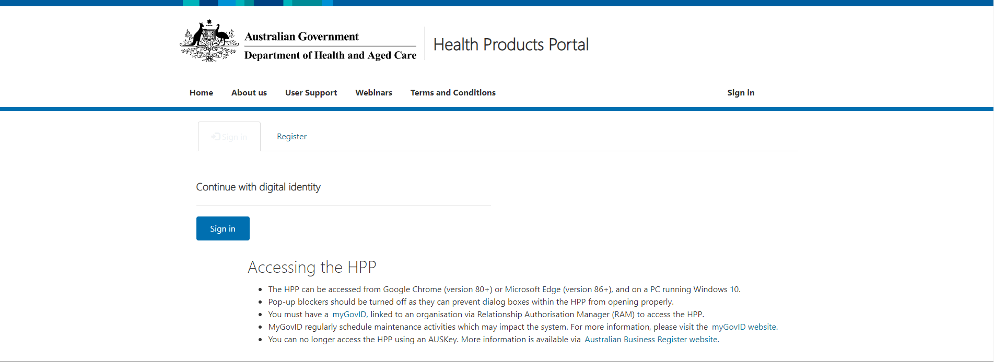
Access the Health Products Portal via https://business.health.gov.au/SignIn

Slide 12
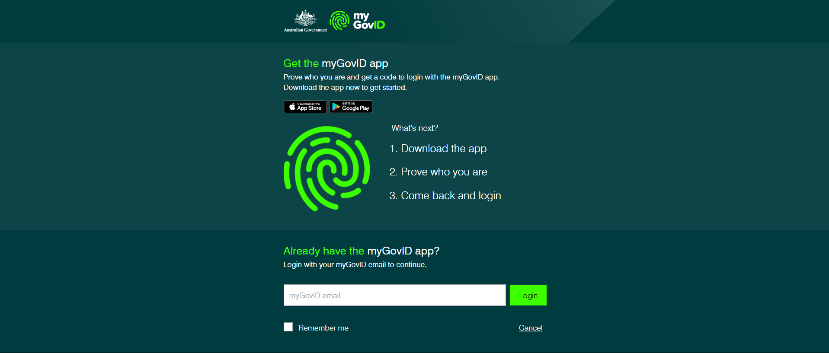
This must match your myGovID email address, not the one registered with Health Products Portal

Slide 13
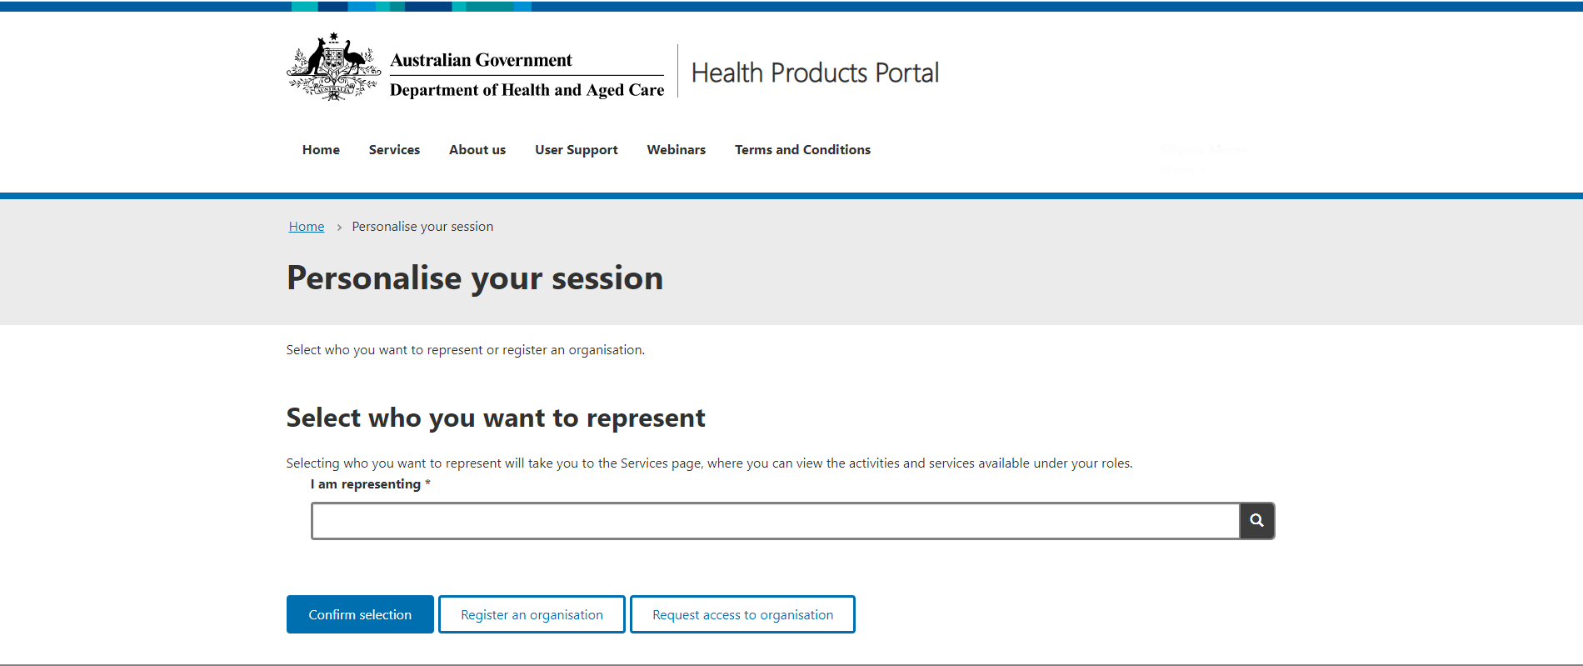

Slide 14
Demonstration

