Slide 1
PBS Software Vendor
Webinar
Introduction to PBS Data API Public Beta
Pull quote
Thank you for joining, this webinar will begin at 2.00pm,
3 July 2023
www.health.gov.au

Slide 2
Acknowledgement of Country
We acknowledge the Traditional Custodians of country throughout Australia and their connections to land, sea and community.
We pay our respect to their Elders past and present and extend that respect to all Aboriginal and Torres Strait Islander people on this webinar today.

Slide 3
Before we begin…
Please turn off your webcam
Please mute your microphone unless speaking
Any questions? Email HPP.Support@health.gov.au

Slide 4
Agenda
PBS Data Distribution Project background and timeline
Introduction to the Public Beta API
Accessing the API
API Features
Components of the API
User journeys to access the API

Slide 5
PBS Data Distribution Project
Background
The Department of Health is modernising the consumption and data distribution model for the monthly PBS Schedule data, in order to:
Improve accessibility to PBS Schedule data;
Make the data easier to understand and use in software; and
Improve data latency and data provision through best practice architecture.

Slide 6
PBS Data Distribution Project
Timeline
The project started in 2019, and conducted a series of working group meetings in 2020-21
A Private Beta with a small group of vendors was held in late 2022
The Public Beta commenced in June 2023 and will finish when the Department is sure that it meets user needs and delivers the full end-to-end user journey
The Department will cease to provide ALL existing forms of data currently distributed to vendors at a point in time to be determined in consultation with Beta participants

Slide 7
PBS Data Distribution Project
Accessing the Public Beta API
Each Software Vendor is provided unique credentials to access the API
Applications to access the API are made through the Health Products Portal https://hpp.health.gov.au/
Note: As the API contains data under embargo, only software vendors or developers with a need to access the embargo data will be given access.
A version of the API (that will contain only public domain data) for use by the general public is being developed

Slide 8
PBS Data Distribution Project
Features of the API
The PBS schedule data has been loaded into a relational database
There is one API endpoint for each table in the database
There is one logical set of data in the API for each combination of PBS item code and Trade Product Pack
Each monthly PBS schedule for the most recent 12 months is in the API
Each month is distinguished in the API by a ‘schedule code’
The ‘schedules’ endpoint in the API has metadata about each schedule code
Each API request can be filtered by schedule code, PBS program and PBS item code
The API is rate-limited to one request per second

Slide 9
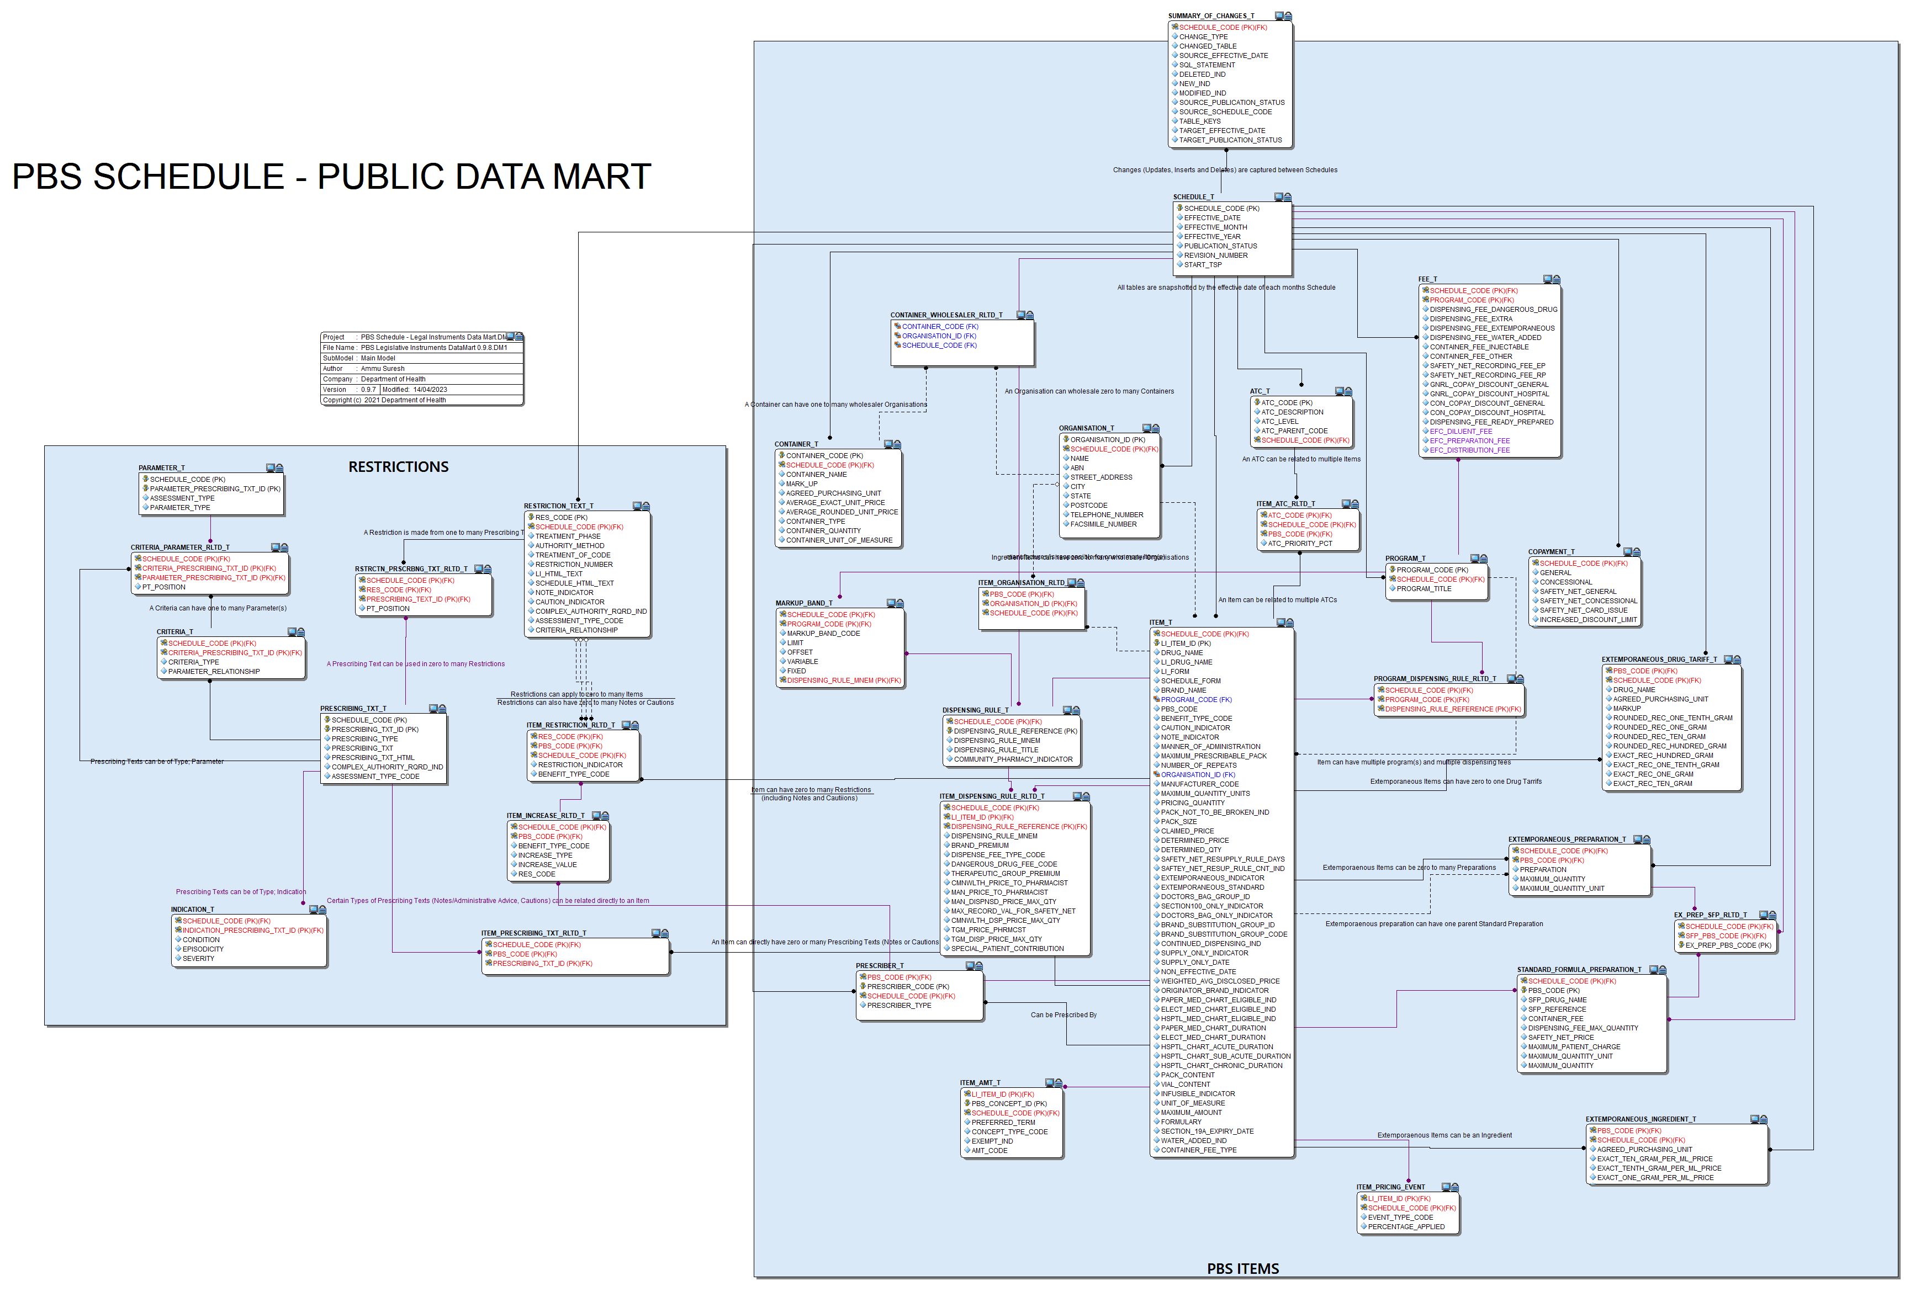

Slide 10
PBS Data Distribution Project
Components of the solution
Health Products Portal
Developer Portal
API
For initial access and annual renewal of credentials
Login with myGovID and RAM
Register your organisation
Request access
(Departmental approval)
Receive API credentials
For development of your solution
Login with myGovID and RAM
Access your subscription key
Browse API documentation
Test endpoints
Sample API queries
For regular downloads of PBS schedule data
Authenticate with API credentials and subscription key
Download schedule data from API endpoints

Slide 11
PBS Data Distribution Project
User Journeys
Dept. approval
Initial
Get a myGovID
Link to your company in RAM
Register your company in the HPP
Apply for access to the API
Development
(after approval) Receive API credentials
Login to dev. portal (using MyGovID/RAM)
View API documentation
Access your subscription key
Regular
Request a bearer token
Download API data

Slide 12
Further HPP training coming soon on:
Using the HPP to register your company and apply for access to the API
Accessing the developer portal and connect to the API
Understanding the PBS data API
https://data.pbs.gov.au/download/90205?filename=Training-Webinars-PBS-Embargo-Data-API-Public-Beta.pdf

Slide 13
Resources
Project page: Data Distribution Project | PBS Data
User guide for accessing the API (including gaining access, FAQ’s, data dictionary and database diagram): HPP Article Details · Health Products Portal
Any feedback during the public beta can be provided
via email to HPP.Support@health.gov.au

Slide 14
Questions?
Any feedback during the public beta can be provided
via email to HPP.Support@health.gov.au

