Slide 1
PBS Developers’ Forum
24th February 2016

Slide 2
Agenda
Welcome/Introduction
Action Items
Discount Copayment
Expanded Safety Net Early Supply Rule
EFC Compounding
Hospital Med Charts
OTC Measure
PBS XML Review
Automated Authorities
AMT v3
PBS XML Schema 3.0
Other Business
Meeting close

Slide 3
Agenda
Welcome/Introduction
Action Items
Discount Copayment
Expanded Safety Net Early Supply Rule
EFC Compounding
Hospital Med Charts
OTC Measure
PBS XML Review
Automated Authorities
AMT v3
PBS XML Schema 3.0
Other Business
Meeting close

Slide 4
Action Items
Health to investigate whether non-AMT concepts should be kept explicitly separate from AMT concepts using the scheme attribute or remove the code and will produce test data for comment
PBS XML v3 distinguishes codes using @rdf:resource
PBS: http://snomed.info/sct/911000144106
AMT: http://snomed.info/sct/32506021000036107
Online discussion posting: no responses

Slide 5
Action Items
Health to investigate whether restrictions on extemporaneous preparations are still required
Yes, for certain items
no indication ⇒ prescriber instruction
Map Drug Tariffs to AMT Substances
Future work

Slide 6
Action Items
Map V2 controlled vocabularies to V3 terminology concepts
Will be done in V3 documentation
pre-production-1 release

Slide 7
Action Items
Health to find out why the PBS Item Code can’t be printed on the script
Can any Community Pharmacy dispense to HS

Slide 8
Action Items
Health to check Markup Bands for Private Hospital dispensing rule
Dispensing rules are correct

Slide 9
Action Items
Health to create PBS XML v2.12 schema test data with the changes injected and distribute to vendors. Coordinate with DHS to load data into the test environment to be available late October
Released 6th October 2015

Slide 10
Agenda
Welcome/Introduction
Action Items
Discount Copayment
Expanded Safety Net Early Supply Rule
EFC Compounding
Hospital Med Charts
OTC Measure
PBS XML Review
Automated Authorities
AMT v3
PBS XML Schema 3.0
Other Business
Meeting close

Slide 11
PBS XML Schema v2.12
Discount Copayment
v2.12 Schema in production 1st December 2015
1st January 2016 Schedule
Issue: can discount be applied to Brand Premium?
A: No, only copayment may be discounted

Slide 12
Agenda
Welcome/Introduction
Action Items
Discount Copayment
Expanded Safety Net Early Supply Rule
EFC Compounding
Hospital Med Charts
OTC Measure
PBS XML Review
Automated Authorities
AMT v3
PBS XML Schema 3.0
Other Business
Meeting close

Slide 13
Early Supply Rule
Expanded Safety Net Early Supply Rule
Expansion of medicines
1 January 2016
Copayment discount cannot be applied to early supply items
Feedback welcome

Slide 14
Agenda
Welcome/Introduction
Action Items
Discount Copayment
Expanded Safety Net Early Supply Rule
EFC Compounding
Hospital Med Charts
OTC Measure
PBS XML Review
Automated Authorities
AMT v3
PBS XML Schema 3.0
Other Business
Meeting close

Slide 15
EFC Compounding
EFC Compounding Fee
Proposed (awaiting approval)
Continue 1 July 2015 arrangement
2 tiers:
$40 in prep fee
+$20 paid direct - TGA licensed
Claim: Compounder ID, Infusion ID

Slide 16
Agenda
Welcome/Introduction
Action Items
Discount Copayment
Expanded Safety Net Early Supply Rule
EFC Compounding
Hospital Med Charts
OTC Measure
PBS XML Review
Automated Authorities
AMT v3
PBS XML Schema 3.0
Other Business
Meeting close

Slide 17
Hospital Medication Charts
March 2016
May 2016
July 2016
March 2017
Trial
Testing
Paper charts
Electronic

Slide 18
Hospital Medication Charts
Trials underway, completed March 2016
Test environment available from May 2016
Paper-based charts start July 2016
Electronic charts start March 2017

Slide 19
Agenda
Welcome/Introduction
Action Items
Discount Copayment
Expanded Safety Net Early Supply Rule
EFC Compounding
Hospital Med Charts
OTC Measure
PBS XML Review
Automated Authorities
AMT v3
PBS XML Schema 3.0
Other Business
Meeting close

Slide 20
OTC Measure
Change to listings for Paracetamol 665mg
1st January 2016 Schedule
Existing script validity unchanged
pre-1 January 2016
Notes:
Raised by George Pavlidis

Slide 21
Agenda
Welcome/Introduction
Action Items
Discount Copayment
Expanded Safety Net Early Supply Rule
EFC Compounding
Hospital Med Charts
OTC Measure
PBS XML Review
Automated Authorities
AMT v3
PBS XML Schema 3.0
Other Business
Meeting close

Slide 22
Agenda
Engagement objective and our task
Background
Our approach
Key findings
Draft Recommendations
Questions

Slide 23
Engagement objective and our task
The key objective of this engagement was:
To provide an independent high-level review of the generation of XML and the consumption of XML by external stakeholders, with the aim of providing recommendations to improve the usability and operability of the transfer of PBS information to stakeholders.
Our task therefore was to undertake an independent high-level review of the generation of PBSXML and the consumption of the PBSXML by stakeholders, with a particular focus on:
Usability;
Interoperability;
Recommended best practice;
Recommendations for improvement of the transfer of PBSXML information to stakeholders;
Potential impact on PharmCIS and publishing windows; and
The impact, size and complexity of XML v3.

Slide 24
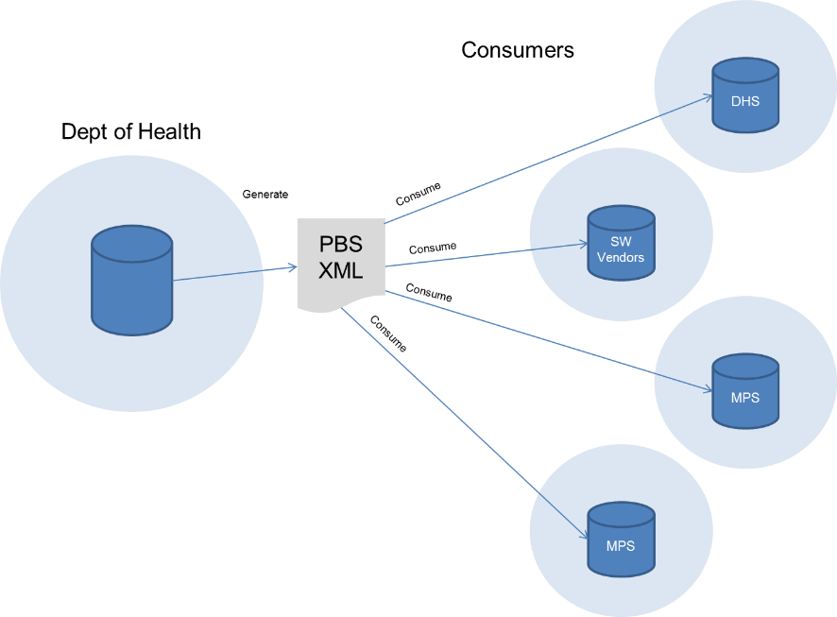
Background
The intent of the PBS XML exchange model is to enable the interchange of data from Health to consumers including DHS and software vendors.

Slide 25
Key Findings
Technology Platform
The PBS XML provides a common, interoperable format for the PBS data to be shared from the Department of Health’s Relational Database in which it is stored, to other consumers, without requiring them to use the same Relational Database system as the Department.
XML is a suitable technology choice for a common format to share monthly PBS data. It provides:
Well adopted, mature technology with widespread tools and support, conforming to industry standards;
A broad technology stack including associated standards for validation and transformation; and
An interoperable format, very suitable to encapsulate data independently from business rules/logic.
The size and complexity of the XML export poses problems for consumers to process the data. This has resulted in a majority of consumers utilising the legacy text file subsets of the data to varying extents, either supplementing the XML data or completely replacing it.

Slide 26
Key Findings
XML v3 Transition
The upcoming major revision of the PBS XML to Version 3 has the potential to cause concern for some consumer groups.
Stakeholder feedback reveals uncertainty about the time frames required to adopt the new schema, particularly given the possibility of no alternative to the XML as per the text files currently offered.

Slide 27
Key Findings
Stakeholder Engagement
There are a number of stakeholder engagement mechanisms utilised to provide updates to stakeholders and consumers, including forums, developer’s website, news email alerts, discussion board and face to face meetings.
Some aspects of community consultation seem strong. However, many consumers are not fully aware of the business reasons behind schema amendments being implemented and are unable to provide their input.
The nature of the data domain, and the different consumer uses of the underlying data, are complex. A certain level of dissatisfaction is to be expected in a common data model with these characteristics.
With no way to assess the implication of change on stakeholders, software communities with a common data model like this need to rely on consultation to assess the impact and cost of change on the community.

Slide 28
Recommendations
Move to XML v3, with additional views
The PBS XML should continue to be developed and refined. PBS XML v3 offers a number of improvements, and should continue design and development.
The legacy text files should be discontinued with XML v3, and replaced with an alternative of subsets or “views” of the PBS XML.
These views should be targeted at specific groups of users; initially it is suggested that views for Prescribing, Dispensing, Publishing and DHS be provided.
The views should not be focused on achieving standards compliance, rather, the simplest possible document to facilitate ease of processing.
These views will provide the optimum balance of consumability, data integrity, and efficiency of development effort.

Slide 29
Recommendations Cont.
Delay the release of XML v3
The implementation of PBS XML v3 should be delayed from May 2016 to December 2016.
This delay is to provide adequate time for some consumer groups to prepare their systems for the new schema.
This time should be utilised by the Department of Health to continue development of a formal transition plan, including time frames for planning, design and implementation, stakeholder impact assessment and implications, and deprecation and decommissioning of XML v2.

Slide 30
Recommendations Cont.
Extend the formal SDLC for PBS XML
The PBS XML should further extend the existing formal Software Development Lifecycle (SDLC), considering all of the following phases; Requirements, Design, Build, Test, Document, Release and Maintain.
Stakeholder engagement should be integrated into this lifecycle at all phases, and a focus should be placed on communication with consumers, with a view to minimising the impact on consumers whilst meeting departmental obligations for changes to the PBS Schedule.
This will improve visibility of the PBS XML business requirements to consumers, ensure that the development of the XML is aligned with strategic and business requirements, and facilitate the assessment and prioritisation of requirements.

Slide 31
Agenda
Welcome/Introduction
Action Items
Discount Copayment
Expanded Safety Net Early Supply Rule
EFC Compounding
Hospital Med Charts
OTC Measure
PBS XML Review
Automated Authorities
AMT v3
PBS XML Schema 3.0
Other Business
Meeting close

Slide 32
Automated Authorities
Department of Human Services initiative
PBS XML will include increase values from May 2016 Schedule

Slide 33
Agenda
Welcome/Introduction
Action Items
Discount Copayment
Expanded Safety Net Early Supply Rule
EFC Compounding
Hospital Med Charts
OTC Measure
PBS XML Review
Automated Authorities
AMT v3
PBS XML Schema 3.0
Other Business
Meeting close

Slide 34
AMT v3
PharmCIS implementation underway
Phase 1
Planned for late February/early March
May 2016 Schedule

Slide 35
AMT v3
Reconcile non-AMT concepts
Post-May-2014
Pre-May-2014

Slide 36
Agenda
Welcome/Introduction
Action Items
Discount Copayment
Expanded Safety Net Early Supply Rule
EFC Compounding
Hospital Med Charts
OTC Measure
PBS XML Review
Automated Authorities
AMT v3
PBS XML Schema 3.0
Other Business
Meeting close

Slide 37
PBS XML v3.0
Working Group
Progress
Schedule
Release Plan
Transition Plan

Slide 38
PBS XML v3.0
Working Group
Small group to develop v3.0
Design feedback
Testing
Feedback

Slide 39
PBS XML v3.0
Working Group
Workshop: 20th November 2015

Slide 40
PBS XML v3.0
Working Group
Action items
1: sample data bug: non-AMT id = AMT id
fixed
2: Consider separate element for non-AMT codes
Question raised in online forum: no response

Slide 41
PBS XML v3.0
Working Group
Action items
3: Add example showing change from non-AMT concept to AMT and reverse
added

Slide 42
PBS XML v3.0
Working Group
Action items
4, 5, 6: Late changes
out-of-scope/deferred

Slide 43
PBS XML v3.0
Working Group
Action items
7: Add second moved element to distinguish between removed and relocated
added terminology concepts; @rdf:resource

Slide 44
PBS XML v3.0
Working Group
Action items
8: Consider how “supply-only” will be populated
in development

Slide 45
PBS XML v3.0
Working Group
Action items
9: Include restriction for 12 months, SAC only
added effectivity to moved element
10: Consider impact on document size
anticipate minor impact; further analysis required

Slide 46
PBS XML v3.0
Working Group
Action items
11: Automated authorities: align DHS questions with PBS XML
ongoing; further modelling & analysis required
12: Ask DHS for demonstration
open

Slide 47
PBS XML v3.0
Working Group
Action items
13: Consider add capability for all restriction components to have codes
done
14: Change increases from multiplier/add to total
rejected

Slide 48
PBS XML v3.0
Working Group
Action items
15: Transition Plan: when will v3 data changes occur?
open
16: Summary if AMT implementation plan to Nehta
open

Slide 49
PBS XML v3.0
Working Group
Progress
Schedule
Release Plan
Transition Plan

Slide 50
PBS XML v3.0
WIP

Slide 51
PBS XML v3.0
v3.0 beta 4 released 22nd December 2015
v3.0 beta 5 released 4th February 2016

Slide 52
PBS XML v3.0
Beta 4: outcomes of Workshop
Extend history
Add effectivity to pbs:moved element
Add pbs:reason to pbs:moved element
Add pbs:moved element to restriction-references-list
Add pbs:non-effective to restriction content

Slide 53
PBS XML v3.0
Beta 4: outcomes of Workshop
Extend history
Add @rdf:resource to pbs:moved element to distinguish removed from relocated
Add separate Streamlined Authority Code to restrictions
New scenarios documentation

Slide 54
PBS XML v3.0
Beta 5: finalise authorities requirements
Separate authority required benefit type from assessment
Add pbs:assessment element
Change “simple” and “complex” authority methods to “immediate” and “full” assessment
Add http://pbs.gov.au/DHS/authority/complex for CAR

Slide 55
PBS XML v3.0
Beta 5
Improve documentation
Improve sample data

Slide 56
PBS XML v3.0
prescriber instruction
[assessment]
definition
admin advice
foreword
caution
indication
[snomed]
CAR
restriction
[code],[SAC]
<assessment>
phase
[snomed]
all,
any,
one-of
criteria
prescribing
rule
increase
benefit-type
benefit-type
all, any, one-of
parameter
[assessment]
[snomed]
prescriber-type
= 𝚫 code
one
many

Slide 57
PBS XML v3.0
prescribing
rule
benefit-type
authority-method/simple
prescribing
rule
benefit-type
authority-required
restriction
immediate
<prescribing-rule xml:id="a247912942">
<benefit-types-list>
<benefit-type
rdf:resource="http://pbs.gov.au/benefit-type/authority-required">

Slide 58
PBS XML v3.0
restriction
full
initial
prescribing
rule
benefit-type
authority-required
restriction
immediate
continuing

Slide 59
PBS XML v3.0
Schedule
Align with DHS
February 2017 Schedule

Slide 60
PBS XML v3.0
Release Plan
Alpha stage
Schema design unstable; frequent releases
Beta stage
Schema design stable, bug fixes; less frequent releases
Pre-production
Production

Slide 61
PBS XML v3.0
Release Plan
Beta stage
Beta 5 released February 2016

Slide 62
PBS XML v3.0
Release Plan
Pre-Production stage
Finalise schema
Complete package, test data available
Pre-Production Release 1: March 2016

Slide 63
PBS XML v3.0
Release Plan
Production stage

Slide 64
PBS XML v3.0
Transition Plan
Support users to transition from v2 to v3
Support users to adopt v3

Slide 65
Agenda
Welcome/Introduction
Action Items
Discount Copayment
Expanded Safety Net Early Supply Rule
EFC Compounding
Hospital Med Charts
OTC Measure
PBS XML Review
Automated Authorities
AMT v3
PBS XML Schema 3.0
Other Business
Meeting close

Slide 66
Agenda
Welcome/Introduction
Action Items
Discount Copayment
Expanded Safety Net Early Supply Rule
EFC Compounding
Hospital Med Charts
OTC Measure
PBS XML Review
Automated Authorities
AMT v3
PBS XML Schema 3.0
Other Business
Meeting close

Slide 67
Meeting Close
Next meeting August/September 2016

