Slide 1


PBS Developers’ Forum
17th September 2015

Slide 2
Agenda
Welcome/Introduction
Action Items
PBS XML Schema 3.0
AMT v3
FHIR
Post-Market Authority Review
PBS XML Schema 2.11
6CPA Changes
PBS XML Schema 2.12
Other Business
Meeting close

Slide 3
Agenda
Welcome/Introduction
Action Items
PBS XML Schema 3.0
AMT v3
FHIR
Post-Market Authority Review
PBS XML Schema 2.11
6CPA Changes
PBS XML Schema 2.12
Other Business
Meeting close

Slide 4
Action Items
Test data for CAR items
Drug concepts: Separate AMT-mapped from non-AMT-mapped
  Produce test data
Include MPUU information for ready-prepared items
Streamlined Authority Codes: format and length
v3.0: temporal data

Slide 5
Action Items
v3.0: use of changes-list; inline or out-of-band
Restrictions on extemporaneous preparations

Slide 6
Agenda
Welcome/Introduction
Action Items
PBS XML Schema 3.0
AMT v3
FHIR
Post-Market Authority Review
PBS XML Schema 2.11
6CPA Changes
PBS XML Schema 2.12
Other Business
Meeting close

Slide 7
PBS XML v3.0
Schedule
Release Plan
Working Group
Transition Plan
Progress

Slide 8
PBS XML v3.0
Schedule
Targeting May 2016 Schedule
Production release May 2016

Slide 9
PBS XML v3.0
Release Plan
Alpha stage
  Schema design unstable; frequent releases
Beta stage
  Schema design stable, bug fixes; less frequent releases
Pre-production
Production

Slide 10
PBS XML v3.0
Release Plan
Alpha stage
Gathering/finalising requirements
First release April 2015 (alpha 3)
Released Alpha 5-8

Slide 11
PBS XML v3.0
Release Plan
Beta stage
Stable schema
Not static
Bug fixes, minor changes

Slide 12
PBS XML v3.0
Release Plan
Beta stage
Develop schema package
  Documentation
  Sample document
Beta 1: late September/early October

Slide 13
PBS XML v3.0
Release Plan
Pre-Production stage
Finalise schema
Complete package, test data available
Pre-Production: December 2015/January 2016

Slide 14
PBS XML v3.0
Release Plan
Production stage
March 2016
for May 2016 Schedule

Slide 15
PBS XML v3.0
Working Group
Small group to develop v3.0
  Design feedback
  Testing
  Feedback

Slide 16
PBS XML v3.0
Working Group
Meeting/workshop

Slide 17
PBS XML v3.0
Transition Plan
Support users to transition from v2 to v3
Support users to adopt v3

Slide 18
PBS XML v3.0
Transition Plan
Schema release package
  Relax-NG, XSD schemas
  Revision history
  Example instance document
    Converted from production v2 PBS XML
    plus extra examples

Slide 19
PBS XML v3.0
Transition Plan
Conversion
  Upconvert: v2 to v3
  Optionally add examples
  Limited by v2 data model

Slide 20
PBS XML v3.0
Transition Plan
Conversion
  Downconvert: v3 to v2
  Reduce quality due to data model differences

Slide 21
PBS XML v3.0
Transition Plan
Conversion
Currently alpha quality
Aim for production quality

Slide 22
PBS XML v3.0
Transition Plan
Publication
Aim for agreed timeframe to publish v3
Parallel publication of v2 and v3
Sunset for v2
  12 months

Slide 23
PBS XML v3.0
Transition Plan
Publication
Text extracts generated from v2
Health will not upgrade PBS Software to use v3

Slide 24
PBS XML v3.0
Progress
  Alpha 8
    Outstanding:
      Increases

Slide 25
PBS XML v3.0
Internal layer
Merged into public
<pharmaceutical-item>

Slide 26
PBS XML v3.0
Temporal data

Slide 27
Temporal Data
Requirements
  “Active” schedule data
  Delta from previous month
  Start dates

Slide 28
Temporal Data
Non-Requirement
  History over last twelve months
    Dispensing view of Schedule
Experimentation
  Too difficult to incorporate

Slide 29
Temporal Data
Hybrid design
“Active” data
  Effective
  Supply-only
  Non-effective, but still needed

Slide 30
Temporal Data
Two categories of elements
  Complex content
  Simple content

Slide 31
Temporal Data
Complex content
Elements that contain other (child) elements
Effectivity only of the element content
Child elements have their own effectivity

Slide 32
Temporal Data
Simple content
Element contains atomic value
Mixed content:
  Must only contain non-PBS elements
  Same as simple content
Effectivity is previous value of the element

Slide 33
Temporal Data
Inline vs out-of-band
Hybrid model
Effectivity (start dates) inline
Previous values out-of-band

Slide 34
Temporal Data
Every PBS element has effectivity
All data values must be contained
v2.x: <pbs:maximum-quantity>2</pbs:maximum-quantity>
v3.0:
<maximum-prescribable>
<value>2</value>
<effective>
<start>1990-03-01</start>
</effective>
</maximum-prescribable>

Slide 35
Temporal Data
Every PBS element has effectivity
New elements for month
  Effective start date = schedule date
<product-listing>
…
<effective>
<start>2015-09-01</start>
</effective>
</product-listing>
<root>
<info>
<dct:valid>2015-09-01</dct:valid>
</info>
…
</root>

Slide 36
Temporal Data
<root>
<info>
<dct:valid>2015-09-01</dct:valid>
</info>
<previous-list>
<previous xml:id=“a1234”>
<product-listing>
…
<non-effective>
<date>2015-09-01</date>
</non-effective>
<effective>
<date>1999-12-01</date>
</effective>
</product-listing>
</previous>
</previous-list>
</root>
Delisted elements
previous-list
previous
moved
<moved xlink:href=“#a1234”/>

Slide 37
Temporal Data
<root>
<info>
<dct:valid>2015-09-01</dct:valid>
</info>
<previous-list>
<previous xml:id=“a9012”
xlink:href=“#a5678”>
<maximum-prescribable>
<value>3</value>
<non-effective>
<date>2015-09-01</date>
</non-effective>
<effective>
<date>2002-02-01</date>
</effective>
</maximum-prescribable>
</previous>
</previous-list>
</root>
Modified elements
previous element
previous attribute
<maximum-prescribable xml:id=“a5678”
previous=“#a9012”>
<value>2</value>
<effective>
<date>2015-09-01</date>
</effective>
</maximum-prescribable>

Slide 38
Temporal Data
Advance notices
Future change in status
Effectivity contains future change

Slide 39
Temporal Data
Advance notices
<product-listing>
…
<effective>
<date>2011-11-01</date>
<non-effective>
<date>2016-03-01</date>
</non-effective>
</effective>
</product-listing>

Slide 40
Temporal Data
Advance notices
<product-listing>
…
<effective>
<date>2011-11-01</date>
<supply-only>
<date>2016-03-01</date>
<non-effective>
<date>2016-09-01</date>
</non-effective>
</supply-only>
</effective>
</product-listing>

Slide 41
Temporal Data
Transitional listings
supply-only
May not be prescribed
May be supplied/claimed
<product-listing>
…
<supply-only>
<date>2015-09-01</date>
</supply-only>
</product-listing>

Slide 42
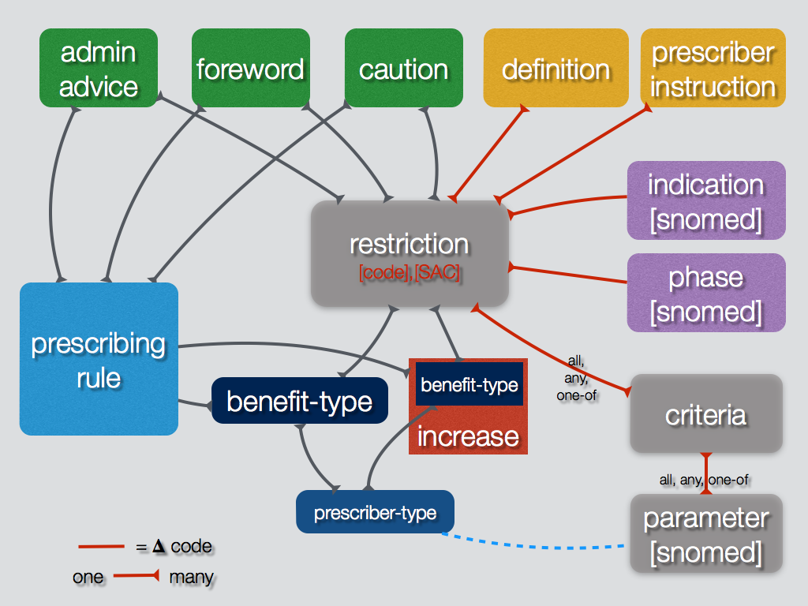
Restrictions

Slide 43
Restrictions
Code management
Separate restriction code from Streamlined Authority Code
  Future: support different format for SAC

Slide 44
Restrictions
Code management
Legal vs informational
𝚫 legal ⇒ new code
𝚫 informational ⇒ same code

Slide 45

Restrictions
restriction
Benefit type
unrestricted, restricted, authority-required
Different per prescriber type
prescribing
rule
benefit-type
prescriber-type

Slide 46
Restrictions
restriction: psychosis, shared care
Benefit type
Example: 1001Q
Shared Care Model
MP: unrestricted
NP: restricted
1001Q
restricted
unrestricted
medical-prac
nurse-prac

Slide 47

Increases
restriction
Proposal
Benefit type structure
MQ, repeats value
Different per prescriber type
prescribing
rule
increase
benefit-type
prescriber-type

Slide 48
Increases
restriction
Different benefit type
Current: simple assessment
Future: streamlined, complex
prescribing
rule
increase
benefit-type
prescriber-type

Slide 49
Increases
Example
Current
no increase
1001Q
unrestricted
MQ 1
repeats 0
increase
MQ x1
repeats 0
unrestricted
medical-prac
nurse-prac

Slide 50
Increases
Severe
Herpes
Example
Current
Simple assessment
1002R
restricted
MQ 1
repeats 0
increase
MQ x2
repeats 1
a/r simple
medical-prac
nurse-prac

Slide 51
Increases
Severe
Herpes
1002R
restricted
MQ 1
repeats 0
Example
Future
Different per prescriber
increase
MQ x2
repeats 1
increase
MQ x1
repeats 0
a/r simple
unrestricted
medical-prac
nurse-prac

Slide 52
Increases
1002R
MQ 1
repeats 0
restriction: Herpes, shared care
Severe
Herpes
restriction: Herpes
a/r simple
restricted
increase
MQ x2
repeats 1
increase
MQ x1
repeats 0
a/r simple
unrestricted
medical-prac
nurse-prac

Slide 53
Increases
5678
Severe
Diabetes
Example
Future
Self assessment
10032B
streamlined
MQ 1
repeats 5
increase
MQ x2
repeats 2
a/r streamlined
medical-prac
nurse-prac

Slide 54
Agenda
Welcome/Introduction
Action Items
PBS XML Schema 3.0
AMT v3
FHIR
Post-Market Authority Review
PBS XML Schema 2.11
6CPA Changes
PBS XML Schema 2.12
Other Business
Meeting close

Slide 55
AMT v3
PharmCIS implementation underway
Phase 1
Planned for December
  February 2016 Schedule

Slide 56
AMT v3
Reconcile non-AMT concepts
Post-May-2014
Pre-May-2014

Slide 57
Agenda
Welcome/Introduction
Action Items
PBS XML Schema 3.0
AMT v3
FHIR
Post-Market Authority Review
PBS XML Schema 2.11
6CPA Changes
PBS XML Schema 2.12
Other Business
Meeting close

Slide 58
FHIR
Nehta presentation

Slide 59
Agenda
Welcome/Introduction
Action Items
PBS XML Schema 3.0
AMT v3
FHIR
Post-Market Authority Review
PBS XML Schema 2.11
6CPA Changes
PBS XML Schema 2.12
Other Business
Meeting close

Slide 60
Initial/Continuing Authorities
PBAC Recommendation
Normal process to obtain authority for initial treatment
  Telephone/electronic or in writing
No need to contact DHS for authority for continuing treatment
  Streamlined Authority

Slide 61
Hospital Access
PBAC Recommendation
Option 1
  Create ‘HP’ program
  Deprecate ‘HB’, ‘HS’ programs

Slide 62


Hospital Access
HS
HB
CA
s94-private
s94-public
s90-cp-s100

Slide 63

Hospital Access
HS
HB
HP
CA
s94-private
s94-public
s90-cp
s90-cp-s100

Slide 64
Hospital Access
HP
CA
s94-private
s94-public
s90-cp
s90-cp-s100

Slide 65
Hospital Access
PBAC Recommendation
Option 2
  Add private hospital dispensing rule to ‘HB’ program
  Delist ‘HS’ program

Slide 66
Hospital Access
HS
HB
CA
s94-private
s94-public
s90-cp
s90-cp-s100

Slide 67
Hospital Access
HS
HB
CA
s94-private
s94-public
s90-cp
s90-cp-s100

Slide 68
Hospital Access
HB
CA
s94-private
s94-public
s90-cp
s90-cp-s100

Slide 69
Agenda
Welcome/Introduction
Action Items
PBS XML Schema 3.0
AMT v3
FHIR
Post-Market Authority Review
PBS XML Schema 2.11
6CPA Changes
PBS XML Schema 2.12
Other Business
Meeting close

Slide 70
PBS XML Schema 2.11
Support AHI
Add new markup band type
Combine fixed and percentage with offset
Introduced in September 2015 Schedule

Slide 71
PBS XML Schema 2.11
ext:markup-type
ext:markup-fixed
ext:markup-offset
<pbs:markup-band xml:id="a215328918">
<pbs:code>C</pbs:code>
<pbs:limit>180.00</pbs:limit>
<pbs:type>markup:percent</pbs:type>
<pbs:amount>3.50</pbs:amount>
<ext:markup-type>markup:combined</ext:markup-type>
<ext:markup-offset>-180.00</ext:markup-offset>
<ext:markup-fixed>3.49</ext:markup-fixed>
</pbs:markup-band>

Slide 72
PBS XML Schema 2.11
3.0 markup
Merge all markup band types
Components may be zero
<markup-band xml:id=“GE-d4e62"> <!— Tier 2 —>
<code
rdf:resource="http://pbs.gov.au/markup/band/community-pharmacy">C</code>
<limit xml:id="d3e11142">180.00</limit>
<offset>-180.00</offset>
<fixed>3.49</fixed>
<variable>3.5</variable>
</markup-band>

Slide 73
PBS XML Schema 2.11
3.0 markup
Merge all markup band types
Components may be zero
<markup-band xml:id=“GE-d4e53"> <!— Tier 1 —>
<code rdf:resource="http://pbs.gov.au/markup/band/community-pharmacy">C</code>
<limit xml:id="d3e37564">0.01</limit>
<offset>0.00</offset>
<fixed>3.49</fixed>
<variable>0</variable>
<effective>
<date>2015-07-01</date>
</effective>
</markup-band>

Slide 74
PBS XML Schema 2.11
Default dispensing rule
Use Case:
  Single price for an item
Introduced in September 2015 Schedule

Slide 75
PBS XML Schema 2.11
ext:default
Child of pbs:dispensing-rule
<pbs:dispensing-rules-list>
<pbs:dispensing-rule about="dr:RP/s90-cp">
<dbk:title>Community Pharmacy</dbk:title>
<ext:default/>
<pbs:fees-list>
…

Slide 76
PBS XML Schema 2.11
3.0 markup
Group
<dispensing-rule xml:id="d3e11057"
rdf:resource="http://pbs.gov.au/dispensing-rule/rp-s90-cp">
<member-of-list>
<member-of rdf:resource="http://pbs.gov.au/dispensing-rule/default">yes</member-of>
</member-of-list>
<fee-definitions-list>
…

Slide 77
Agenda
Welcome/Introduction
Action Items
PBS XML Schema 3.0
AMT v3
FHIR
Post-Market Authority Review
PBS XML Schema 2.11
6CPA Changes
PBS XML Schema 2.12
Other Business
Meeting close

Slide 78
6CPA Changes
PFDI
Additional rule:
  Brand must be substitutable with another brand that has a premium
Change to data population
No change to schema

Slide 79
6CPA Changes
PFDI
Introduced July 2015 Schedule

Slide 80
6CPA Changes
Compounding fee
PBS XML: change to preparation fee

Slide 81
6CPA Changes
Life Saving Drugs programme
New programme
Similar to IVF/GIFT
Commences: ?

Slide 82
Agenda
Welcome/Introduction
Action Items
PBS XML Schema 3.0
AMT v3
FHIR
Post-Market Authority Review
PBS XML Schema 2.11
6CPA Changes
PBS XML Schema 2.12
Other Business
Meeting close

Slide 83
PBS XML Schema 2.12
Copayment discount
Pharmacy may discount patient copayment
Optional
Variable
  From zero to full discount

Slide 84
PBS XML Schema 2.12
Copayment discount
Different discounts may be permitted
  General: $1.00
  Hospital: up to entire copayment
  Friendly Society: ?

Slide 85
PBS XML Schema 2.12
Copayment discount
ext:discounts-list, ext:discount
Child of pbs:copayment
<pbs:copayment xml:id="a215327865">
<pbs:type>copay:general</pbs:type>
<pbs:amount>37.70</pbs:amount>
<ext:discounts-list>
<ext:discount>…</ext:discount>
</ext:discounts-list>
</pbs:copayment>

Slide 86
PBS XML Schema 2.12
Discount type
<ext:discount>
<ext:type>pbs:discount-general</ext:type>
<pbs:amount>1.00</pbs:amount>
</ext:discount>
<ext:discount>
<ext:type>pbs:discount-hospital</ext:type>
<pbs:amount>37.70</pbs:amount>
</ext:discount>

Slide 87
PBS XML Schema 2.12
3.0 markup
<copayment xml:id=“a215327865"
rdf:resource=“http://pbs.gov.au/copayment/general”>
<amount>37.70</amount>
<discounts-list>
<discount rdf:resource=“http://pbs.gov.au/discount/general”>
<amount>1.00</amount>
<effective>…</effective>
</discount>
</discounts-list>
</copayment>

Slide 88
PBS XML Schema 2.12
Originator brand
Identifies first brand that was marketed
Required for Price Disclosure
  Legal Instrument

Slide 89
PBS XML Schema 2.12
Originator brand
Data item for TPP
<pbs:tpp xml:id="a215426640">
<pbs:code scheme="urn:snomed-org/sct">69781000144104</pbs:code>
<dbk:title>Mylanta P Oral suspension 200 mg-200 mg per 5 mL, 500 mL, 1</dbk:title>
<dbk:subtitle>Mylanta P</dbk:subtitle>
<ext:originator/>
<pbs:organisation-reference xlink:href="#a217053314"/>
<pbs:pack-size>1</pbs:pack-size>
<pbs:effectivity>
<pbs:start>2015-09-01</pbs:start>
</pbs:effectivity>
<pbs:ex-manufacturer>4.56</pbs:ex-manufacturer>
</pbs:tpp>

Slide 90
PBS XML Schema 2.12
3.0 markup
Group
<tpp xml:id="a183093930">
<code rdf:resource=“http://snomed.info/sct/911000144106">69781000144104</code>
<member-of-list>
<member-of ref:resource=“http://pbs.gov.au/brand/originator”/>
</member-of-list>
<preferred-term>Mylanta P Oral suspension 200 mg per 5 mL, 500 mL, 1</preferred-term>
<pack-size>1</pack-size>
<ex-manufacturer>4.56</ex-manufacturer>
…
</tpp>

Slide 91
PBS XML Schema 2.12
Schema-validation
Forward compatibility
If only understanding 2.10+
  Use rng/pbs.rng
  Ignores extension elements

Slide 92
PBS XML Schema 2.12
Schema-validation
Forward compatibility
Improvements to extension validation

Slide 93
PBS XML Schema 2.12
Schema-validation
Forward compatibility
If must understand 2.12 (and only 2.12)
  Use rng/extension.rng
  Validates 2.11, 2.12 extension elements
  Not 2.13, 2.14, etc

Slide 94
Agenda
Welcome/Introduction
Action Items
PBS XML Schema 3.0
AMT v3
FHIR
Post-Market Authority Review
PBS XML Schema 2.11
6CPA Changes
PBS XML Schema 2.12
Other Business
Meeting close

Slide 95
Agenda
Welcome/Introduction
Action Items
PBS XML Schema 3.0
AMT v3
FHIR
Post-Market Authority Review
PBS XML Schema 2.11
6CPA Changes
PBS XML Schema 2.12
Other Business
Meeting close

Slide 96
Meeting
Next meeting February/March 2016

