Slide 1
Monthly Publishing System (MPS) Developer Workshop
25 August, 2015

Slide 2
High-level Overview
Introduction
Preliminary discussion session
Overview of the MPS
Lunch
Presentation and Workshop
Wrap-up discussion session
Finish (‘Break’ for those that want to continue)
Informal Workshop

Slide 3
Preliminary Discussion Session
Results of the Developer Survey

Slide 4
MPS Overview
Design Objectives

Slide 5
Monthly Publishing System (MPS) Developer Workshop
25 August, 2015

Slide 6
Workshop Agenda
Deliverables
Quality
Validation (testing)
Verification (counting)
Tracking Changes
Options for formatting
Options for querying

Slide 7
Workshop Format
Keep it interactive!
The learning should go both ways.
Some questions may need to be deferred till the informal session.
The objective is to be ‘hands-on’ but the format may require some flexibility.

Slide 8
MPS Overview
What does it deliver?
Reports
Publications
How does it deliver?
MPS API
Summary of Changes
SQLite
JSON

Slide 9
What does the MPS deliver?
Publications
Summary of Changes
Hardcopy schedules (PDF)
Legislative Instruments
Website / offline website / mobile website
SQLite / SQL script
Text files
API

Slide 10
Key Challenges
Grouping
Hardcopy vs legislative instruments vs …?
Sorting
The primary specification is the 30 year old hardcopy.
Ordering
Varies – a recent example is notes to restrictions.
Identifying
The lack of permanent IDs is not optimal.
The fundamental issue is coping with the complexity of the data in the context of each deliverable!

Slide 11
Other challenges
The schema is big and there are a lot of places for data to hide.
No one asks what will work best for developers before they amend the legislation.
The first day of the month is non-negotiable.
IE 6…

Slide 12
The solution
Both ends are volatile.
Neither end is under our control.
The business logic is expensive and fragile therefore duplication must be avoided.
Stability is needed somewhere, so the only option for the MPS is to create an API in between the source data and the deliverables.

Slide 13
MPS processing
Start with the PBS XML and extensive validation.
Well-formedness
Schema
Schematron
Internal format validation
Validation isn’t enough.
No errors doesn’t guarantee no problems.
Validation errors aren’t always easy to interpret.

Slide 14
MPS Verification
Count everything (between months and each version)
Generic Drug
PBS Item
PBS Product
Schedule
Reports:
https://dev.pbs.gov.au/docs/reference/pbsxml_reports.html

Slide 15
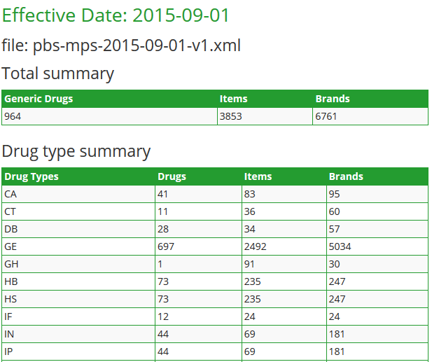
MPS Statistics Report

Slide 16
MPS Summary of Changes

Slide 17
MPS Summary of Changes

Slide 18
MPS Summary of Changes

Slide 19
MPS Summary of Changes

Slide 20
MPS Summary of Changes

Slide 21
Processing issues
Data overlap
Much of the source data looks the same.
It isn’t easy to determine which values are correct or when you have used the wrong value.
Correct decisions may become wrong.

Slide 22
Protection from volatility
MPS API
Consequences of change are always limited to the distance between the source of the change and the API.

Slide 23
Example: Summary of Changes
Addition Items
Pull data by item code
Use service: /0.3/items/{code}
Addition Brands
Pull date by brand code
Use service: /0.3/brands/{code}
Addition Notes
Pull data by note code
Use service: /0.3/notes/{code}

Slide 24
Example: Summary of Changes
Deletion Items
Pull last month of data by item code
Use service: /0.3/items/{code}?effectivedate=2015-07-01
Deletion Brands
Pull last month date by brand code
Use service: /0.3/brands/{code}?effectivedate=2015-07-01
Deletion Notes
Pull last month data by note code
Use service: /0.3/notes/{code}?effectivedate=2015-07-01

Slide 25
Example: Summary of Changes
Alteration
Brand name
Form strength
Prescriber group
Manufacturer
Restriction
Authority type
Max quantity
Pack quantity
Number of repeat

Slide 26
Example: Summary of Changes
Alteration (continue)
Pull data by item code
Current month:
/0.3/items/{code}?effectivedate=2015-08-01
Last month:
/0.3/items/{code}?effectivedate=2015-07-01

Slide 27
Example: Summary of Changes
Advance notice
- Pull data by item code
Current month:
/0.3/items/{code}?effectivedate=2015-08-01
- Check the element
AdvanceNotice.Type
AdvanceNotice.EffectiveDate
http://api.pbs.gov.au/0.3/items/8023G.xml?effectivedate=2015-08-01&advancenotice=true
<AdvanceNotice.Type>deletion </AdvanceNotice.Type>
<AdvanceNotice.EffectiveDate>2015-10-01 </AdvanceNotice.EffectiveDate>

Slide 28
MPS SQLite
Business Objectives
Create a portable, lightweight representation of the data as an alternative to the text files.
Minimal dependencies.
Zero licensing issues.
The answer
SQLite database.

Slide 29
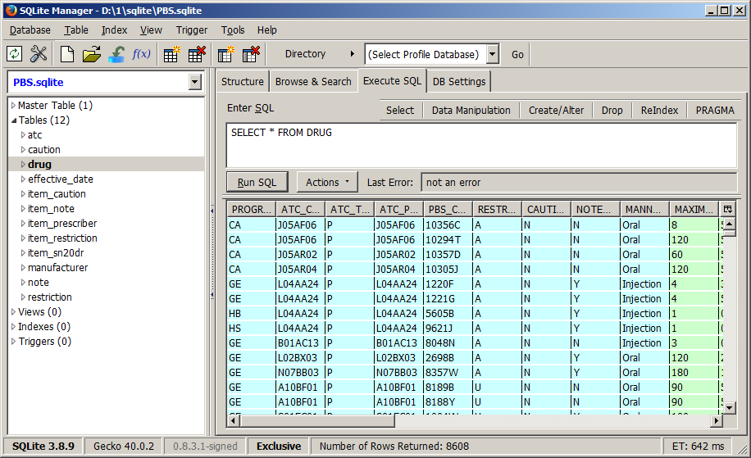
MPS SQLite

Slide 30
MPS JSON
A lightweight approach suited to modern web architectures.
JSON connects directly to the API.
Use Javascript to process in the browser.
Minimal learning required.
Very little infrastructure required.
More usable than the text files but based on modern technology.

Slide 31
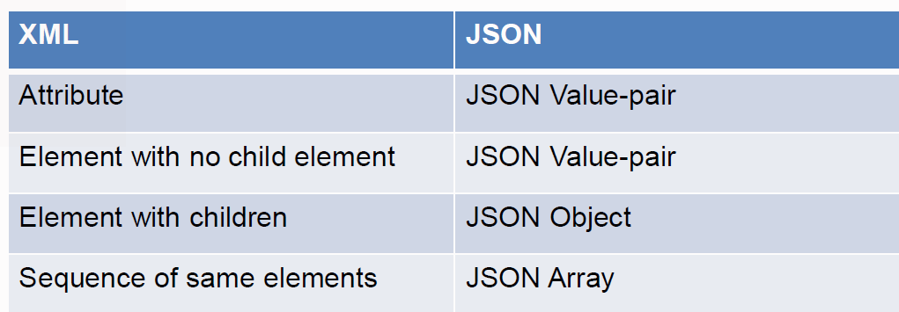
MPS JSON
JSON Syntax
Constructed from the XML syntax
Namespace is ignored
Using the following rules:

Slide 32
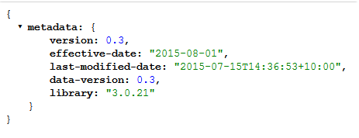
MPS JSON
XML
JSON

Slide 33
MPS API
How mature is the API?
Used by the MPS since July 2011 opened to the public in August 2012.
Powers the general PBS Website.
Powers the mobile PBS Website.
Recently upgraded to 0.3 (4th version).
Now used for the hardcopy and Summary of Changes.
Undergoes extensive automated testing each month.
Is manually reviewed by a lot of people each month (community and industry).
Previous API versions are kept up-to-date until all users have migrated forward.

Slide 34
MPS API
Where is it?
http://api.pbs.gov.au

Slide 35
MPS API
How to access it?
Sign up by sending an email to: pbs.websmaster@health.gov.au
You will be given a unique API Key
To give you access to the API
To protect the system from abuse
To allow us to optimise the data based on real usage

Slide 36
MPS API
What formats are supported?
The API can deliver the PBS data
as XML
Or as a JSON object
Also supports JSONP

Slide 37
More information
API Documentation
https://dev.pbs.gov.au/docs/
To familiarise yourself with API
http://api.pbs.gov.au/howto.html
Developer online forum
https://dev.pbs.gov.au/discussions.html

