Slide 1
PBS Developers’ Forum
13th October 2016

Slide 2
Agenda
Welcome/Introduction
Action Items
ePrescribing
IHIN
Automated Authorities
AMT v3
PBS XML Schema 3.0
PBS XML Views
Other Business
Meeting close

Slide 3
Agenda
Welcome/Introduction
Action Items
ePrescribing
IHIN
Automated Authorities
AMT v3
PBS XML Schema 3.0
PBS XML Views
Other Business
Meeting close

Slide 4
Action Items
Health to look at possibility of re-working the system so that Pharmacists are not working backwards to find streamlined codes
PBS XML v3.0 will include restriction data for 12 month period

Slide 5
Action Items
The PBS Online system will identify if a patient has been to another Pharmacy for the same script. Department of Health will advise further on this issue.
ERRCD

Slide 6
Agenda
Welcome/Introduction
Action Items
ePrescribing
IHIN
Automated Authorities
AMT v3
PBS XML Schema 3.0
PBS XML Views
Other Business
Meeting close

Slide 7
e-PBS Prescribing
PBD is actively considering e-PBS prescribing
Developing legal and policy requirements
Engage with clinical software stakeholders
e-PBS prescribing as another prescribing option
Seamless prescribing, dispensing and claiming
No need to transcribe from paper-based prescription

Slide 8
e-PBS Prescribing
Implementation to be consistent with Government requirement for digital health surety and security
PBD in consultation with:
ADHA, DVA, DHS
all jurisdictions’ Health CIO, Chief Pharmacist
Part of AHMAC

Slide 9
e-PBS Prescribing
PBD focus: legislation and policy
Agency focus: technical development, consultations and implementation
Important digital health functionality
Benefit for consumers

Slide 10
e-PBS Prescribing
Electronic Prescribing Working Group
Within AHMAC
Develop processes and rules

Slide 11
e-PBS Prescribing
e-PBS Prescription:
Digital
Immutable
No change in PBS patient, provider or supplier eligibility
High level of trust and security

Slide 12
e-PBS Prescribing
Next steps
High-level mapping of PBS prescription lifecycle
Develop core e-PBS prescribing data components
C’wlth legal arrangements
Agency: National Requirements for Electronic Prescribing, National Compliance Framework

Slide 13
Agenda
Welcome/Introduction
Action Items
ePrescribing
IHIN
Automated Authorities
AMT v3
PBS XML Schema 3.0
PBS XML Views
Other Business
Meeting close

Slide 14
IHIN
International Harmonisation of Ingredient Names
a.k.a. Int’l Harmonisation of Medicine Names
TGA initiative
ADHA implementation in AMT

Slide 15
IHIN
International agreement on medicine naming convention
TGA has implemented new medicine names
www.tga.gov.au/updating-medicine-ingredient-names
Since 6 April 2016
amoxycillin ⇒ amoxicillin
ARTG entries updated

Slide 16
IHIN
4-7 year transition
Ends April 2023
ADHA updating AMT
starting October 2016
3 months

Slide 17
IHIN
PBS will load AMT releases
New PBS brands and submissions will use AMT name
Current practice

Slide 18
Agenda
Welcome/Introduction
Action Items
ePrescribing
IHIN
Automated Authorities
AMT v3
PBS XML Schema 3.0
PBS XML Views
Other Business
Meeting close

Slide 19
Automated Authorities
Department of Human Services initiative
Commenced May 2016 Schedule
All PBS items include threshold values

Slide 20
Agenda
Welcome/Introduction
Action Items
ePrescribing
IHIN
Automated Authorities
AMT v3
PBS XML Schema 3.0
PBS XML Views
Other Business
Meeting close

Slide 21
AMT v3
PharmCIS implementation complete
Phase 1
Deployed February/March 2016
May 2016 Schedule
Backlog of un-reconciled concepts

Slide 22
AMT v3

Slide 23
Agenda
Welcome/Introduction
Action Items
ePrescribing
IHIN
Automated Authorities
AMT v3
PBS XML Schema 3.0
PBS XML Views
Other Business
Meeting close

Slide 24
PBS XML v3.0
Schedule
Transition Plan
Progress

Slide 25
PBS XML v3.0
Schedule
Align with DHS
No changes in March 2017
V3 Go-Live: April 2017 Schedule

Slide 26
PBS XML v3.0
March 2017
June 2017
Jan 2017
Feb 2017
April 2017
May 2017
V2 Prod
V3 Test
V3 Prod
V2 Down

Slide 27
PBS XML v3.0
Schedule
Transition Plan
Progress

Slide 28
PBS XML v3.0
Transition Plan
Support users to transition from v2 to v3
Support users to adopt v3
Support users to transition from text extracts to v3 or Views

Slide 29
PBS XML v3.0
Transition Plan
Provide sample data with embargo files
Started September 2016 Schedule
Upconverted from V2 embargo PBS XML
NOT production quality
For testing/evaluation only

Slide 30
PBS XML v3.0
Transition Plan
No upconversion in production
∥ publication of V2 and V3 PBS XML
12 months: final v2 PBS XML March 20172018
Notes:
Correct typo in published slides

Slide 31
PBS XML v3.0
Transition Plan
Downconversion of V3 to V2
Freeze v2 schema

Slide 32
PBS XML v3.0
Down convert specification
Supply-only ⇒ delist then remove
PR Notes ⇒ copy to restrictions
Assessment ⇒ authority method
Images ⇒ remove

Slide 33
PBS XML v3.0
Down convert specification
Increases ⇒ e-authority value
CAR ⇒ ext:complex-authority-required
Benefit Type ⇒ move all prescriber types, restrictions to prescribing rule

Slide 34
PBS XML v3.0
Down convert specification
Logical operators ⇒ simulate logical constraints

Slide 35
Agenda
Welcome/Introduction
Action Items
ePrescribing
IHIN
Automated Authorities
AMT v3
PBS XML Schema 3.0
PBS XML Views
Other Business
Meeting close

Slide 36
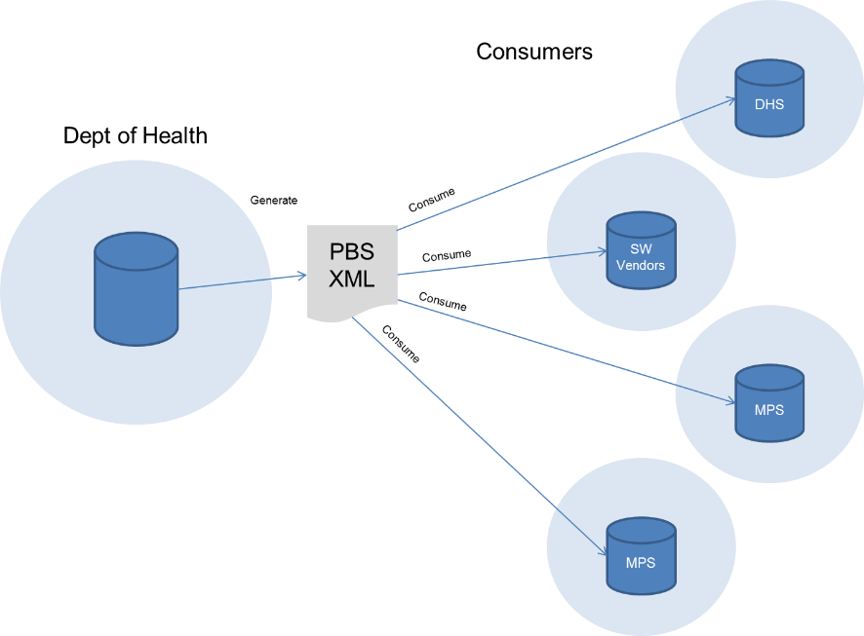
PBS XML Views
Background
The intent of the PBS XML exchange model is to enable the interchange of data from Health to consumers including DHS and software vendors

Slide 37
PBS XML Views
Projects Assured previously undertook an independent high-level review of the generation of PBS XML and the consumption of the PBS XML by stakeholders. A particular focus was placed on the following consumer characteristics:
Usability;
Interoperability;
Best practice;
Recommendations for improvement of the transfer of PBS information to sub groups of stakeholders.

Slide 38
PBS XML Views
The Review made a number of key findings and recommendations to improve the usability and operability of the transfer of PBS information to stakeholders.

Slide 39
PBS XML Views
Review Key Findings
Technology Platform
The PBS XML provides a common, interoperable format for the PBS data to be shared from the Department of Health to other consumers.
The size and complexity of the XML export poses problems for consumers to process the data. This has resulted in many consumers utilising legacy text file subsets of the data to varying extents, either supplementing the XML data or completely replacing it.

Slide 40
PBS XML Views
XML V3 Transition
PBS XML V3 offers a number of improvements, and should continue design and development.
Stakeholder feedback revealed uncertainty about the time frames required to adopt the new V3 Schema, particularly given the possibility of no alternative to the text files currently offered.

Slide 41
PBS XML Views
Project Objectives
The key objective of the project is to implement some of the recommendations of the XML Review.

Slide 42
PBS XML Views
The project will be undertaken in the following stages:
Stage 1 – formalise governance and support;
Stage 2 – XML V3 Views stakeholder engagement and analysis;
Stage 3 – XML V3 Views development;
Stage 4 – XML V2 to V3 transition capability.
This presentation will largely cover Stage 2

Slide 43
PBS XML Views
Definition
An XML V3 View is a consumable sub-set of the PBS XML data based on how that data is commonly used/viewed:
Legislative Instruments
Prescribers (all data less pricing)
Dispensers (all data less restrictions)

Slide 44
PBS XML Views
Listings (includes Items, Brands)
Pricing (could be incorporated into Listings)
Restrictions
Fees

Slide 45
PBS XML Views
Our Task
Our task for the PBS XML V3 Views Project was to:
Engage, analyse and define PBS XML consumers’ data requirements.
Analyse and define technical prerequisites and requirements for integration with XML V3.

Slide 46
PBS XML Views
Stakeholder Engagement
We have:
Engaged with Prescribers, Dispensers, Publishers and DHS to gather their requirements for sub-sets of the data;
Captured the high level requirements for Prescribers and Dispensers;

Slide 47
PBS XML Views
Stakeholder Engagement
We have:
Listed the V3 elements that must be included in the prescriber and dispenser XML sub-sets.

Slide 48
PBS XML Views
This has been done through:
Stakeholder survey;
Workshops.

Slide 49
PBS XML Views
PBS XML Survey
The survey contained questions designed to gather information regarding consumption of the PBS data.
There were a total of 21 responses to the survey from the following groups:

Slide 50
PBS XML Views
PBS XML Survey
Dispensing | Prescribing | Dispensing & Prescribing
Corum Health Services | Best Practice Software | Cerner Corporation
CSC | Best Practice Software Pty Ltd | Emerging Systems
Fred IT | EPAS Clinical Analyst | HTSV
HealthSoft Australia Ltd | MedicalDirector | Pharmhos Software Pty Ltd
Minfos | Medication Services Queensland, Queensland Health
Mountaintop Systems | Specialist Information Services
NPD
Phillips & Phillips Pharmacy Computers
POS Works
Symbion
Victoria University

Slide 51
PBS XML Views
Workshops
In addition to the survey, requirements were also elicited via a number of workshops with the following organisations:
Medical Software Industry Association;
Monthly Index Medical Specialities;
MedicalDirector.

Slide 52
PBS XML Views
Next Steps
The following activities within PBS XML V3 upgrade programme are key dependencies for the, design and implementation of the data sub-sets:

Slide 53
PBS XML Views
Next Steps
PBS XML documentation to be complete and endorsed by key internal and external stakeholders including:
PBS XML V3 Schema
Documentation on V3 elements and patterns to extract data
Any residual post-processing activities that may occur after V3 XML export from PharmCIS.

Slide 54
PBS XML Views
Next Steps
V2 data to be migrated and validated to V3 model in PharmCIS, (including restrictions)
Development work on the V3 Schema related to the V3 upgrade programme has ceased.
Validation of the final version of the extracted data from PharmCIS be compliant to the V3 Schema.

Slide 55
PBS XML Views
Next Steps
Conduct workshops with 4/5 key vendors and researchers to further specify the sub-sets and their requirements.
Determine technologies distribution method for the development of the data sub-sets.
Continue to work with the user community on improvements and changes to the PBS XML content and delivery.

Slide 56
Agenda
Welcome/Introduction
Action Items
ePrescribing
IHIN
Automated Authorities
AMT v3
PBS XML Schema 3.0
PBS XML Views
Other Business
Meeting close

Slide 57
PBS XML v3.0
Schedule
Transition Plan
Progress

Slide 58
PBS XML v3.0
Pre-Production stage
Finalise schema, complete package, test data available
Pre-Production Release 1: March February 2016
Pre-Production Release 2: July 2016
Pre-Production Release 3: September 2016
Pre-Production Release 4: October 2016

Slide 59
PBS XML v3.0
Production release
March 2017
Minor releases
Use extension mechanism

Slide 60
PBS XML v3.0
Progress
Proposed changes (June 2016)
#1: Identifier for system software ✓
#2: equal data facet ✓
#3: benefit-type ⇒ restriction-level ✗
#4: Informational text on benefit-type ✗

Slide 61
PBS XML v3.0
Progress
Proposed changes (June 2016)
#5: Identify (legal) CAR items ✓
#6: brand-name ✓
#7: normalise restriction components ✓

Slide 62
PBS XML v3.0
Legal CAR
Group
http://pbs.gov.au/complex-authority-required
Two instances
http://pbs.gov.au/complex-authority-required/is-complex
http://pbs.gov.au/complex-authority-required/not-complex

Slide 63
PBS XML v3.0
All prescribing rules member of one group
<member-of-list>
<member-of rdf:resource="http://pbs.gov.au/complex-authority-required/not-complex">
<code
rdf:resource="http://pbs.gov.au/code/complex-authority-required">not-complex</code>
<effective>
<date>2013-12-01</date>
</effective>
</member-of>
</member-of-list

Slide 64
PBS XML v3.0
Brand name
TPUU, TPP, CTPP
<tpp>
…
<brand-name>
<value>Mylanta P</value>
<effective>
<date>2016-01-01</date>
</effective>
</brand-name>
…
</tpp>

Slide 65
PBS XML v3.0
Normalise restriction components
Only references
No inline elements
No mixed content

Slide 66
PBS XML v3.0
Progress
Other changes
Supply-only now points to substitute PR
Remove product-listing code (October 2016)
treatment-of code

Slide 67
PBS XML v3.0
Supply-only
Don’t maintain pricing data
Give substitute prescribing rule for claiming
<supply-only>
<date>2016-04-01</date>
<prescribing-rule-reference xlink:href="#a247919353">
<code rdf:resource="http://pbs.gov.au/code/item">10389T</code>
<effective>
<date>2016-04-01</date>
</effective>
</prescribing-rule-reference>
<non-effective>
<date>2017-04-01</date>
</non-effective>
</supply-only>

Slide 68
PBS XML v3.0
Product listing code
Introduced pre-prod-1
<product-listing xml:id="d5e8293">
<tpp-reference xlink:href="#a247902300">
<code rdf:resource="http://snomed.info/sct/900062011000036108">94291000036105</code>
<effective>
<date>2013-12-01</date>
</effective>
</tpp-reference>
<code rdf:resource="http://pbs.gov.au/code/manufacturer">NE</code>
<code rdf:resource=“http://pbs.gov.au/code/product-listing">291845732</code>

Slide 69
PBS XML v3.0
Restriction code management
Restriction code
Configuration of entire restriction, including informational text
treatment-of code
Configuration of legal components

Slide 70
prescriber instruction
admin advice
foreword
caution
definition
condition
episodicity
restriction
[restriction-code]
[treatment-of-code]
indication
severity
prescribing
rule
phase
benefit-type
criteria
prescriber-type
parameter

Slide 71
PBS XML v3.0
Restriction code is unique
treatment-of code may be duplicated
Same treatment-of code ⇒ same legal components

Slide 72
Agenda
Welcome/Introduction
Action Items
ePrescribing
IHIN
Automated Authorities
AMT v3
PBS XML Schema 3.0
PBS XML Views
Other Business
Meeting close

Slide 73
Agenda
Welcome/Introduction
Action Items
ePrescribing
IHIN
Automated Authorities
AMT v3
PBS XML Schema 3.0
PBS XML Views
Other Business
Meeting close

Slide 74
Meeting Close
Next meeting February 2017

